Slide 1
Lecture 12
Capital, Interest, and Savings
Economics 2 Emmanuel Saez
Fall 2024

Slide 2
I. Capital

Slide 3
Capital
Capital refers to any human-made aids to the production process of businesses, govt, housing:
  Tangible capital: Land set-up for agriculture or construction, buildings and infrastructure, tools, machines, vehicles, etc.
  Intangible capital: brands, intellectual property (software), etc.
Capital is a stock: Increase in capital from one year to the next is called investment (=additions to capital)

Slide 4
How much capital does a firm want to use?
Its decision will be based on profit maximization.
The firm looks at the marginal revenue product (mrp) of another unit of capital K (e.g. machine):
    mrp_{K} = mp_{K} • mr
    mp_{K} is the marginal product of capital (the extra output you get with an extra machine)
    mr is the additional revenue a firm earns by producing and selling one more unit.
    Key complication: a capital asset is durable (=lasts for a number of years)

Slide 5
II. Present Value and Interest

Slide 6
Poll
Suppose I can give you each $100 today. Or I can give you more if you wait 1 year. How much would I need to give you in 1 year to make you as happy as getting $100 today:
A. $100
B. $103
C. $105
D. $110
E. $120 or more

Slide 7
Time Preferences
People prefer things today to things tomorrow = impatience
Time preference is the reason that banks pay interest on saving deposits or why you have to pay interest if you borrow (student loan, credit card)
  Interest is the amount extra that you receive each year above what you put into into your savings account
  Interest is also the amount extra you have to pay each year above what you borrowed if you take a loan
Time preferences very heterogeneous, inconsistent (behavioral economics)

Slide 8
Present Value
What a payment to be received in the future is worth to you today.
If you have $1 today and save it, you will have $1+i one year from now where i is the interest rate
Typically i is around 5% but varies quite a bit overtime and based on the saving vehicle you use
We are going to assume a single and constant interest i for simplicity

Slide 9
Present value A of $100 one year from now:
Assuming the interest rate is 3%.
A (1+.03) = 100
100
A =
(1 + .03)
A = $97.1

Slide 10
Present value A of $100 one year from now:
Assuming the interest rate is 8%.
A (1+.08) = 100
100
A =
(1 + .08)
A = $92.6

Slide 11
Present value A of $100 two years from now:
Assuming the interest rate is 3%.
A (1+.03)(1+.03) = 100
100
A =
(1 + .03)²
A = $94.3

Slide 12
Present value of a single payment in the future:
F
PV(F) =
(1 + i)^{t}
F = future payment
i = interest rate (expressed as a decimal)
t = number of years in the future the payment is to be received
If interest rate is high, future is heavily discounted
  Recall that future climate change costs are small if we discount the future heavily

Slide 13
Present value of $1000 each of the next three years:
Assuming the interest rate is 3%.
1000 1000 1000
+ +
(1 + .03)¹ (1 + .03)² (1 + .03)³
970.1 + 942.6 + 915.1
= $2827.8

Slide 14
Present value of a stream of payments:
PV(Stream of F’s) =
F F F F
+ + + … +
(1 + i)¹ (1 + i)² (1 + i)³ (1 + i)^{t}
F = future payment in each year
i = interest rate (expressed as a decimal)
t = number of years in the future the last
payment is made

Slide 15
III. Purchasing Capital and the Investment Demand Curve

Slide 16
What a machine is worth to a firm today:
PV(Stream of mrp_{K}’s) =
mrp_{K} mrp_{K} mrp_{K} mrp_{K}
+ + + … +
(1 + i)¹ (1 + i)² (1 + i)³ (1 + i)^{t}
mrp_{K} = marginal revenue product of capital in each year
i = interest rate (expressed as a decimal)
t = lifespan of the machine
=> Machine’s worth to business declines with i

Slide 17
Investment Demand Curve
Interest
Rate (i)
Investment (I)

Slide 18
Investment Demand Curve
Interest
Rate (i)
I
Investment (I)

Slide 19
Quiz
Why does investment by firms decline with the interest rate r?
A. Because investment is new capital that can be used for production for several years
B. Because a payment in the future is less valuable when the interest rate is higher
C. Because firms equate the cost of a new investment to the present discounted value of the extra profits the new investment will generate
D. All of the above
E. None of the above

Slide 20
Shifts in the Investment Demand Curve
(Pessimism about Future MRP_{K})
i
I₂
I₁
I
Recall: PV(Stream of mrp_{K}’s) = Purchase Price

Slide 21
IV. Supply of Savings and Interest Rate

Slide 22
Saving, Consumption, and Income
Household has disposable income $Y (after taxes and transfers)
Y can be used for consumption C and savings S
Y = C + S
S>0 means the household is adding S to its wealth (stock of past savings and inheritances)
S<0 means the household is borrowing to consume more than its income, increasing its debt and hence reducing its wealth = assets - debt

Slide 23
Poll
How do you think about how much of your monthly income you decide to spend vs. save and how does this relate to the interest rate to get on your savings?
A. I don’t care about the interest rate, I just spend all the income I have and can’t afford to save anything.
B. I can save some of my income but how much I save has nothing to do with the interest rate
C. If the interest rate is higher, I cut down my consumption and save more.
D. If the interest rate is higher, I increase my consumption and save less.

Slide 24
The Interest Rate and the Opportunity Cost of Current Consumption
Think of a household trying to maximize its utility from consumption today and consumption in the future (=1 year from now):
1) Consume $1 today
2) Or save it and consume $(1+i) in 1 year
When maximizing utility, consumer is indifferent at the margin between 1) and 2):
MU_{current}=MU_{future} × (1+i)

Slide 25
The Interest Rate and Saving
The condition for utility maximization between consumption today and consumption in the future:
MU_{current}=MU_{future} × (1+i)
If the interest rate i rises, the relative price (opportunity cost) of future consumption falls.
=> Consume more in the future and less today (substitution effect) and hence save more
Empirically, this channel is not very strong

Slide 26
The Supply of Saving
Interest rate i
S
Savings S

Slide 27
Quiz
How does the interest rate on your student loans will affect your spending after your graduate?
A. It won’t affect my spending because I don’t have student loans
B. Higher student loan payments will force me to cut down my other spending
C. Higher student loan payments won’t affect my spending, I’ll just save less and spend the same
D. Higher student loan payments won’t affect my spending, I’ll just borrow more on my credit card

Slide 28
Why does the interest rate affect spending and saving in practice?
Borrowers are low income while lenders are high income
Low income people tend to spend everything they earn (can’t afford to save)
High income people tend to save a large fraction of any extra income they make
A higher interest rate gives more income to lenders and correspondingly less to borrowers
Borrowers cut spending by more than lenders increase their spending => aggregate saving goes up

Slide 29
V. The Determinants of Investment, Saving, and the Interest Rate (Long Run)

Slide 30
Market for Loanable Funds where Investment and Saving Meet
Demand = Investments that businesses want to fund = I(i) decreases with interest rate i
Supply = Savings provided by households or firms = S(i) increases with interest rate I
In long-run equilibrium: interest i* adjusts so that I(i*)=S(i*)
In practice, many loanable funds markets
In any closed economy: Investment = Savings: What is not consumed is invested

Slide 31

The Long-Run Saving and Investment Market for Loanable Funds
Interest rate i
S
i*
I
I*=S*
Savings S, Investment I

Slide 32




A New Technology That Raises Future MRP_{K}’s
i
S₁
$i_{2}^{∗}$
$i_{1}^{∗}$
I₂
I₁
$$I_{1}^{∗}$$
S, I
$$I_{2}^{∗}$$

Slide 33


A shift out in household savings supply: people become less impatient
i
S₁
S₂
$i_{1}^{∗}$
$i_{2}^{∗}$
I₁
$$I_{1}^{∗}$$
S, I
$$I_{2}^{∗}$$

Slide 34
VI. Wealth Fluctuations:
Stock Prices

Slide 35
Wealth
Wealth refers to the value of marketable assets (assets that are in principle tradeable). Main assets:
  Businesses (shares of corporations, smaller businesses)
  Housing
  Loans and debt: loan is positive wealth for lender and negative wealth for borrower (which net out)
  Durables (vehicles, collectibles, jewelry) small overall
Wealth is a stock that accumulates from past savings and inheritances received
Value of assets can fluctuate quickly and widely (stock prices)

Slide 36
How are Stock Prices (value of companies) Determined?
For publicly traded companies (listed on a stock exchange, about 5000 largest companies in US), there is a continuous market for the stock
Sellers meet buyers and price adjusts constantly so that supply equals demand
If more people want to buy than sell, price goes up until this is adjusted.
How should the price be determined?
Stock price =
PV(Stream of Expected Future Profits)

Slide 37
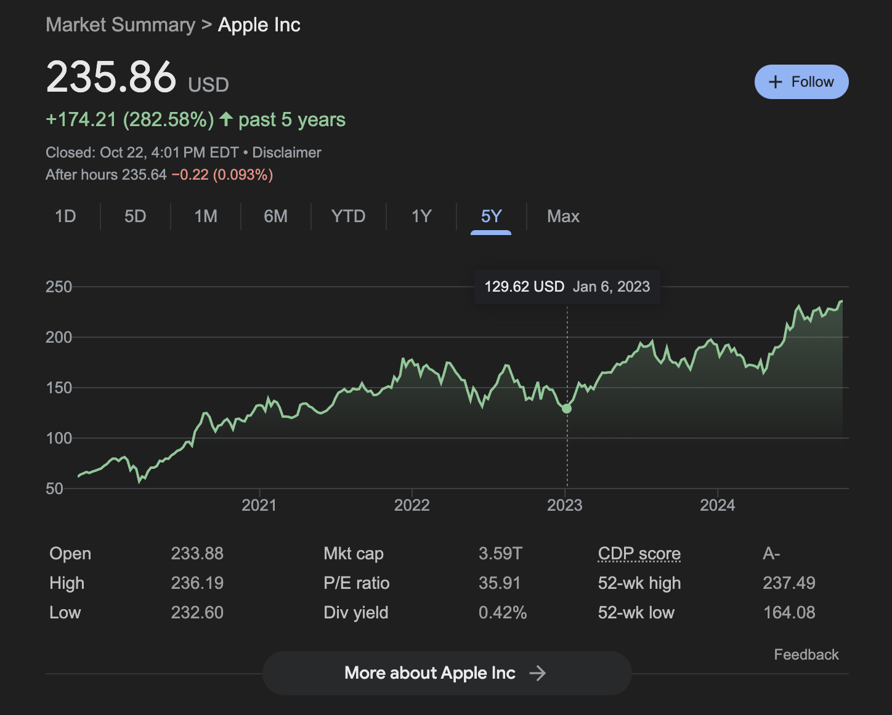
Apple is the highest value US company (about $3.6T today). Stock price has been multiplied by 4 in last 5 years

Slide 38
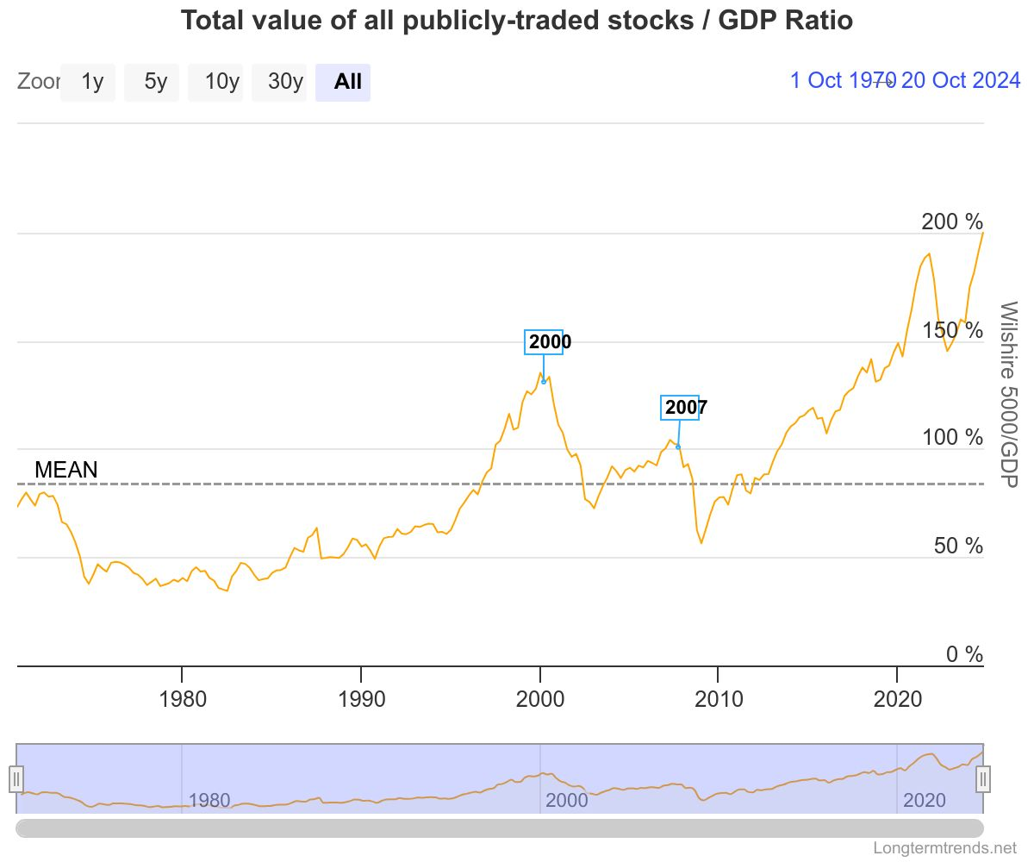
Publicly traded stocks are about 1/3 of total private wealth. Value (relative to GDP) fluctuates quite a bit. Particularly high in 2024.

Slide 39
What moves stock prices?
Stock price = PV(Stream of Expected Future Profits)
A change in the interest rate.
    Lower interest rates, all else equal, are likely to be associated with higher stock prices.
    This is because of the usual negative effect of the interest rate on present value.
    And because of the effect of interest rates on expected economic activity (see macro)
Hard to see empirically as Fed picks interest rate to manage the economy (see macro)

Slide 40
S&P 500 and Interest Rates
Source: Federal Reserve Bank of St. Louis, FRED.

Slide 41
What moves stock prices? (cont.)
Stock price = PV(Stream of Expected Future Profits)
A change in expected future profits.
    If something makes people expect lower future profits, that should be associated with a lower stock price.
    The lower expected profits could apply to a particular firm or to firms in general.
    People can develop irrational exuberance about future profits (1929 bubble, dot-com bubble of 2000)

Slide 42
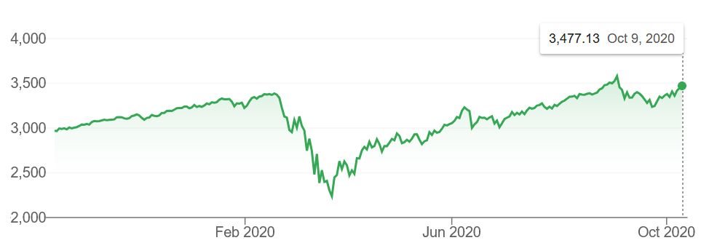
S&P 500 and the Pandemic
S&P500 is an index that represents the value of the largest 500 US companies (about 80% of the value of all the 5000 US companies listed on stock exchange)

Slide 43
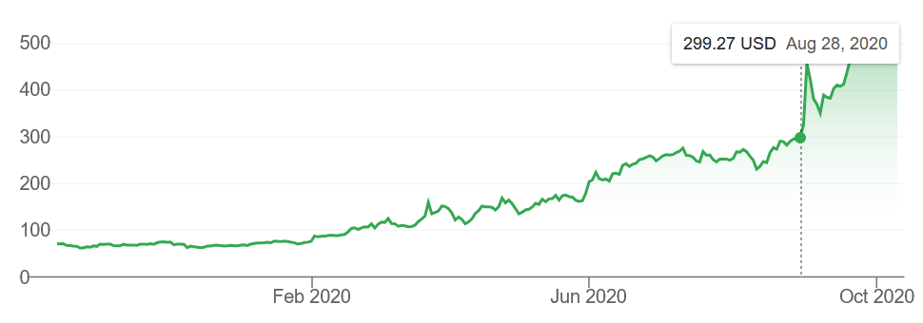
Zoom Stock Price
Source: Google Finance: zoom reported extraordinary 2nd quarter profits on August 31, 2020 driving up stock price by 30%

Slide 44
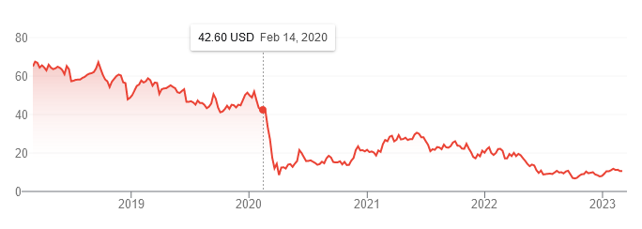
Carnival Cruise Stock Price
Source: Market Finance

Slide 45
1920s Stock Market Bubble
Bubble arises when asset prices get disconnected from future profits and when people buy the asset hoping that prices will keep increasing, until stockholders lose confidence, sell, and prices collapse

Slide 46
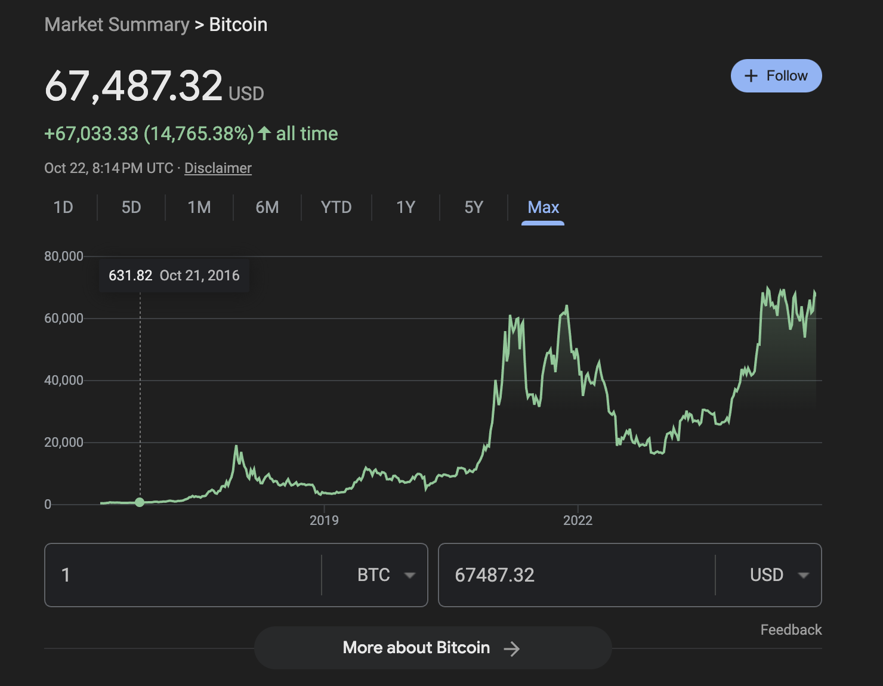
Bitcoin price has increased by factor 100 from $630 in Oct 2016 to $67,500 in Oct 2024. Total bitcoin value is $1.3T today (1/3 of Apple)

Slide 47
Poll on Bitcoin
What do you think of bitcoin, the largest crypto currency? Current price of one bitcoin is $67,500, a hundredfold increase over the last 8 years.
A. Bitcoin is a scam, it should be prohibited
B. Bitcoin seems risky, I don’t want to touch it
C. Bitcoin is the future and I’d love to own some.
D. I would like to buy bitcoins and sell them later when they are worth even more
E. I don’t know or understand what bitcoin is

Slide 48
Crypto Currencies and Bubbles
Crypto currencies are a form of asset (modern analogy to gold mining)
They are costly to produce (electricity and computers)
They do not provide profits nor much services
But they have subjective value to some people and many others buy it expecting prices to rise further
This can lead to a speculative bubble. Bubble bursts when owners lose confidence the asset price will keep increasing and start selling in droves
Examples: 1929 US stock market, dotcom bubble 2000, Tulip mania of 1630s Netherlands, crypto today?

Slide 49
Efficient Markets Hypothesis
It is difficult to make money off news in the stock market because information is processed very quickly
Example of a common short-run scam:
  An influencer quietly buys a specific stock then tells their followers the price will increase.
  Followers buy the stock, leading to a temporary price surge. Scammer then quickly sells its stocks while price is abnormally high.
But hard to influence stock prices for the long-run

Slide 50
How economists manage their finances
Avoid high interest debt (such as credit card) or pay it back in priority
Have some cushion in your bank account for unexpected expenses
Invest extra savings in a broad passive index of stocks (such as S&P500) rather than
  betting on specific stocks (or bitcoin) is more risky
  Managed funds charge a lot and do not deliver higher returns on average
Save in subsidized retirement savings 401(k)s with your employer

Slide 51
References
CORE-The Economy, Chapter 10.
Principles of Economics, Chapters 21 and 33.

