Slide 1
Lecture 6
Consumers and Utility Maximization
Economics 2 Emmanuel Saez
Fall 2024

Slide 2
I. Introduction to Consumer Optimization

Slide 3
Why Consumer Optimization Is Important
It has implications for how we view the desirability of market outcomes.
It can help us to understand the many choices that consumers make.

Slide 4
II. The Budget Constraint

Slide 5
A Household’s Budget Constraint
In words: The total amount the household spends cannot exceed its income.
In symbols:
P_{a}•q_{a} + P_{b}•q_{b} + P_{c}•q_{c} + … + P_{z}•q_{z} = Income,
where the P’s are the market prices of the various goods, and the q’s are the quantities that the individual household buys.

Slide 6
Budget Constraint for the Case of Two Goods
P_{food}•q_{food} + P_{clothing}•q_{clothing} = Income
q_{food}
q_{clothing}

Slide 7



Budget Constraint for the Case of Two Goods
P_{food}•q_{food} + P_{clothing}•q_{clothing} = Income
q_{food}
Intercept = $\frac{Income}{P_{food}}$
Budget constraint
Slope = $−\frac{P_{clothing}}{P_{food}}$
Intercept = $\frac{Income}{P_{clothing}}$
q_{clothing}

Slide 8
A Rise in the Household’s Income
q_{food}
Budget constraint₁
q_{clothing}

Slide 9
A Rise in the Household’s Income
q_{food}
Budget constraint₂
Budget constraint₁
q_{clothing}

Slide 10
A Rise in the Price of Clothing
q_{food}
Budget constraint₁
q_{clothing}

Slide 11
A Rise in the Price of Clothing
q_{food}
Budget constraint₁
Budget constraint₂
q_{clothing}
Recall that the slope of the budget constraint is −P_{clothing} /P_{food} .

Slide 12
What point does the consumer choose on the budget constraint?
q_{food}
Budget constraint₁
q_{clothing}

Slide 13
Utility Maximization

Slide 14
What do we think consumers maximize?

Slide 15
What do we think consumers maximize?
Happiness, satisfaction, utility.
Economists don’t make judgments about what gives people happiness.
Preferences of individuals are “sacred” for economists and are revealed by their choices

Slide 16
Utility
Total utility: The total happiness one gets from consuming a given amount of a good.
Marginal utility: The extra utility derived from consuming one more unit of a good.

Slide 17
Diminishing Marginal Utility
As a household consumes more of a given good, the marginal utility of the good declines.
Canonical example is food:
  when hungry, an extra unit of food gives you a lot of utility
  when satiated, an extra unit of good gives you a lot less utility, eventually negative

Slide 18
Diminishing Marginal Utility
marginal
utility
q

Slide 19
Diminishing Marginal Utility
marginal
utility
mu
q

Slide 20
Relationship between
Total Utility and Marginal Utility
Suppose
u = f(q)
where q is the quantity of some good a household consumes, and u is the total utility the household gets from consuming the good.
Then
mu = f’(q)
where mu is marginal utility
f’(q) is derivative of function f at point q

Slide 21
Recall about derivatives
Function f(x)
Derivative f’(x) is the slope of function at x
f’(x)=(f(x+1)-f(x))/1
assuming that 1 extra unit is small
Formal mathematical definition is:
f’(x) = limit of (f(x+e)-f(x))/e when e goes to zero
In economics: marginal always means derivative (adding one extra small unit) so that we can use calculus

Slide 22
Relationship between Total and Marginal Utility
total
utility
q
marginal
utility
Marginal utility is the derivative of utility (slope of utility function)
q

Slide 23
Marginal Utility Likely Declines at Different Rates for Different Goods
Good a
Good b
mu_{a}
mu_{b}
q_{a}
q_{b}

Slide 24
Marginal Utility Likely Declines at Different Rates for Different Goods
Good a (food)
Good b (clothes)
mu_{a}
mu_{b}
mu_{b}
mu_{a}
q_{a}
q_{b}

Slide 25
The Condition for Utility Maximization
(the Rational Spending Rule)
A household is doing the best that it can—that is, it is maximizing its utility—if:
The marginal utility derived from spending one more dollar on a good is the same for all goods.
Technical (but not substantial) assumption: people can fine tune the exact quantity they buy → we can apply mathematical calculus

Slide 26
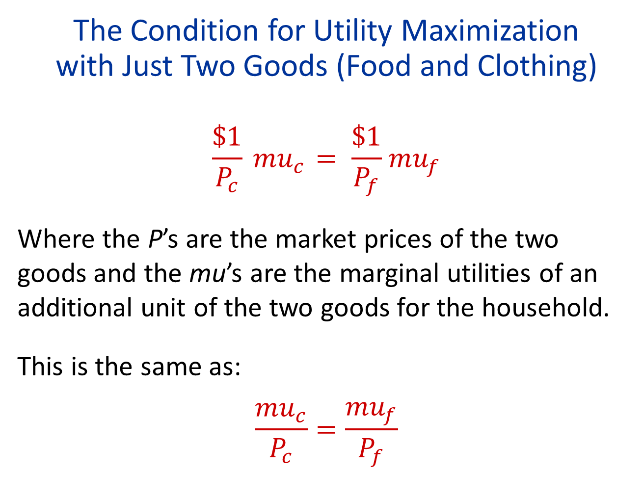
The Condition for Utility Maximization
with Just Two Goods (Food and Clothing)
$$\frac{\$1}{P_{c}}{ mu}_{c} = \frac{\$1}{P_{f}}{ mu}_{f}$$
Where the P’s are the market prices of the two goods and the mu’s are the marginal utilities of an additional unit of the two goods for the household.
This is the same as:
$$\frac{{mu}_{c}}{P_{c}}=\frac{{mu}_{f}}{P_{f}}$$

Slide 27
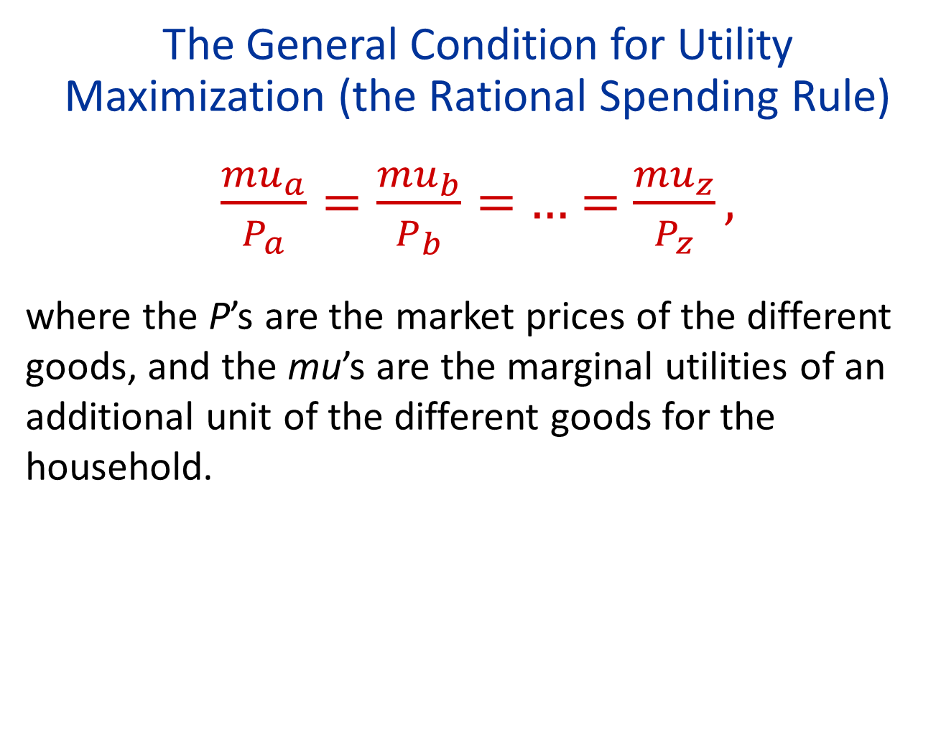
The General Condition for Utility Maximization (the Rational Spending Rule)
$\frac{{mu}_{a}}{P_{a}}=\frac{{mu}_{b}}{P_{b}}=$ … = $\frac{{mu}_{z}}{P_{z}},$
where the P’s are the market prices of the different goods, and the mu’s are the marginal utilities of an additional unit of the different goods for the household.

Slide 28
Consumer Optimization and the Demand Curve

Slide 29
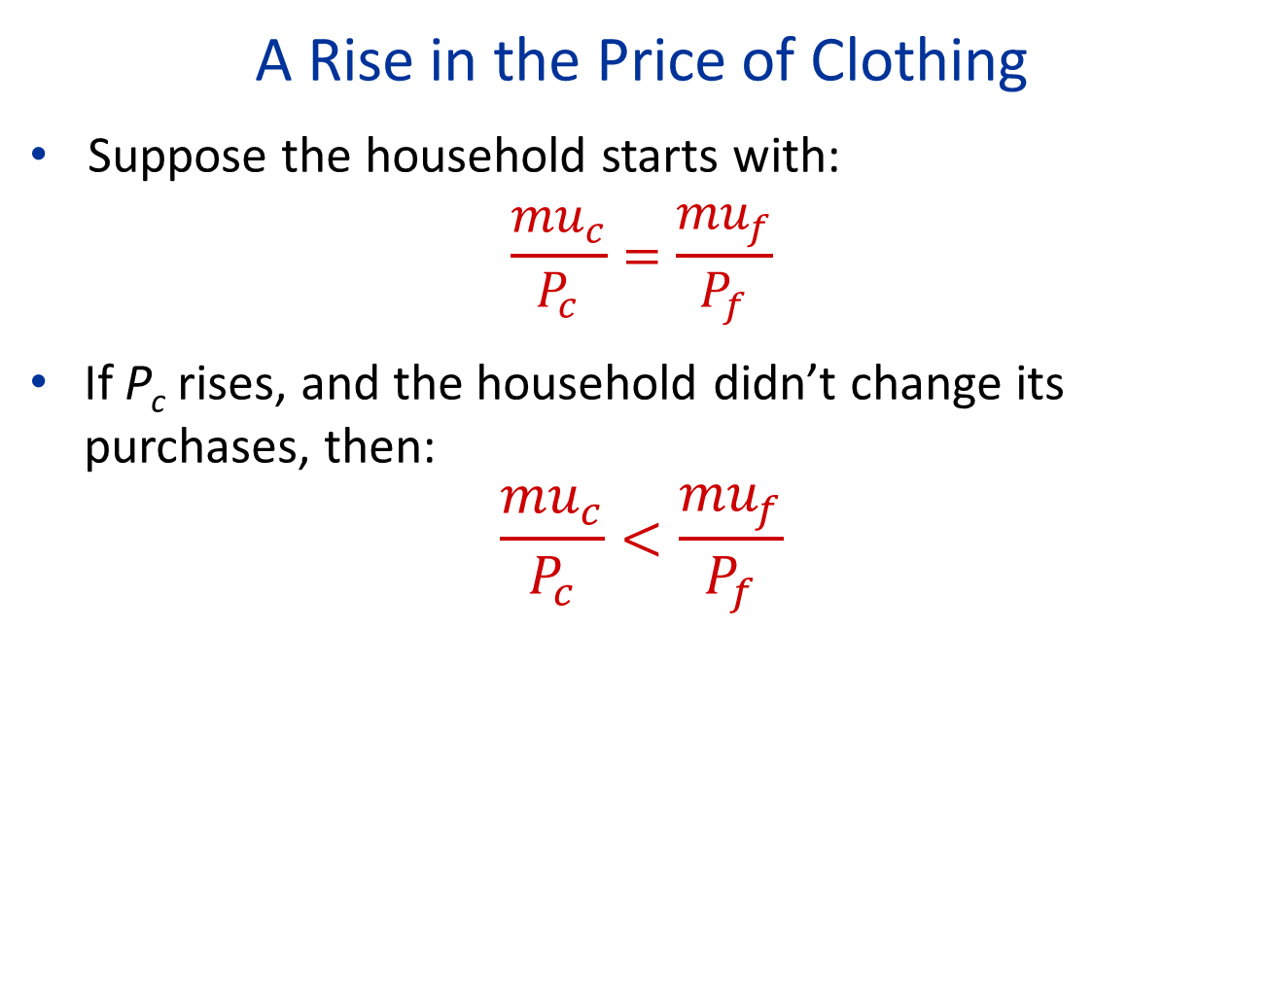
A Rise in the Price of Clothing
Suppose the household starts with:
$$\frac{{mu}_{c}}{P_{c}}=\frac{{mu}_{f}}{P_{f}}$$
If P_{c} rises, and the household didn’t change its purchases, then:
$$\frac{{mu}_{c}}{P_{c}}<\frac{{mu}_{f}}{P_{f}}$$

Slide 30
Diminishing Marginal Utility
marginal
utility
mu
q

Slide 31
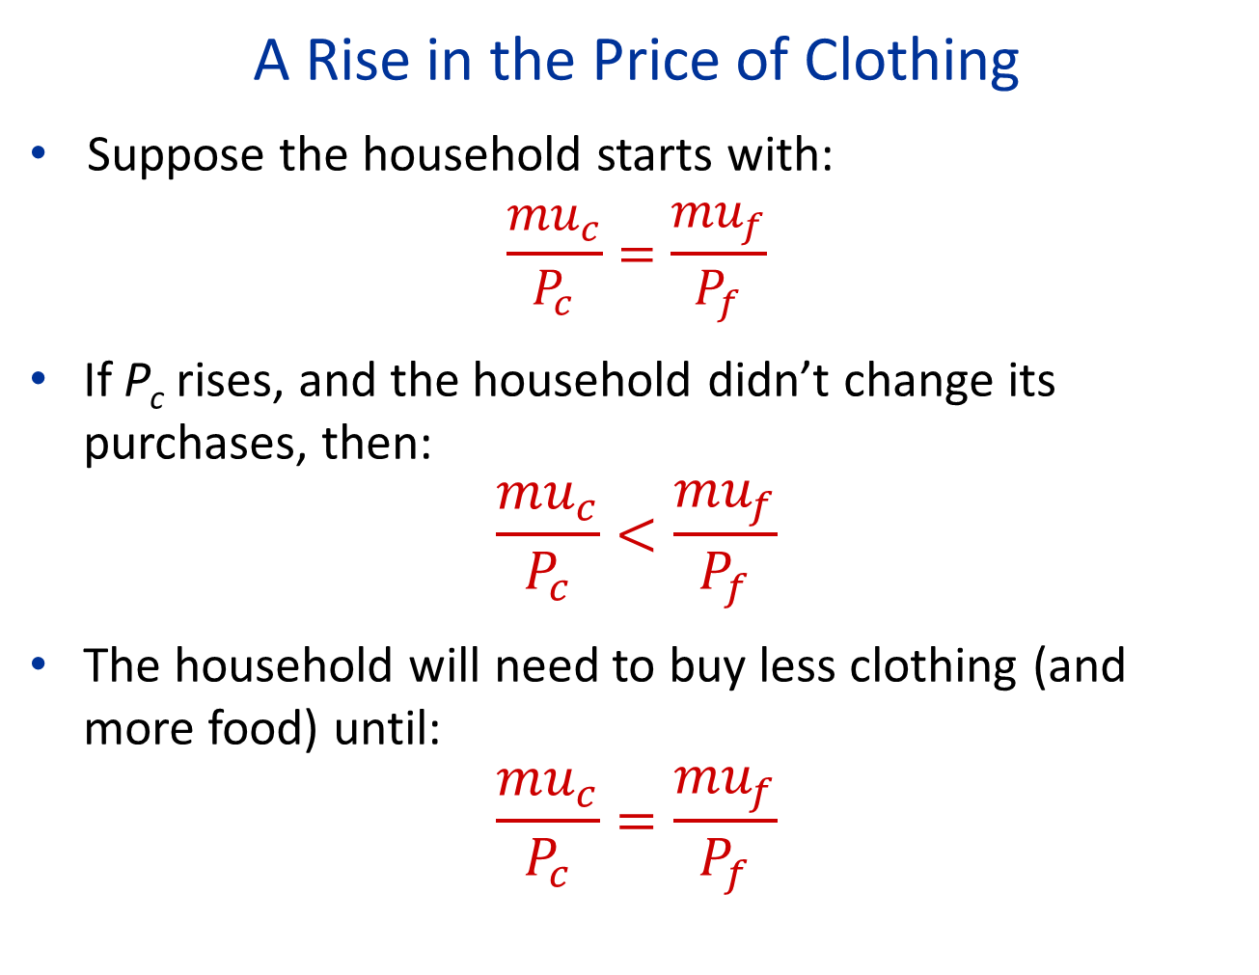
A Rise in the Price of Clothing
Suppose the household starts with:
$$\frac{{mu}_{c}}{P_{c}}=\frac{{mu}_{f}}{P_{f}}$$
If P_{c} rises, and the household didn’t change its purchases, then:
$$\frac{{mu}_{c}}{P_{c}}<\frac{{mu}_{f}}{P_{f}}$$
The household will need to buy less clothing (and more food) until:
$$\frac{{mu}_{c}}{P_{c}}=\frac{{mu}_{f}}{P_{f}}$$

Slide 32
Why Demand Curves Slope Down
Substitution effect: When the price of a good rises, a household wants less of the good and more of other goods, because the good becomes relatively more expensive.

Slide 33
A Rise in the Price of Clothing
q_{food}
Budget constraint₁
Budget constraint₂
q_{clothing}

Slide 34
Why Demand Curves Slope Down
Substitution effect: When the price of a good rises, a household wants less of the good and more of other goods, because the good is relatively more expensive.
“if price increases, I buy something else”
Income effect: When the price of a good rises, a household wants less of all goods, because its budget constraint has changed for the worse.
“if price increases, I can’t buy as much”

Slide 35
Demand Curves
Individual Household
Market
P
P
q
Q

Slide 36
Demand Curves
Individual Household
Market
P
P
d
q
Q

Slide 37
Household and Market Demand Curves
The market demand curve is the horizontal sum of each individual household’s demand curve.
Because each household’s demand curve (d) slopes down, the market demand curve (D) slopes down.

Slide 38
Demand Curves
Individual Household
Market
P
P
d
D
q
Q

Slide 39
Household and Market Demand Curves
The market demand curve is the horizontal sum of each individual household’s demand curve.
Because each household’s demand curve (d) slopes down, the market demand curve (D) slopes down.
Because each household’s demand curve is derived from optimizing behavior, the market demand curve is as well.

Slide 40

Blueberries may help prevent Alzheimer's, new research suggests
4:41PM GMT 13 Mar 2016
Scientists say the fruit is loaded with healthful antioxidants which could help prevent the effects of the increasingly common form of dementia
Blueberries, already classified as a “superfruit” for its health boosting properties, could now also help fight dementia, new research suggests. The study shows the berry, which can potentially lower the risk of heart disease and cancer, could also be a weapon in the battle against Alzheimer's disease. Scientists say the fruit is loaded with healthful antioxidants which could help prevent the devastating effects of the increasingly common form of dementia. One study involved 47 adults aged 68 and older, who had mild cognitive impairment, a risk condition for Alzheimer’s disease.

Slide 41
Positive News about Blueberries
mu
mu₁
q

Slide 42
Positive News about Blueberries
mu
mu₁
mu₂
q₁
q

Slide 43
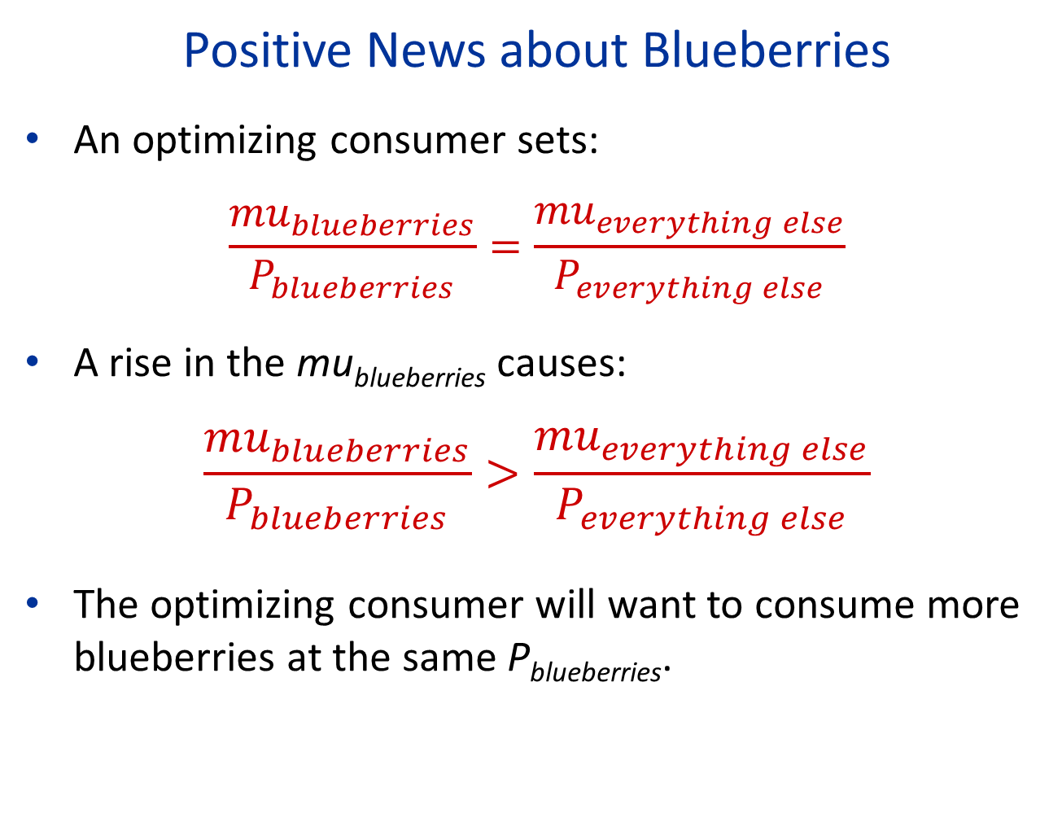
Positive News about Blueberries
An optimizing consumer sets:
$$\frac{{mu}_{blueberries}}{P_{blueberries}}=\frac{{mu}_{everything else}}{P_{everything else}}$$
A rise in the mu_{blueberries} causes:
$$\frac{{mu}_{blueberries}}{P_{blueberries}}>\frac{{mu}_{everything else}}{P_{everything else}}$$
The optimizing consumer will want to consume more blueberries at the same P_{blueberries}.

Slide 44
Positive News about Blueberries
mu
mu₁
mu₂
q₁
q

Slide 45
Effect of Positive News on the Demand Curve
P
d₁
q

Slide 46
Effect of Positive News on the Demand Curve
P
d₁
d₂
q

Slide 47
Utility of Income
Consumer has income c that is used to buy all sorts of goods: P_{a}•q_{a} + P_{b}•q_{b} + P_{c}•q_{c} + … + P_{z}•q_{z} = c where c is total amount spent on consumption.
This consumer optimization generates utility u(c) with u(.) an increasing function of c.
The marginal utility of income is u’(c), the slope of utility function u(c) = extra utility from having +$1
We expect u’(c) to decrease with c which means that u(c) is concave in c.

Slide 48
Quiz 1:
  Question: Suppose UC Berkeley gives you an extra $500/month stipend this academic year. The extra stipend is most useful to you if:
  A. My current stipend is low ($1000/month)
  B. My current stipend is medium ($2000/month)
  C. My current stipend is high ($3000/month)
  D. It is equally useful to me in all A,B,C cases
  Answer based on YOUR feelings (not ECON2 theory)

Slide 49
Utility Function
u(c) is increasing
u(c) is concave (means u’(c) is decreasing)
Utility
u(c)
0
$ consumption c

Slide 50
Utility Function
u(c) is increasing
u(c) is concave (means u’(c) is decreasing)
Utility
u(c)
Example:
u(c)=log(c)
u’(c)=1/c
10% increase in c gives same utility whether c is high or low
0
$ consumption c

Slide 51
Utility of Income
Even though consumer satiates with any specific good, you never satiate with total income c because there are always more expensive goods to start consuming (fancier house, car, etc.)
With concave u(c): u’(poor)>u’(rich) => taking $1 from rich to give $1 to poor increases total utility
Non-satiation (“it’s never enough”) is what drives perpetual economic growth
Sociologically: non-satiation arises because utility is always relative to what others consume

Slide 52
How to Measure Society’s Well-Being?
Libertarian: social well-being is the sum of $ of economic surplus across agents regardless of who gets it => Inequality irrelevant, no value in redistribution.
Utilitarian: social well-being is sum of utilities. If u(c) is concave, value in redistributing from rich to poor. Traditional criterion for economists.
Rawlsian: (after John Rawls) social well-being is the utility of the worst-off person in society. Aim is to make the poorest as well-off as possible.
All these measures are based on individualistic outcomes and miss fairness, rights, process considerations

Slide 53
Quiz 2:
  Question: Which measure of social welfare fits best with your views?
  A. Libertarian ($ sum of economic surplus)
  B. Utilitarian (sum of utilities)
  C. Rawlsian (utility of the poorest person)
  D. None of these fit with my views
  Answer based on YOUR feelings (not ECON2 theory)

Slide 54
“Fairness as a Constraint on Profit Seeking” by Kahneman, Knetsch, and Thaler

Slide 55
Behavioral Economics
Brings the complexity of human behavior into the analysis of economic decision-making.
Blends psychology and economics.
The Undoing Project by Michael Lewis and Misbehaving by Richard Thaler are fun books on the birth of the field.

Slide 56
Lab Experiments
Another way to gather information about economic behavior.
Watch behavior in a controlled laboratory setting.

Slide 57
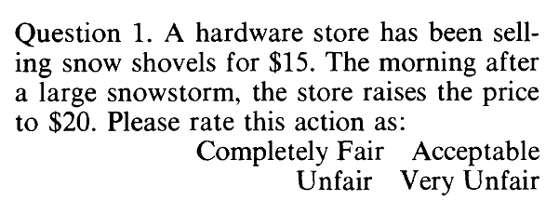
Empirical Strategy of Kahneman, et al.
Asking people to respond to vignettes.
I-Clicker quiz: A. Completely Fair, B. Acceptable, C. Unfair, D. Very Unfair.
Answer based on feelings, not ECON2 theory

Slide 58
Some Findings from Kahneman, et al.
Price increases based on a shift in demand are viewed as unfair.

Slide 59
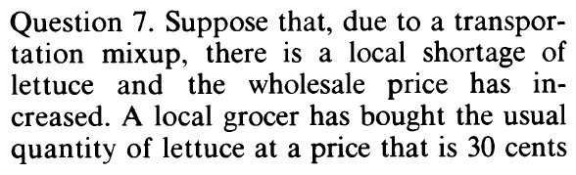
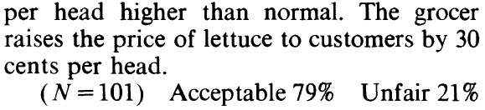
Some Findings from Kahneman, et al.
Price increases based on increased production costs are viewed as acceptable.

Slide 60
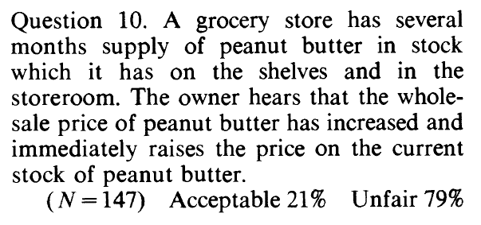
Some Findings from Kahneman, et al.
Price increases based on increased opportunity cost are viewed negatively.

Slide 61
Some Findings from Kahneman, et al.
Reference transactions matter.

Slide 62
What do you think of the research?

Slide 63
What do I think of the research?
People have a sense of fairness that’s relevant to basic economic choices
Taking advantage of disaster to increase prices is wrong = price gouging.
Market logic does not always seem fair to humans, explains anti-price gouging laws, allocation of some goods such as COVID vaccines in non-market ways
These fairness effects are even bigger for wage determination in the labor market as workers care a lot about pay fairness

Slide 64
Implications of Findings for Analysis of Household and Firm Optimization
Need a broad definition of utility.
There are important deviations from simple optimizing behavior for people.
Firms may need to think about customer relationships and workers’ morale in figuring out how to maximize long-run profits.
But basic insights and implications of utility and profit maximization still useful.

Slide 65
References
CORE-The Economy, Unit 3.
Principles of Economics, Chapter 5.
Kahneman, Daniel, Jack L. Knetsch, and Richard Thaler. "Fairness as a constraint on profit seeking: Entitlements in the market." The American economic review (1986): 728-741.

