Slide 1
Lecture 9
Externalities and Climate Change
Economics 2 Emmanuel Saez
Fall 2024

Slide 2
I. Overview

Slide 3
Market Failure
When markets do not lead to an efficient outcome
First example was monopoly—a profound lack of competition.
This lecture is about externalities, an important source of market failures.
Economic activity can create external harm (external means not taken into account by the market participants).

Slide 4
Externality
An externality arises whenever the actions of one economic agent directly affect another economic agent outside the market mechanism
A power plant that pollutes a river used for recreation is an externality
A power plant that increases its price of electricity because of a shift in demand is NOT an externality (as this is a market mechanism)

Slide 5
SUV Externalities Example
Example: negative externalities of driving a gas powered large Sport Utility Vehicle:
  1. Environmental externality: carbon emissions and global warming
  2. Infrastructure externality: Larger cars wear down the roads more
  3. Safety externality on other drivers: The odds of having a fatal accident increase if hit by a bigger car
  4. Congestion externality: driving a car adds to traffic which increases travel time for others

Slide 6
Quiz:
  Question: Which of these is NOT a negative externality?
A. Cigarette smoking that damages your future health.
B. Texting while driving which increases accident risk.
C. Pesticide runoff from farms that pollutes land/water.
D. Noise related to a construction project.
E. All are negative externalities

Slide 7
Quiz
Example: Suppose you have a beehive in your garden to produce homemade honey you sell to fellow students. Does this produce externalities?
  Yes, a negative externality if neighbors get stung by your bees.
  Yes, a positive externality as the bees help with pollination in the organic farm next door.
  Yes, a positive externality because fellow students love to stop by and discuss my beehive hobby.
  All of A, B, and C

Slide 8
Quiz
Example: suppose you are still talking when I start lecturing. Is this an externality as economists define it? Only 1 answer is correct.
  No, because this has nothing to do with markets
  No, because I was engrossed in the conversation and did not even notice class had started
  Yes, but only if the background noise makes it harder for the students to understand the lecture.
  No, because many students were also talking so my talking does not make any difference.
  Yes, because the rule is to be quiet when class starts

Slide 9
II. Negative Externalities

Slide 10
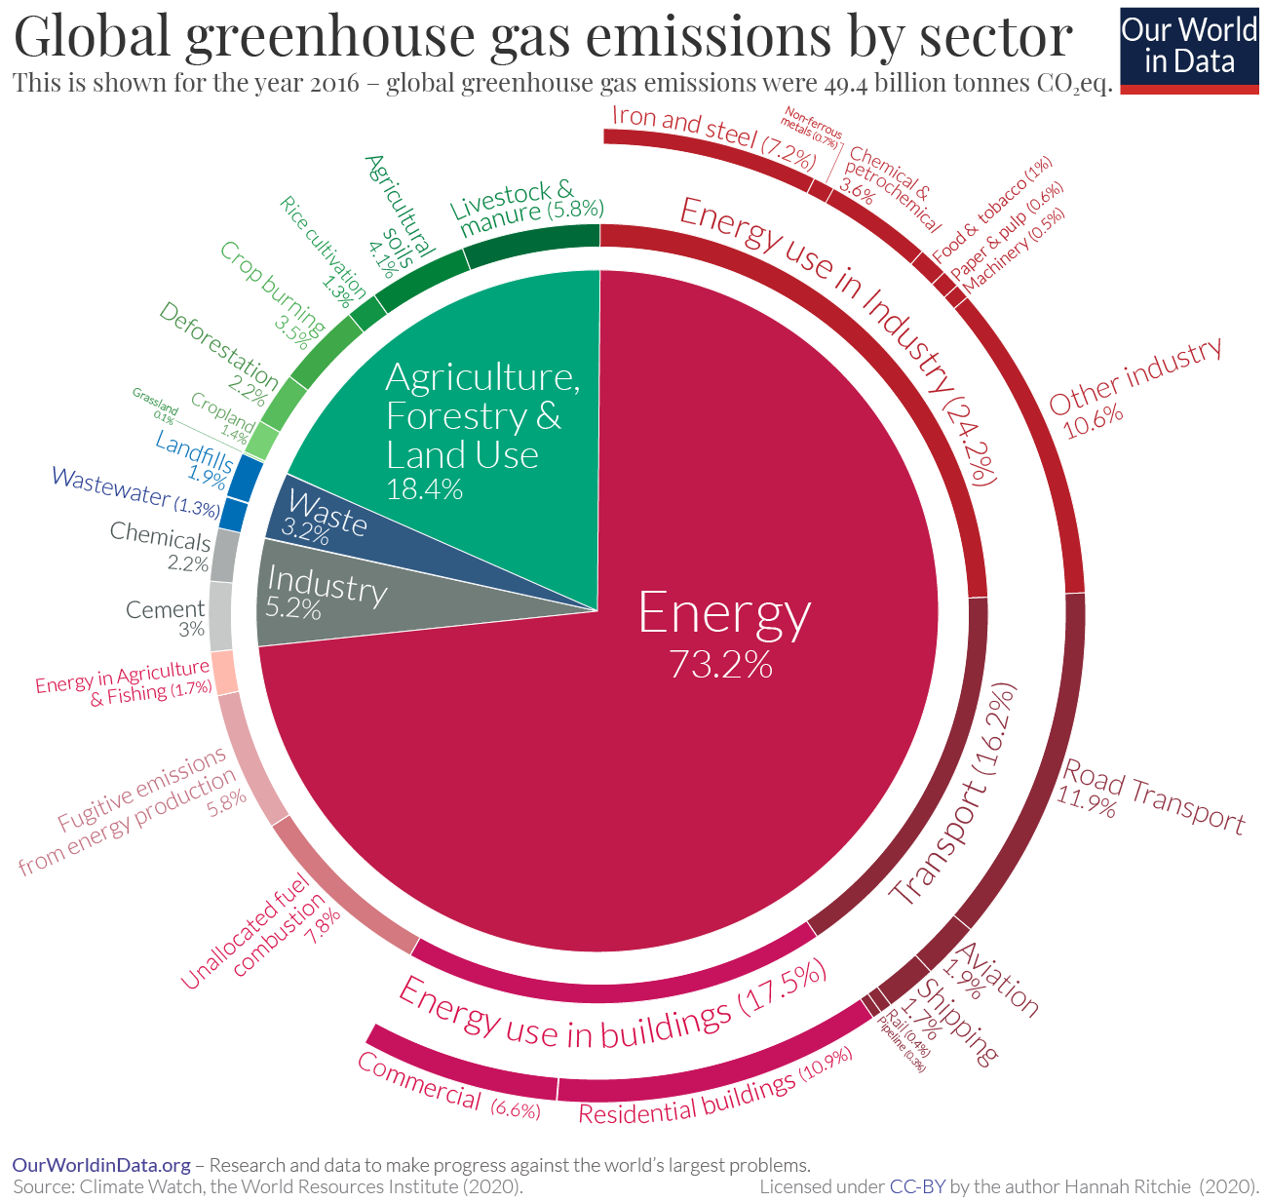

Slide 11
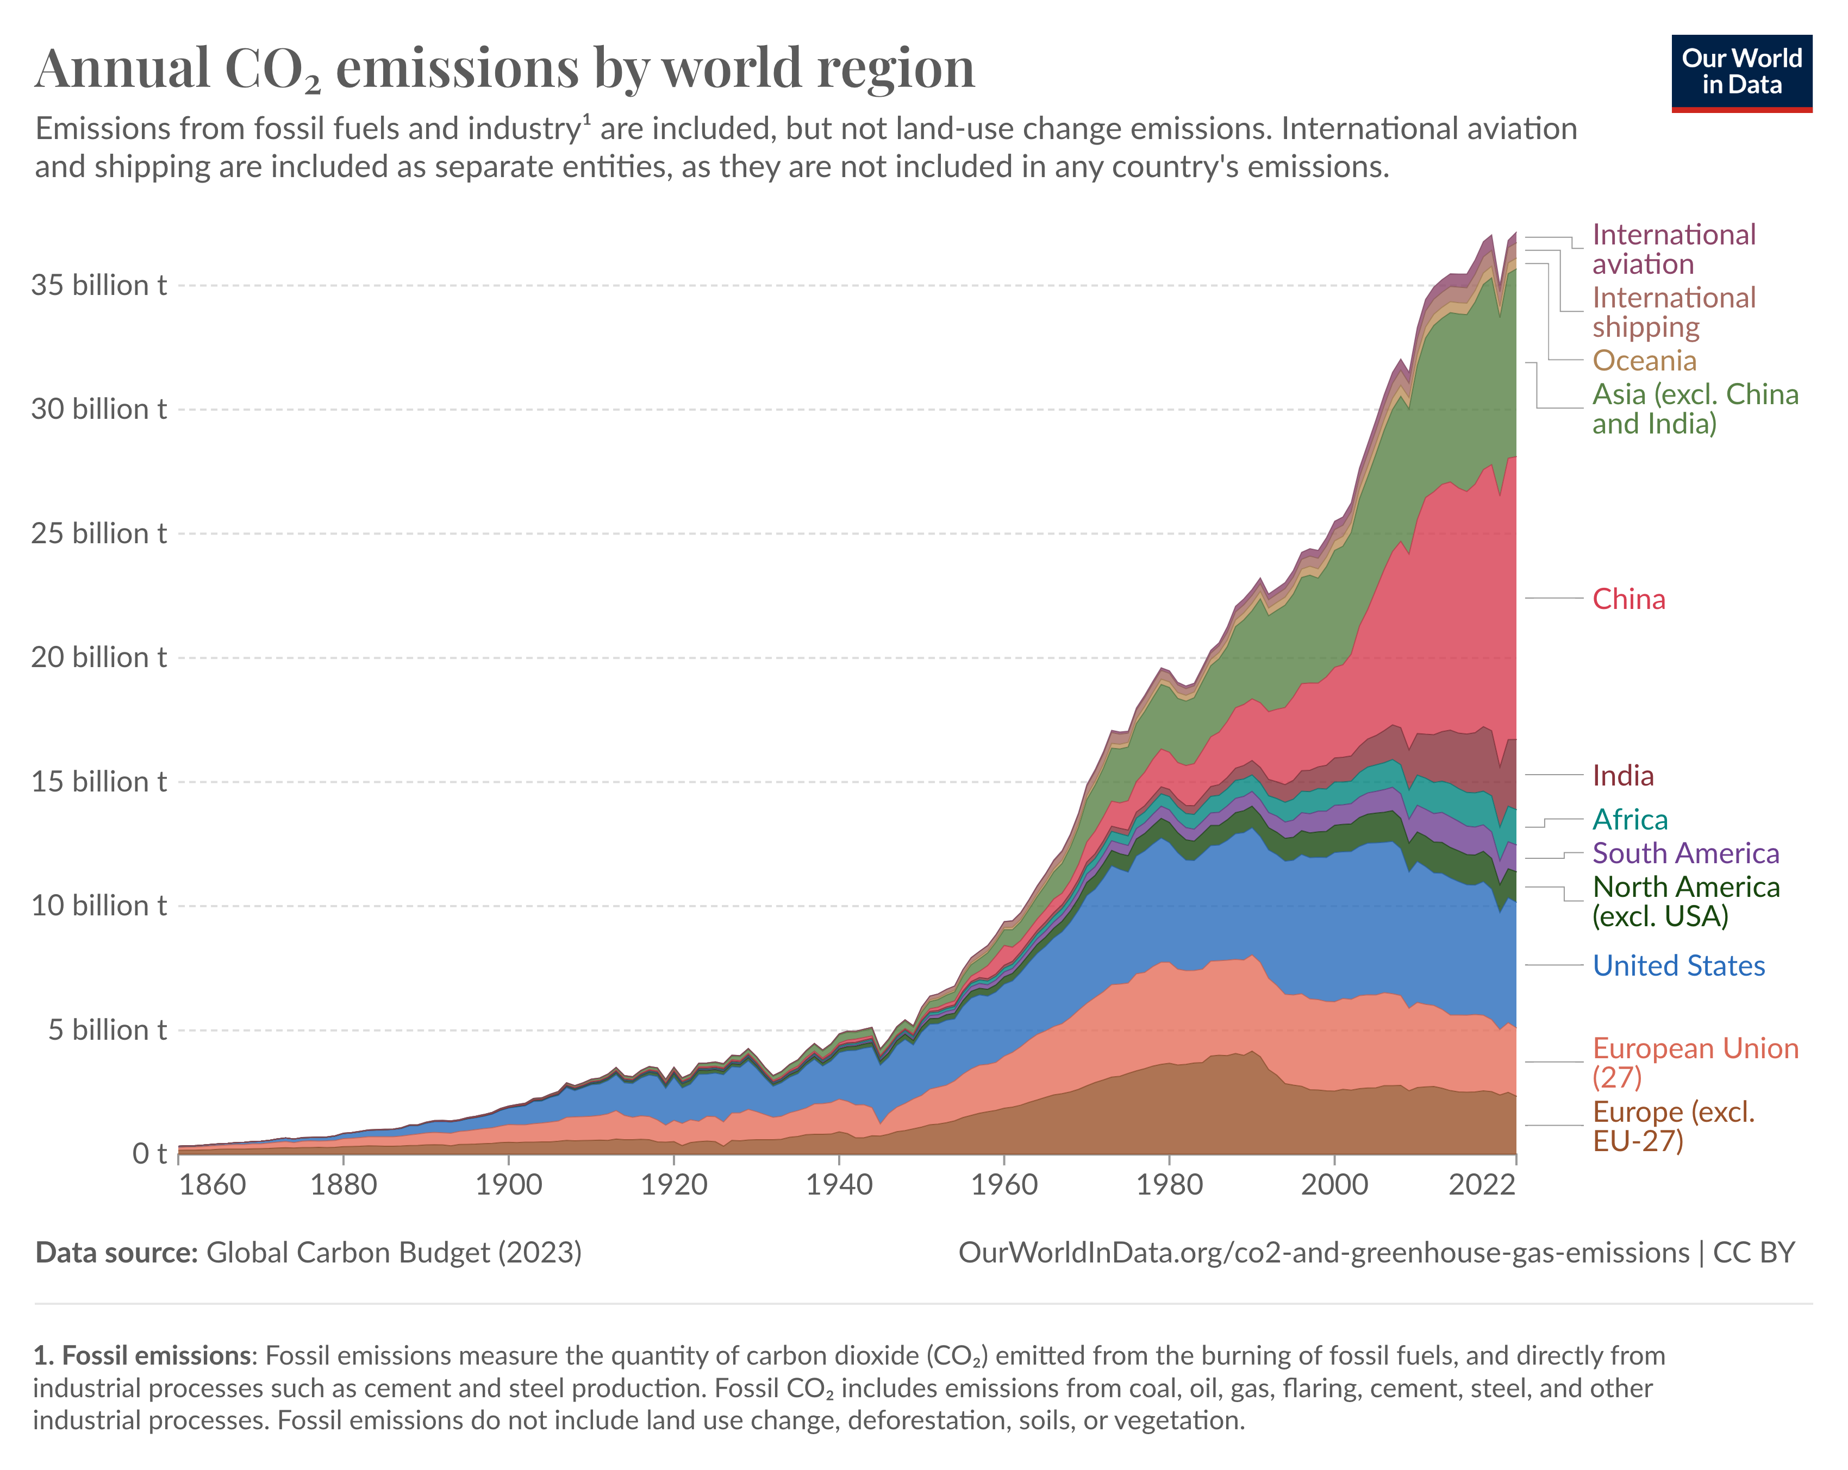

Slide 12
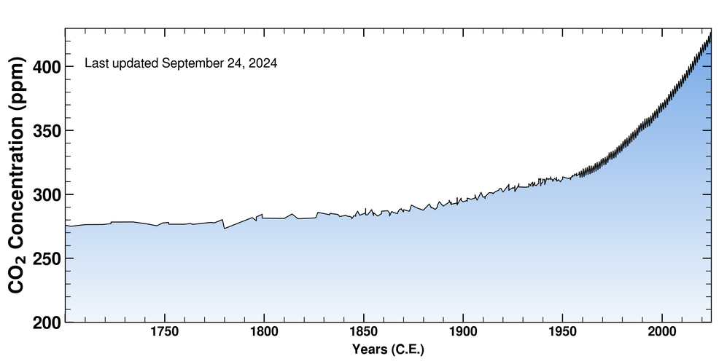
Atmospheric CO₂ Concentration
Source: Scripps Institution of Oceanography: Keeling Curve, Hawaii Observatory
https://keelingcurve.ucsd.edu/
Atmospheric CO₂ concentration is the cumulative CO₂ emissions since industrialization because CO₂ lasts 300 to 1000 years in atmosphere

Slide 13
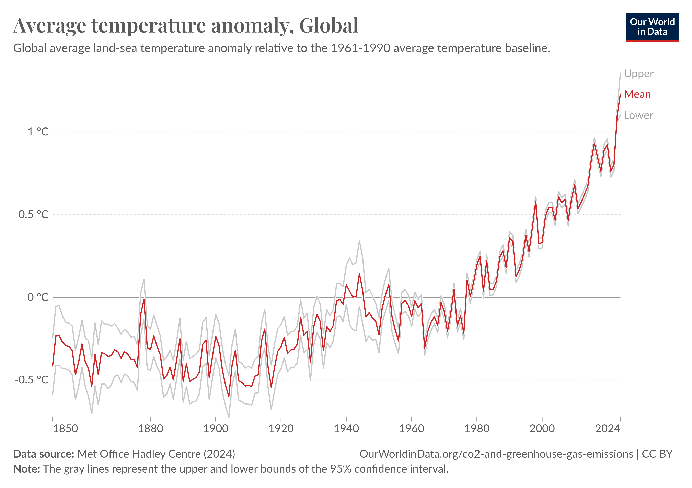
Temperature gains are approximately proportional to atmospheric CO₂

Slide 14
Negative Externality Econ Modeling
There are negative effects on agents outside the market mechanism
These negative effects can be measured in $ costs (for economists, anything that matters can be measured in $ costs, a strong assumption)
Negative externalities can result from either the consumption or the production of a good
  Consumption negative externality: emitting CO₂ when driving a gas powered car
  Production negative externality: emitting CO₂ when producing electricity in coal power plant

Slide 15
Market for Coal Powered Electricity
P
S₁, MC₁
P₁
D₁, MB₁
Q₁
Q

Slide 16
Some Terminology
“Private” refers to the people participating in the market (the buyers and sellers, and the government if there is a tax or a subsidy).
“Social” includes effects on people both in the market and outside the market.

Slide 17
Market for Coal Powered Electricity
P
S₁,PMC₁
P₁
D₁,PMB₁
Q₁
Q
PMC is the private marginal cost (we used to call this MC)
PMB is the private marginal benefit (we used to call this MB)

Slide 18
Total Private Surplus
Sum of consumer surplus and producer surplus (plus government revenue and minus government expenditure).

Slide 19
Review of Welfare Analysis
P
S₁,PMC₁
P₁
D₁,PMB₁
Q₁
Q
PMC is the private marginal cost; PMB is the private marginal benefit.

Slide 20
Market produces economic surplus for participants: consumers and producers
P
Sum of Consumer
& Producer Surplus
S₁,PMC₁
P₁
D₁,PMB₁
Q₁
Q
PMC is the private marginal cost (we used to call this MC)
PMB is the private marginal benefit (we used to call this MB)

Slide 21
More Terminology
External Marginal Cost: The additional cost to people outside the market when one more unit is produced and consumed (sometimes called marginal damage)
Social Marginal Cost: Private marginal cost plus external marginal cost.

Slide 22
Negative Production Externality
(Market for Coal Powered Electricity)
P
S₁,PMC₁
Private
Economic
Surplus
P₁
D₁,PMB₁
Q₁
Q

Slide 23
Negative Production Externality
(Market for Coal Powered Electricity)
P
SMC₁
S₁,PMC₁
External MC
P₁
D₁,PMB₁=SMB₁
Q₁
Q
External MC is the $ measure of the external cost of producing 1 extra unit of coal powered electricity (e.g. global warming)

Slide 24
Negative Production Externality
(Market for Coal Powered Electricity)
P
SMC₁
S₁,PMC₁
Private
Economic
Surplus
External MC
P₁
D₁,PMB₁=SMB₁
Q₁
Q
External MC is the $ measure of the external cost of producing 1 extra unit of coal powered electricity (due to climate change)

Slide 25
Total Social Economic Surplus
Total private economic surplus plus external benefits minus external costs.
It includes the welfare (measured in $) of both people in the market and outside the market.

Slide 26
Negative Production Externality
(Market for Coal Powered Electricity)
P
SMC₁
S₁,PMC₁
External MC
P₁
Total External Cost
D₁,PMB₁=SMB₁
Q₁
Q
Dark blue area is the total external cost of producing Q₁:
sum of external MC from 0 to Q₁

Slide 27
Negative Production Externality
(Market for Coal Powered Electricity)
P
SMC₁
S₁,PMC₁
Social
Economic
Surplus
External MC
P₁
Negative Social Economic Surplus
D₁,PMB₁=SMB₁
Q₁
Q
Social Economic Surplus at Q₁ is the light blue area minus the dark blue area

Slide 28
Efficient Quantity with Externality
P
SMC₁
S₁,PMC₁
Social
Economic
Surplus
External MC
D₁,PMB₁,SMB₁
Q*
Q₁
Q
Efficient quantity that maximizes social economic surplus is Q* (where SMC and SMB intersect)

Slide 29
Negative Production Externality
(Market for Coal Powered Electricity)
P
SMC₁
S₁,PMC₁
External MC
P₁
Deadweight loss
D₁,PMB₁,SMB₁
Q*
Q₁
Q
Efficient quantity is Q* but market equilibrium quantity is Q₁:
Deadweight loss: triangle starting at Q₁ and pointing to Q*

Slide 30
Welfare Analysis of a Negative Production Externality
P
SMC₁
S₁,PMC₁
External MC
a
d
c
b
D₁,PMB₁,SMB₁
Q*
Q₁
Q
Q₁ Q*
Consumer and Producer Surplus a+b+c a+b
External Costs −(b+c+d) −b Total Social Surplus a−d a
Deadweight Loss d

Slide 31
Deadweight Loss
The total social surplus is largest at the quantity (Q*), where SMB=SMC.
Why is this the case?
Any shortfall from the largest total social surplus is the deadweight loss.

Slide 32
Whenever There Is a Negative Production Externality:
The SMC curve lies above the PMC curve.
The people in the market will choose to produce where PMC=PMB (or supply is equal to demand).
But total social economic surplus higher if the market produced and consumed less (where SMC=SMB).

Slide 33
Some Points about the Welfare Analysis of a Negative Externality
The total social surplus includes producers and consumers in the market as well as all agents affected by the externality
Even with a negative externality, some production may still be desirable (if SMC and SMB intersect).
When there is no externality, SMB and PMB are the same, and SMC and PMC are the same.
Negative Consumption Externalities work the same by shifting down the PMB into the SMB

Slide 34
Negative Consumption Externality
(Market for Gasoline)
P
S₁,PMC₁
P₁
Deadweight loss
External MC
D₁,PMB₁
SMB₁
Q*
Q₁
Q
Efficient quantity is Q* but market equilibrium quantity is Q₁:
Deadweight loss: triangle starting at Q₁ and pointing to Q*

Slide 35
Quiz:
  Question: Gasoline consumption generates a climate change negative externality. The market outcome is inefficient. Who is at fault?
  A. Consumers who don’t take into account that gasoline contributes to global warming
  B. Producers who don’t take into account that gasoline contributes to global warming
  C. Both consumers and producers
  D. Nobody is at fault

Slide 36
III. Positive Externalities

Slide 37
Positive Externality
The effects on those outside the market are good.
There is an external benefit.
Positive externalities can result from either the consumption or the production of a good (or both).

Slide 38
More Terminology
External Marginal Benefit: The additional benefit to people outside the market when one more unit is produced and consumed.
Mathematically: external marginal benefit is like a negative external marginal cost
Social Marginal Cost: Private marginal cost minus external marginal benefit if positive externality in production
Social Marginal Benefit: Private marginal benefit plus external marginal benefit if positive externality in consumption

Slide 39
Positive Production Externality
(Beehive honey production that helps crops)
P
S₁,PMC₁
SMC₁= PMC₁-
External MB
P₁
Deadweight loss
D₁,PMB₁,SMB₁
Q₁
Q*
Q
Efficient quantity is Q* but market equilibrium quantity is Q₁:
Deadweight loss: triangle starting at Q₁ and pointing to Q*

Slide 40
Positive Consumption Externality
(Market for Vaccines)
P
S₁,PMC₁,SMC₁
Deadweight loss
P₁
External MB
SMB₁
D₁,PMB₁
Q₁
Q*
Q
Efficient quantity is Q* but market equilibrium quantity is Q₁:
Deadweight loss: triangle starting at Q₁ and pointing to Q*

Slide 41
Other Examples of Positive Externalities?
Technology spillovers: Firms constantly invent better production processes that can then be copied and drive long-run economic growth
Education and research: Fundamental knowledge taught and created also has spillovers on industry (e.g., Stanford and Silicon Valley)
Mundane example: Planting flowers in your yard that neighbors enjoy. Almost everything not market mediated has externalities!

Slide 42
Whenever There Is a Positive Externality:
The SMC curve lies below the PMC curve.
The people in the market will choose to produce where PMC=PMB (or supply is equal to demand).
But society would be better off if the market produced and consumed more (where SMC=SMB).

Slide 43
IV. Remedies for Externalities

Slide 44
Remedies for Externalities
Private Solution:
    Negotiation and compensation
    Social sanctions
Government Regulation
    Some externality generating actions are regulated or prohibited
Taxes and Subsidies
    Taxes can discourage negative externalities and subsidies encourage positive externalities

Slide 45
Tax Remedy for a Negative Producer Externality
P
SMC₁,
S₁,PMC₁
External MC
P₁
D₁,PMB₁,SMB₁
Q*
Q₁
Q

Slide 46
Tax Remedy for a Negative Producer Externality
P
SMC₁,S₂
S₁,PMC₁
External MC,
P_{2c}
P₁
Tax
P_{2p}
D₁,PMB₁,SMB₁
Q₂=
Q*
Q₁
Q
A tax on producers equal to the external MC shifts PMC up to SMC and moves equil. from Q₁ to Q₂=Q*. P_{2c} is consumer price, P_{2p} producer price

Slide 47
Tax Remedy for a Negative Consumption Externality
P
S₁,PMC₁
P₁
External MC
D₁,PMB₁
SMC₁
Q*
Q₁
Q

Slide 48
Tax Remedy for a Negative Consumption Externality
P
S₁,PMC₁
P_{2c}
P₁
Tax
External MC
D₁,PMB₁
SMC₁
Q₂=
Q*
Q₁
Q
A tax on consumers equal to the external MC shifts PMB down to SMB and moves equilibrium from Q₁ to Q₂=Q*.

Slide 49
Quiz:
  Question: Suppose the externality is on consumer side (like gasoline for driving). Which tax remedy works?
  A. A gas tax on consumers
  B. A gas tax on producers
  C. Both A. and B.
  D. None

Slide 50
Quiz:
  Question: Gasoline consumption generates a climate change negative externality with marginal cost $2 per gallon. What is the correct remedy?
  A. $2 tax per gallon charged on consumers
  B. $2 tax per gallon charged on producers
  C. Either A. or B.
  D. Phase-out gas cars

Slide 51
Tax Remedy for Negative Externality
A tax per unit equal to the external MC moves the market equilibrium to efficiency.
It does not matter whether the tax is charged to consumers or producers (see earlier lecture)
It does not matter whether the externality is created by producers or consumers
If external MC varies with Q: The right tax is the marginal external effect at the socially efficient point

Slide 52
Tax Remedy for Negative Externality
with non constant MC
P
SMC₁
S₂
S₁,PMC₁
External MC
P_{2c}
P₁
Tax
D₁,PMB₁,SMB₁
Q₂=
Q*
Q₁
Q
A tax per unit equal to the external MC at Q* shifts PMC up and moves equilibrium from Q₁ to Q₂=Q*

Slide 53
Remedy for a Positive Externality (Subsidy)
P
S₁,PMC₁,SMC₁
P₁
External MB
SMB₁
D₁,PMB₁
Q₁
Q*
Q

Slide 54
Remedy for a Positive Externality (Subsidy)
P
S₁,PMC₁,SMC₁
P₂
P₁
External MB,
Subsidy
SMB₁,D₂
D₁,PMB₁
Q₁
Q*=Q₂
Q
A producer subsidy equal to the external MB shifts PMB up to SMB and moves equilibrium from Q₁ to Q₂=Q*

Slide 55
Quiz:
  Question: Gasoline consumption generates a climate change marginal external cost of $2 per gallon. But suppose gasoline consumption is completely inelastic to price. What is the correct remedy for efficiency?
  A. A $2 tax per gallon
  B. Nothing
  C. Either A. or B.
  D. Phase-out gas cars

Slide 56
Tax Remedy with inelastic demand
(Tax and externality on producer side for visibility)
P
SMC₁ =PMC₁ +Tax = S₂
S₁,PMC₁
P_{2c}
P₁
Tax = external MC
D₁,PMB₁
Q₂=
Q*
Q₁
Q
With inelastic demand, Q₁ is very close Q₂=Q* (identical with totally inelastic demand). Corrective tax does not change Q. It just reduces consumer surplus and is not needed.

Slide 57
Quiz:
  Question: Suppose ag industry invent a powerful new pesticide that helps grow coffee in poor countries more cheaply but is toxic. Marginal damage is $10/unit as locals are poor (would be $100/unit in the US). What is the correct remedy?
  A. A $10 tax per unit
  B. A $100 tax per unit
  C. Nothing
  D. The pesticide should be entirely prohibited

Slide 58
Corrective (or Pigouvian) Taxes/Subsidies
Named after economist Arthur Pigou (1877-1959)
The idea to make economic agents internalize the externality by incorporating it in the price
For a negative externality: charge you a per-unit tax equal to the amount that others suffer from your action
For a positive externality: award you a per-unit subsidy equal to the amount that others benefit from your action
If you get the amount of the tax or subsidy right, this brings private incentives in line with social incentives
The right amount is the amount of marginal external effect at the socially efficient point

Slide 59
Do taxes/subsidies work in practice?
Examples where the idea is currently used:
    Gas tax: in the US, gas taxes are earmarked for road maintenance (deals with the wear and tear externality only, not global warming)
    Congestion pricing: some cities have imposed taxes on cars coming in crowded cities (London £15 daily) to fight congestion externalities
    Research and Development (R&D) tax credits for firms: subsidy to encourage innovation (but not tied explicitly to size of positive externality)

Slide 60
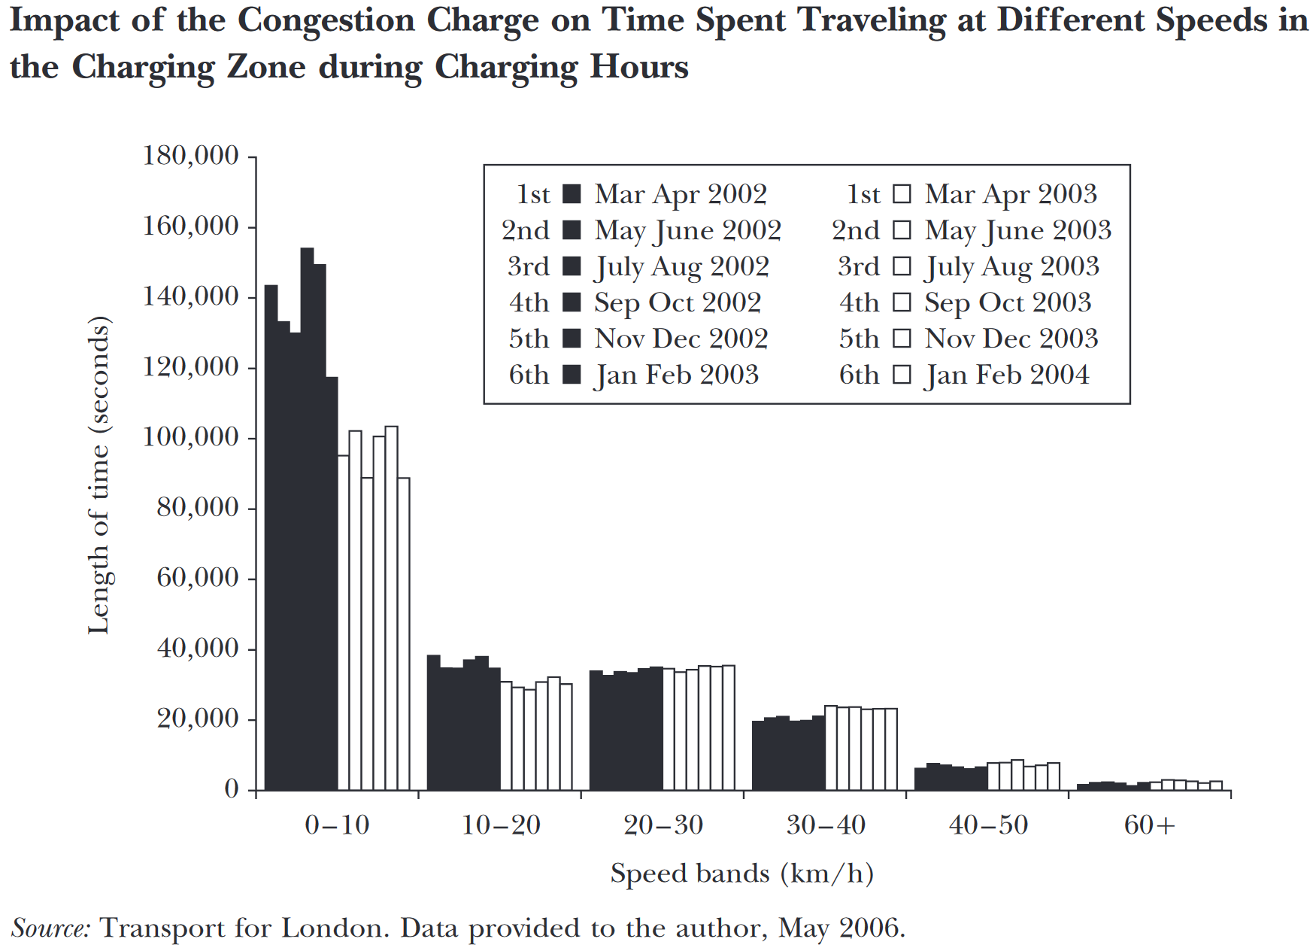
Impact of London congestion charge starting in March 2003 (Leape 2006)

Slide 61
Quiz:
  Question: The state of Texas funds roads with its gas tax—to correct for wear and tear produced by driving. What is the correct tax policy for electric vehicles (EVs) for Texas?
  A. No tax as EVs don’t use gas
  B. An extra specific tax as EVs also use the road
  C. A subsidy as EVs mitigate global warming
  D. Texas should phase out gas cars like California

Slide 62
How do we deal with externalities in practice?
Most common response is regulation:
    Products/actions that generate negative externalities are forbidden by law (Harmful pollutants, dangerous consumer goods, littering, speeding, criminal behavior)
    The penalty starts with a fine: economically equivalent to a tax but psychologically/socially very different [goal is to prohibit not price externality]
    Limit (=allowance) on pollutant emissions. Example: smog check for gas cars in California
Issue with regulation (for economists):
  Issue: cheap to reduce pollutant in some cases but not others. Example: electric cars exist but not electric planes => CO2 allowance could kill high value aviation industry

Slide 63
Taxes and regulation combination: Cap&Trade
Emission permits and trading (=cap&trade):
  Pollutant emitters are given emission permits
  Pollutant emitters can trade their emission allowances.
  Price of emissions is the same for all. If total allowances set such that price=external MC then efficient
Cap&trade has been used in transitions:
  SO₂ emissions creating acid rain, CFCs depleting ozone layer: costly to prohibit immediately as time is needed to develop substitutes
  phased-out over years through cap&trade system with shrinking allowances

Slide 64
Quiz:
  Question: Suppose the US adopts a cap&trade policy for carbon emissions where each industry gets permits equal to 50% of their 2024 emissions. What would happen to aviation industry?
  A. Aviation industry would shrink a lot as they can’t fly planes without fossil fuels
  B. Aviation industry would buy permits from other industries and just charge the extra cost on flyers.
  C. Aviation industry would invent quickly E-planes.
  D. All of A, B, C.

Slide 65
IV. Dealing with Global Warming

Slide 66
Main Costs of Global Warming
Great variation across areas and economic development. Pace of change is what makes adaptation particularly daunting:
Extreme weather makes many populated places less livable (sea rise, heatwaves, droughts, smoke from fires)
  Could lead to mass migration movements that are disruptive in our world of independent nations
Agricultural production disruptions and food security risks:
  demand for food inelastic in the short-run. Spikes in prices if agricultural output falls => Famines in low-income countries
Impact on bio-diversity (mass extinctions)

Slide 67
Quiz:
  Question: Suppose extreme weather shock reduces vegetables production globally by 20% which makes prices go up 200%. Which mitigating policy is most efficient?
  A. Nothing: Let poor people in poor countries starve and let others pay more for food
  B. Regulation: Prohibit meat so that everybody can survive with vegetarian diet.
  C. Tax: Impose a high tax on meat to discourage wasteful use of cereals to grow meat.
  D. Universal basic income so that everybody can afford food funded by tax on rich people/countries

Slide 68
Carbon tax: Economists’ Narrow Solution
CO2 emissions impose a global warming externality ⇒ Solution is to impose a carbon tax equal to the marginal damage of CO2 [economists carbon tax letter]
But what is the marginal damage of CO2? Costs hard to evaluate and depend greatly on how you discount the future as most of the damage is (used to be) in the future
  If future is discounted heavily (individual humans are impatient), CO2 damage cost is small and it is desirable to let global warming happen and civilization collapse!
  If future not discounted heavily, then big but unpopular carbon tax is called for
Economists have probably slowed down the process on net by underestimating costs (comparing Florida to Minnesota)

Slide 69
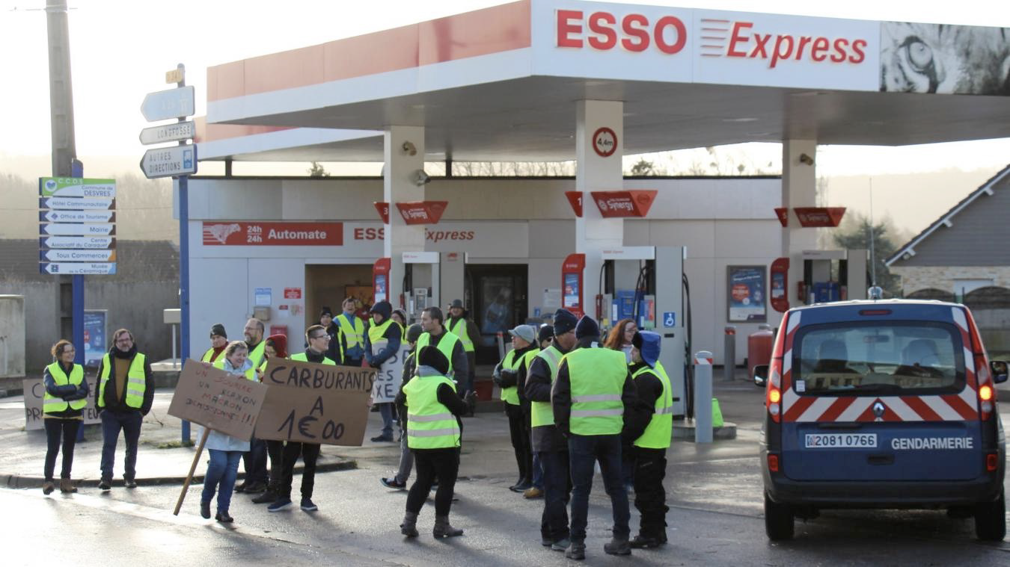
Gas taxes are generally very unpopular
Gas taxes are the go-to solution for economists. In practice, many gas users are inelastic and low income and get upset. Gas taxes tend to generate “tax revolts” as in the Yellow Vest movement in France in 2022.

Slide 71
Broader View on Reducing Emissions
Massive CO2 emissions pose existential civilizational risk (like CFCs destroying vital ozone layer)
Solution is to decarbonize as a social choice and we need to do it fast (within decades not centuries)
Economists’ obsession about estimating the Marginal Cost of CO2 emissions is a distraction. Shows the limitation of marginal analysis dear to economists:
  Getting the exact price/quantity right at the margin is 2nd order
  The 1st order problem is to decarbonize

Slide 72
Broader View on Reducing Emissions: Solutions
Costs of climate change have already surpassed the cost of transition, we moved too slowly.
Decarbonization is within sight: renewable electricity (solar/wind) + grid + big batteries could replace most fossil fuels. Renewable energy cost dropping fast.
Could be done without killing economic growth and without huge short-term disruptions. COVID response likely cost more
Economists’ useful point: some sectors are cheaper to decarbonize than others (cars easier than planes): tradeable allowances can make sense in a transition

Slide 73
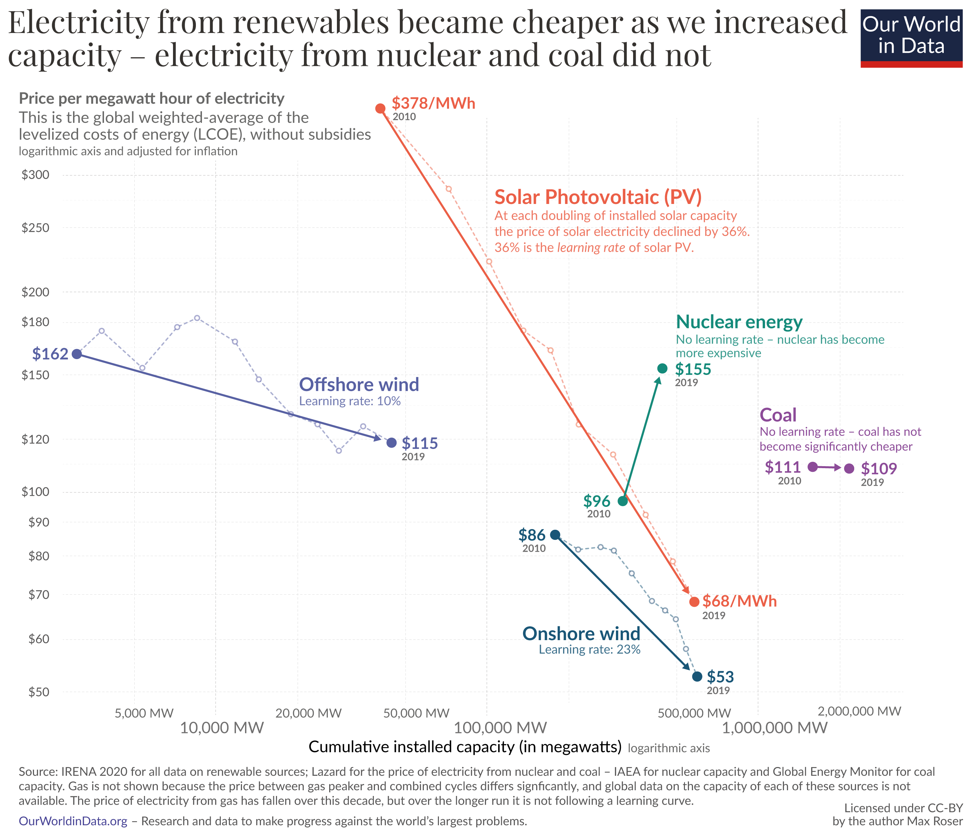

Slide 74
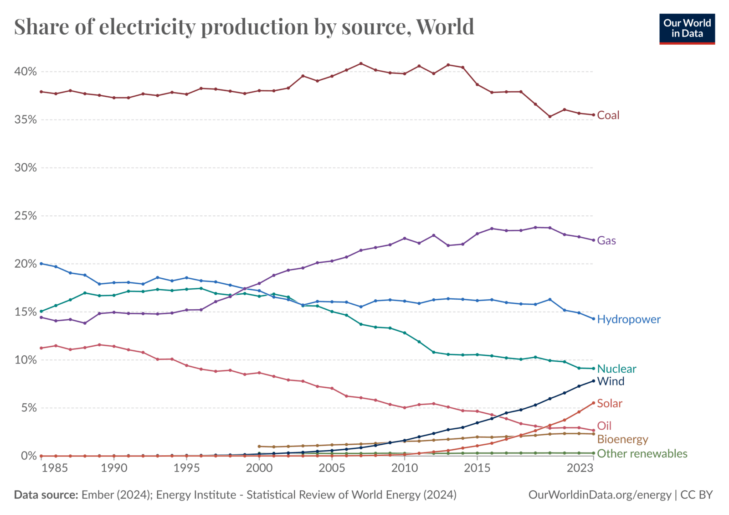

Slide 75
Tools actually used for decarbonization
Government support for (a) fundamental research in clean energy, (b) clean energy industry subsidies (for producers or consumers: e.g., EV credits in the US)
Government development of infrastructure for clean energy: clean energy power plants, grid, etc.
Government regulations to decarbonize: phase-out coal power plants and gas powered-cars, land management, ..
Carbon tax (or equivalent cap-and-trade carbon emission pricing) has been at best a minor tool, because it raises prices of energy and generates protests
2022 Inflation Reduction Act is largest US federal response to climate change to date and has no carbon tax

Slide 76
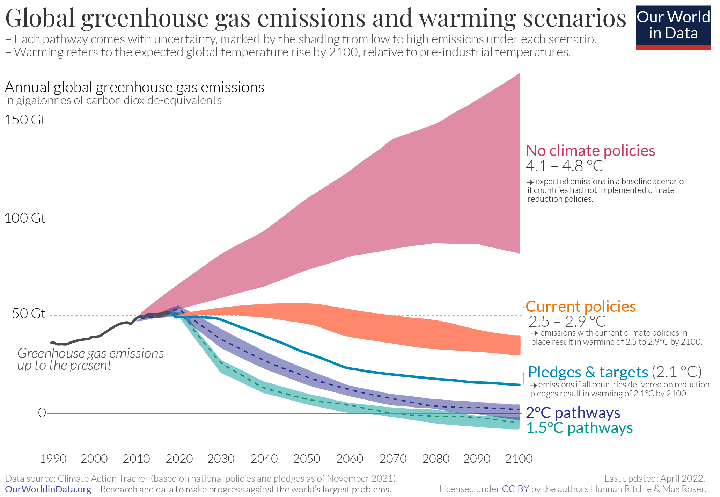

Slide 77
Quiz:
  Question: Would you support spending more through government to decarbonize the economy for good in coming decades?
  A. Yes, that’s the right thing to do for humanity
  B. No, because future generations get most of the benefit while current generation would pay the cost
  C. No, because I am upset previous generations did not do it already (don’t want to pay to clean up their mess)
  D. No, because there are more pressing issues to address with government spending than climate change
  E. No, because markets on their own will do best to invent the new clean technologies of the future

Slide 78
International Coordination
From one country perspective, decarbonizing is costly and benefit is modest (as global emissions is what matters)
Economists: countries need to make a coordinated binding agreement to decarbonize together
Reality: Series of international agreements: Kyoto 1997, …, Paris 2015 where countries make non-binding pledges
Reality: leader countries can have dramatic impact:
  Provide model that others can follow later on: California has 100% renewable electricity mandate by 2045, no new gas cars by 2035
  Rich countries want to develop and control future renewable tech (US, EU vs. China competition for renewables is good)

Slide 79
Quiz:
  Question: Richer countries (US+Europe) produced 2/3 of emissions to date. What seems the best moving forward?
  A. Richer countries should invent and adopt the new technologies, and help other countries adopt them.
  B. Richer countries should lead but also force other countries to transition with carbon content tariffs or sanctions.
  C. An international agreement where countries with the highest benefits from preventing climate change contribute the most.
  D. Let each country chart its own course and do what’s best for its own national interest.
  E. We just need a global carbon tax equal to marginal damage.

Slide 80
References
CORE-The Economy, Chapters 12 and 20.
Principles of Economics, Chapter 11.
Leape, Jonathan, The London Congestion Charge, Journal of Economic Perspectives—Volume 20, Number 4—Fall 2006

