Slide 1
Lecture 7
Firms and Profit Maximization
Economics 2 Emmanuel Saez
Fall 2024

Slide 2
I.Firms and the Decisions They Make

Slide 3
Three Decisions a Firm Has to Make
Short-run choice of output: How much to produce today with the existing set-up?
Long-run choice of output: Expand or contract? Exit the industry? Enter the industry?
Both short-run and long-run – the choice of input mix: What combination of inputs (labor, capital, raw materials, and so on) to use to produce the output?

Slide 4
Profit Maximization
We assume that firms’ objective is to maximize their economic profits.
  In reality, firms can also care about their workers, customers, communities
The definition of economic profits:
Profits = Total Revenue – Total Costs,
where:
Total Revenue = Price * Quantity Sold
Total Cost = Opportunity Cost of All Inputs

Slide 5
What Is the Opportunity Cost to a Firm of:
Raw materials the firm buys?
It’s just what the firm pays.
Unpaid labor the owner of the firm provides?
It’s what the owner could have earned in their next best alternative job.
Money the owner puts into the firm?
It’s what the money what would earn in the next best alternative investment.

Slide 6
Quiz:
  Question: Consider a family running a restaurant and owning the place where it operates. As a result, they don’t pay rent, only property taxes. What’s the opportunity cost of using the place for the restaurant?
  A. Zero, because they don’t pay rent
  B. Only the property taxes
  C. The money they could get if they rented out the place to another business.
  D. None of A, B, C

Slide 7
II. Perfect Competition

Slide 8
Perfect Competition
Each firm is sufficiently small that its behavior has no impact on the prevailing market price.
Occurs in industries with many firms, each of which is small relative to the overall size of the market.
Small firms tend to predominate in industries where:
Output is fairly similar across firms.
It’s easy for new firms to enter.

Slide 9
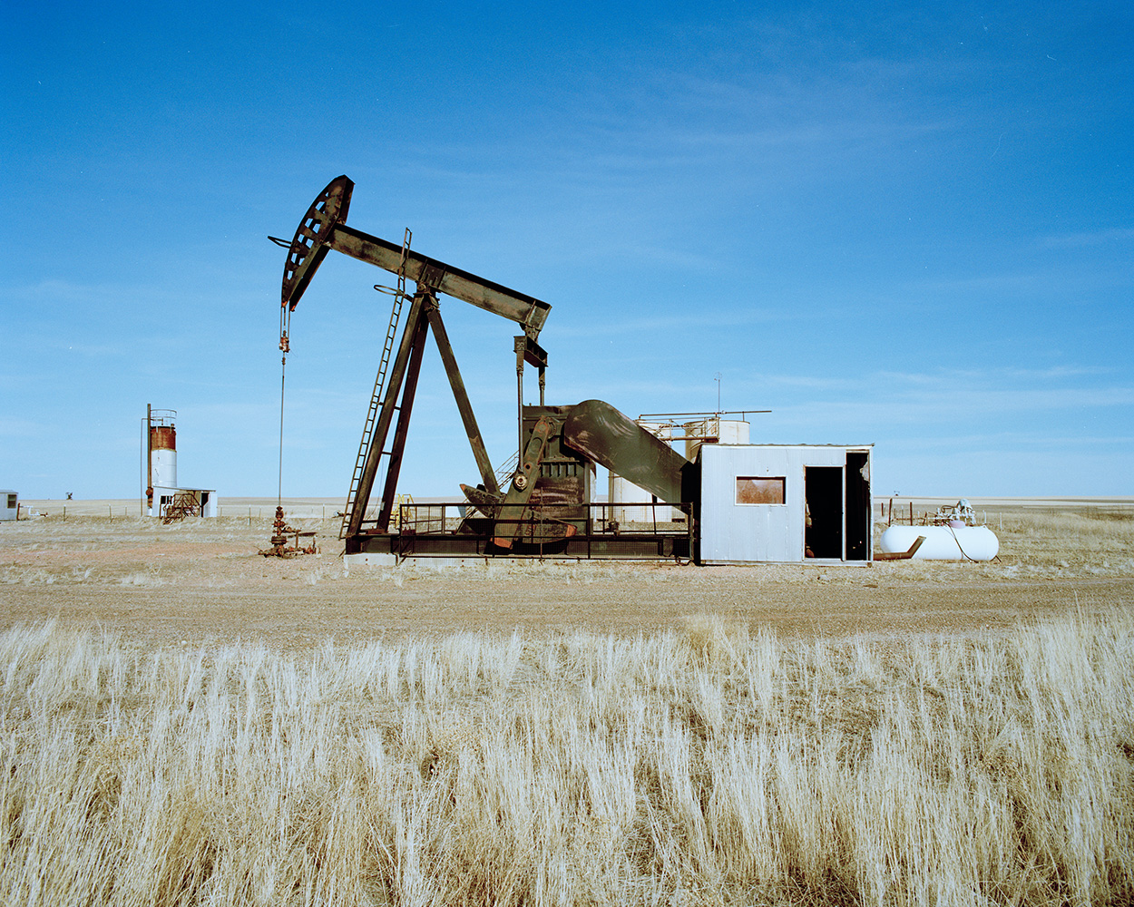
Oil rig in North Dakota takes world oil prices as given

Slide 10
Why Do We Start with the Case of Perfect Competition?
It’s relatively simple
It’s an important reference point for economists (markets work well with perfect competition)
We will study firms with market power later

Slide 11
Market and Individual-Firm Demand Curves
Market
Individual Firm
P
P
S
P₁
δ
D
Q
q
The demand curve facing a perfectly competitive firm is perfectly elastic at the prevailing market price.

Slide 12
III. Short-Run Profit Maximization

Slide 13
The Marginal Revenue Curve of a Perfectly Competitive Firm
mr (in $)
q

Slide 14
The Marginal Revenue Curve of a Perfectly Competitive Firm
mr (in $)
mr
P₁
Marginal revenue for a perfectly competitive firm is constant and equal to the prevailing market price.
q

Slide 15
Marginal Revenue: The Additional Revenue Associated with Producing One More Unit
mr (in $)
P₁
q₁
q₁+1
q
Total revenue at q₁: The rectangle with width q₁ and height P₁.
Total revenue at q₁+1: The rectangle with width q₁+1 and height P₁.
Marginal revenue at q₁: The rectangle with width 1 and height P₁.

Slide 16
Different Types of Costs
Fixed costs: Costs that do not depend on how much is produced: C_{f} (drilling the oil well)
Variable costs: Costs that do vary with how much is produced: C_{v}(q) (pumping quantity q of oil out)
Total costs: The sum of fixed and variable costs: C(q)= C_{f}+C_{v}(q)
Marginal cost: The change in total costs from producing one more unit: mc=C’(q)= C’_{v}(q)
  Note: Since fixed costs do not change when one more unit is produced, marginal cost is also equal to the change in variable costs from producing one more unit.

Slide 17
Marginal Cost: The Additional Cost Associated with Producing One More Unit
mc (in $)
q

Slide 18
Marginal Cost: The Additional Cost Associated with Producing One More Unit
mc (in $)
q
First there are economies of scale in production as it’s less costly (per unit) to produce in bulk

Slide 19
Marginal Cost: The Additional Cost Associated with Producing One More Unit
mc (in $)
q
Second, there are diseconomies of scale in production due to constraints (for example only 1 factory)

Slide 20
Marginal Cost: The Additional Cost Associated with Producing One More Unit
mc (in $)
mc
q
We assume upward mc because competitive model does not work well with declining mc (leads to monopoly)

Slide 21
The Profit-Maximizing Level of Output for a Perfectly Competitive Firm
P
mc
P₁
mr
q₁
q

Slide 22
Marginal profit is marginal revenue minus marginal cost
P
Marginal profit of 1st unit produced and sold
mc
P₁
mr
1
q₁
q

Slide 23
Marginal profit is marginal revenue minus marginal cost
P
Marginal profit of 2nd unit produced and sold
mc
P₁
mr
1 2
q₁
q

Slide 24
Competitive firm produces up to point where mc=mr
P
Total marginal profit of producing q₁
mc
P₁
mr
q₁
q

Slide 25
Mathematical maximization
Consider a smooth function q → L(q)
If L(q) is maximized at q* (interior) then:
L’(q*)=0 (slope is zero at the top of the smooth hill): this is called the FIRST ORDER CONDITION
L’(q) ≥ 0 for q just below q* and L’(q) ≤ 0 for q just below q*: this is the SECOND ORDER CONDITION
First and second order conditions are necessary at interior maximum but not always sufficient

Slide 26
Mathematical maximization
L(q)
L(q)
q*
q

Slide 27
Mathematical maximization
L(q)
L’(q*)=0
L’(q)≥0
L’(q)≤0
L(q)
q*
q
Slope is flat at top of the hill (L’(q*)=0), uphill below q* (L’(q) ≥0) and downhill below q* (L’(q)≤0)

Slide 28
Condition for Profit-Maximization
Marginal Revenue = Marginal Cost (mr = mc)
For a perfectly competitive firm, this is same as:
Price = Marginal Cost (P = mc).
Mathematically: choose q to maximize P×q-C(q)
  where C(q) is total cost of producing quantity q
  Function is maximized when derivative with respect to q is zero (taking P as fixed parameter)
  Implies P-C’(q)=0, which is P=C’(q)=mc

Slide 29
Entry decision of competitive firm:
Compare total marginal profits and fixed costs
P
Total marginal profit of producing q₁
mc
P₁
mr
q₁
q
If green area exceeds the fixed cost of production C_{f} then the firm enters and produces q₁.

Slide 30
Quiz 1:
  Question: Consider an existing oil drill in North Dakota with marginal cost of producing 1 barrel of oil at $50. Suppose, price of oil falls permanently from $80 to $60. What should the business do?
  A. Keep pumping oil out
  B. Keep pumping oil only if this can recoup the fixed cost
  C. Stop pumping oil.
  D. A, B, C could be true, it depends on parameters

Slide 31
Quiz 2:
  Question: Consider an oil drill project in North Dakota with marginal cost of producing 1 barrel of oil at $50. Suppose the price of oil is expected to be $60. Should the project go ahead?
  A. Yes
  B. Yes if fixed costs are small enough
  C. Yes if fixed costs are large enough
  D. No
  E. Either A, B, C, D could be true, it depends.

Slide 32
IV. Why Supply Curves Slope Up

Slide 33
Impact of a Rise in the Market Price
P
mc
P₁
mr₁
q₁
q

Slide 34
Impact of a Rise in the Market Price
P
mc
P₂
mr₂
P₁
mr₁
q₁
q₂
q

Slide 35
A Firm’s Supply Curve
P
s
,mc
P₁
q₁
q
It shows the quantity the firm supplies as a function of price.
It also shows the price it takes to get the firm to supply a given quantity.
Since that price is the firm’s marginal cost at that quantity, this means that the firm’s supply curve is also its marginal cost curve.

Slide 36
Two Ways of Thinking about an Individual Firm’s Supply Curve
The quantity supplied by the firm as a function of the market price (“horizontal” interpretation).
The firm’s marginal cost as a function of the quantity it produces (“vertical” interpretation).

Slide 37
Market and Individual-Firm Supply Curves
Market
Individual Firm
P
P
Q
q

Slide 38
Market and Individual-Firm Supply Curves
Market
Individual Firm
P
P
S (also ∑s)
(also MC)
s (also mc)
Q
q
The market supply curve is also the marginal cost curve for the whole industry.

Slide 39
Two Ways of Thinking about the Market Supply Curve
The horizontal sum of individual firms’ supply curves.
The industry’s marginal cost curve.

Slide 40
The Industry Supply Curve Is the Industry Marginal Cost Curve – Example
Suppose there are 100 firms. Each has MC at 1000 units of $5, MC at 2000 units of $6, etc.
$
$
7
7
6
6
5
5
mc_{i} (also s_{i})
4
4
3
3
2
2
1
1
0
0
200K
Q
q
0
100K
300K
0
1K
2K
3K

Slide 41
The Industry Supply Curve Is the Industry Marginal Cost Curve – Example
Suppose there are 100 firms. Each has marginal cost at 1000 units of $5, marginal cost at 2000 units of $6, etc.
Then the marginal cost of the industry at 100,000 units is $5, at 200,000 units is $6, etc.
$
$
7
7
6
6
5
MC (also S)
5
mc_{i} (also s_{i})
4
4
3
3
2
2
1
1
0
0
200K
Q
q
0
100K
300K
0
1K
2K
3K

Slide 42
V. Why Supply Curves Shift

Slide 43
An Improved Production Technology
Market
Individual Firm
P
P
mc₁
S₁
Q
q

Slide 44
An Improved Production Technology
Market
Individual Firm
P
P
mc₁
S₁
mc₂
S₂
Q
q

Slide 45
An Increase in the Price of an Input
Market
Individual Firm
P
P
S₁
mc₁
Q
q

Slide 46
An Increase in the Price of an Input
Market
Individual Firm
P
P
mc₂
S₂
S₁
mc₁
Q
q

Slide 47
Entry of a Large Number of New Firms
Market
Individual Firm
P
P
S₁
mc₁
Q
q

Slide 48
Entry of a Large Number of New Firms
Market
Individual Firm
P
P
S₁
mc₁
S₂
Q
q

Slide 49
Other Possible Reasons the Market Supply Curve Could Shift
Taxes.
Government regulations.
Would a change in the price of the good shift the supply curve?
No—it would cause a movement along the supply curve.
Try to think of more possibilities!

Slide 50
Quiz:
  Question: Suppose the world price of oil increases due to developments outside the US (e.g. oil embargo on Russia). How does this shift the supply curve of US produced oil?
  A. The supply curve goes up
  B. The supply curve does not change
  C. The supply curve goes down
  D. Either A, B, C could be true, it depends.

Slide 51
The Effects of Profit maximization in the Long Run

Slide 52
Average Total Cost
Costs are measured as opportunity costs.
Fixed costs: Costs that do not vary with how much is produced.
Variable costs: Costs that do vary with how much is produced.
Total cost: The sum of fixed and variable costs.
Average Total Cost =
Mathematically: cost of producing q is C(q). Marginal cost is C’(q). Average cost is C(q)/q.
Total Cost
Quantity

Slide 53
Marginal Cost and Average Total Cost
Cost (in $)
q

Slide 54
Marginal Cost and Average Total Cost
Cost (in $)
mc
q

Slide 55
Marginal Cost and Average Total Cost
Cost (in $)
mc
atc
q
Average Total Cost is high with low q because of fixed costs:
atc=C(q)/q=C_{f}/q+C_{v}(q)/q

Slide 56
Marginal Cost and Average Total Cost
Cost (in $)
mc
atc
q
If atc>mc then atc decreases with q
If atc<mc then atc increases with q
=> The mc and atc curves cross at the lowest point of the atc curve

Slide 57
Marginal Cost and Average Total Cost
Cost (in $)
mc
atc
Mathematically:
C(q)/q minimized when
C’(q)/q-C(q)/q²=0 =>
C’(q)=C(q)/q => mc=atc
q
If atc>mc then atc decreases with q
If atc<mc then atc increases with q
=> The mc and atc curves cross at the lowest point of the atc curve

Slide 58
Average Total Cost (atc), Price, and Profits
Recall:
Profits = Total Revenue – Total Cost
Now:
Total Revenue = P × q
Total Cost = atc × q
So: Profits = (P × q) − (atc × q)
= (P − atc) × q
So: Profits are positive, negative, or zero depending on whether P − atc is positive, negative, or zero.

Slide 59
Revenues, Costs, and Profits
P
atc
mc
P₁
•
mr
atc₁
•
q₁
q

Slide 60
Revenues, Costs, and Profits
P
atc
mc
P₁
mr
atc₁
Revenues = P₁ × q₁
q₁
q

Slide 61
Revenues, Costs, and Profits
P
atc
mc
P₁
mr
atc₁
Costs = atc₁ × q₁
q₁
q

Slide 62
Revenues, Costs, and Profits
P
atc
mc
P₁
mr
atc₁
Profits= (P₁ –atc₁) × q₁
q₁
q

Slide 63
The Signals Sent by Profits
If there are positive profits to be made: New firms will enter.
If there are negative profits: Firms making negative profits will exit.
If there are zero profits: There are no forces tending to cause either contraction or expansion of the industry.

Slide 64
Long-Run Industry Supply Curve when all firms in industry are identical
Suppose firms are all identical (replicable industry)
Example: manufacturing of a standard product with given technology and inputs
In the long-run, supply is such that:
  Zero profit for all firms (otherwise entry or exit)
  P=mc=atc for all firms
  Supply curve is perfectly elastic (horizontal line)

Slide 65
The Long-Run Industry Supply Curve
When All Firms Are Identical
Market
Individual Firm
P
P
mc
atc
Q
q₁
q

Slide 66
The Long-Run Industry Supply Curve
When All Firms Are Identical
Market
Individual Firm
P
P
mc
atc
S_{LR}
P_{LR}
Q
q₁
q
The long-run industry supply curve is perfectly elastic at the minimum of atc if all firms are identical

Slide 67
Long-Run Industry Supply Curve when firms differ in productivity
Suppose some firms are more productive than others
Example: oil production with better/worse wells
In the long-run, supply is such that:
  All producing firms produce up to P=mc
  Least productive firm (marginal firm) makes zero profits
  Other firms make positive profits
  Supply curve is upward sloping (more firms enter when P higher)

Slide 68
Quiz:
  Question: Consider a competitive industry where firms have different fixed costs but they all have the same marginal costs of production. In the equilibrium:
  A. All firms make zero profits
  B. Only the marginal firm make zero profits
  C. All firms make positive profits
  D. Either A, B, C could be true, it depends.

Slide 69
The Invisible Hand
In a market economy, profits provide signals that move resources across industries to where they are most valued.
These movements occur without any centralized planning or direction.
A corollary: In a well-functioning market economy, there are always some industries that are expanding and some that are contracting.
This helps explain economists generally dislike barriers to entry

Slide 70
Summing it all up
A profit-maximizing firm produces up to p = mc
Comparing p to atc tells whether profits are positive, zero, or negative
If firms are making positive profits, entry of new firms drives price down and so drives profits down
If firms are making negative profit, exit of firms drives price up and so drives profit up
In the long-run, profit is zero for the marginal firm: p = atc = mc (profit zero for all firms if all identical)

Slide 71
References
CORE-The Economy, Unit 7.
Principles of Economics, Chapter 5.

