Slide 1
Lecture 1
Introduction to Economics
Economics 2 Emmanuel Saez
Fall 2024

Slide 2
A Few Introductions
Professor Emmanuel Saez
  My research is on inequality and public policy
  I have taught PUBLIC ECONOMICS upper division class
  Second year I am teaching INTRO ECONOMICS
Sections with GSIs start on Tuesday September 2

Slide 3
I. Course Logistics

Slide 4
External Course Website:
https://eml.berkeley.edu/~saez/econ2/econ2.html
For lecture slides and assignments
B-Course Website:
https://bcourses.berkeley.edu/courses/1538268
For lecture recordings

Slide 5
Teaching
The lectures are essential, count for 8% of grade
Strict policy: no laptops, earphones, phones (except for quizzes). Only tablets flat on desk. GSIs at the back monitor policy.
Lectures will be recorded and posted on Bcourse
Slides will be posted by 3pm on the day of lecture.
Section is also incredibly valuable
Office hours and additional tutoring available
Feel free to ask questions during and after class

Slide 6
Enrollment
Enrollment is handled through the CalCentral waiting list.
There is typically space for everybody on the waiting list due to dropouts
Other questions, go to: https://www.econ.berkeley.edu/undergrad/home/enrollment-procedures

Slide 7
Recommended Readings
Textbook 1: Frank, Bernanke, Antonovics, and Heffetz, Principles of Economics, 8th edition.
    Cheap paperback, digital rental at amazon
    Traditional econ textbook
Textbook 2: CORE-The Economy 2.0
    Free at www.core-econ.org/the-economy/
    Political economy broader view
Journal articles:
    Available through links on the slides.

Slide 8
Graded Assignments
Attendance and participation in lectures: (8% of grade): .5 point per lecture, need 16 lectures out of 24 to get the full 8%. No excuses except long-term (3 weeks+) medical absence.
FOUR Problem Sets: (20% of grade)
Two Midterms at class time: (42% of grade)
Wed, October 9, 5:10-6:30pm Wed, November 13, 5:10-6:30pm
Final exam: (30% of grade) Fr, Dec 20, 3pm-5pm
No alternative times for midterms and final

Slide 9
Grade Distribution (from last year)
  A+ = top 10%, A = next 12.5%, A- = next 12.5%
  B+ = next 15%, B = next 20%, B- = next 10%
  C+ = next 5%, C = next 5%
  C- = next 5% [below major requirement]
  D, F = bottom 5% [non passing grade] typically happen when exams and psets are missing with no valid excuse
Avoid bottom 10% to meet major requirement: C or better
Avoid bottom 5% to get passing grade: C- or better

Slide 10
I-clicker quizzes
Lectures will have quizzes using iClicker cloud free for students, make sure you register (enrollment then synced with B-course)
Quizzes are to test your understanding, or poll the class. Participation is part of the attendance grade.
FIRST QUIZ: Do you want to be (or are you) an econ major?
A. Yes
B. No
C. I don’t know yet

Slide 11
II. General Introduction

Slide 12
Asking the Classroom:
What is the most pressing problem that economists should address?
Type in your answer in one or just a few words in i-clicker

Slide 13
Key Economic Features
Humans work in “firms” to produce goods and services that are sold on markets. Workers and firms’ owners share proceeds.
  National income splits 75% for workers, 25% for owners
People are both producers and consumers.
Constant improvement in production processes → secular economic growth but with hiccups
Enormous inequality both across countries and within countries

Slide 14
Economic Growth
Economic growth takes off during 19th century Industrialization (first in Britain, then Europe/US, now China, India) and never stops. How?
A number of countries (mostly in Africa) remain low income. How can they catch-up?
Economic take-off has created sustainability issues, most important is carbon emissions and climate change. How can this be fixed?
Even rich countries experience temporary painful recessions. How can this be addressed?

Slide 15
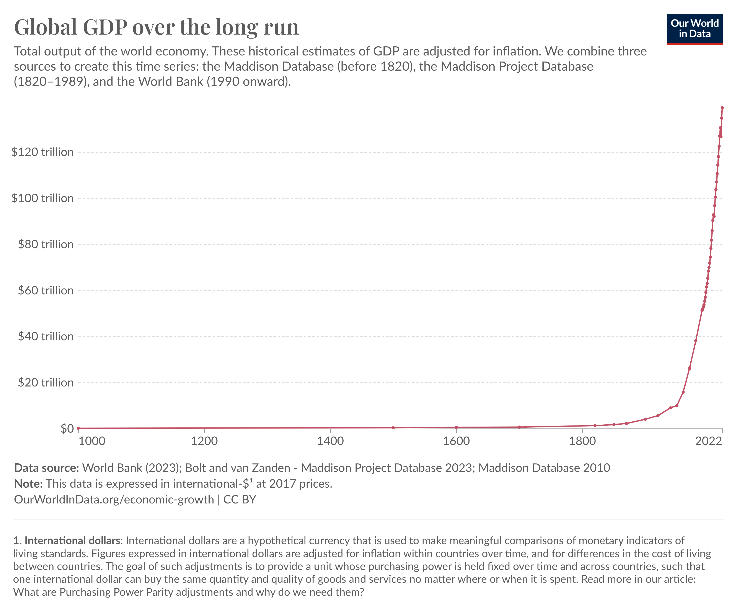

Slide 16


Slide 17
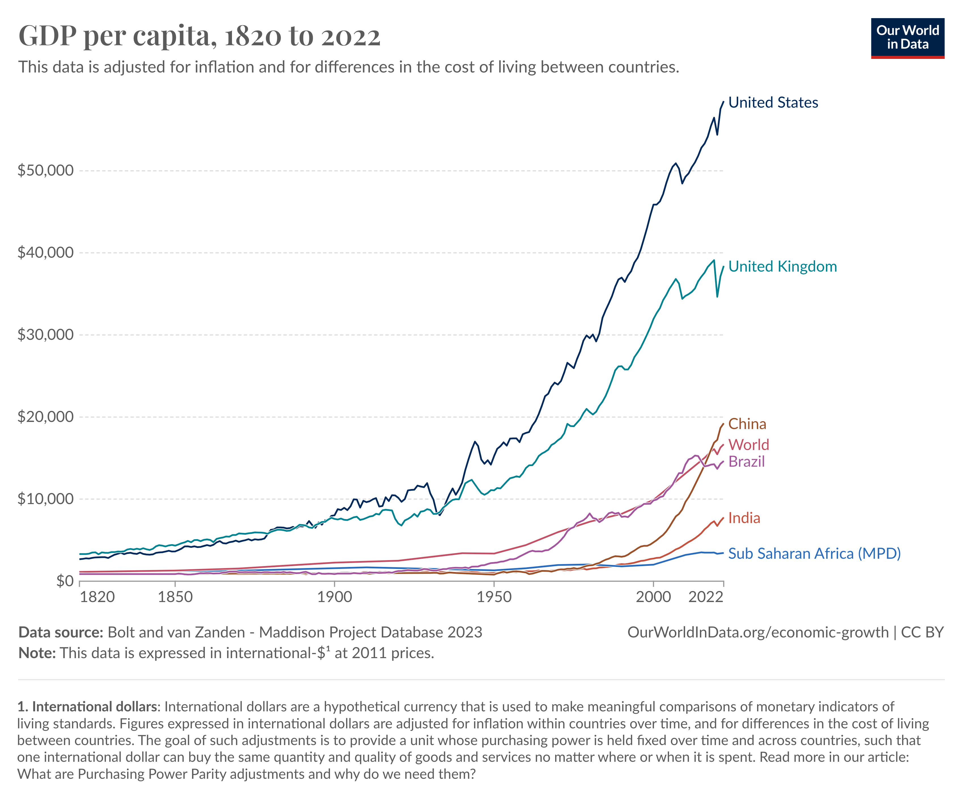

Slide 18
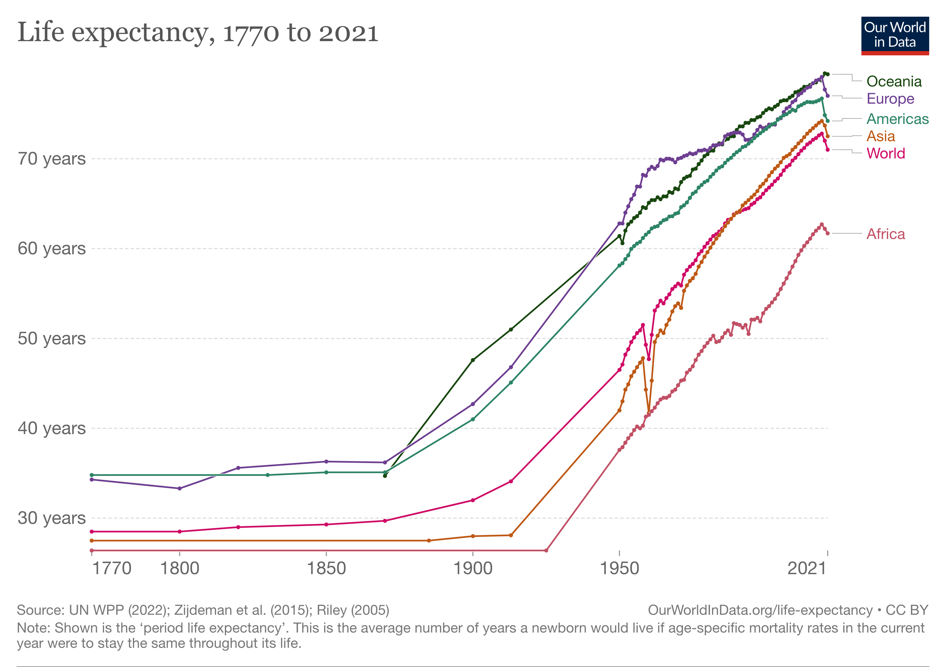

Slide 19
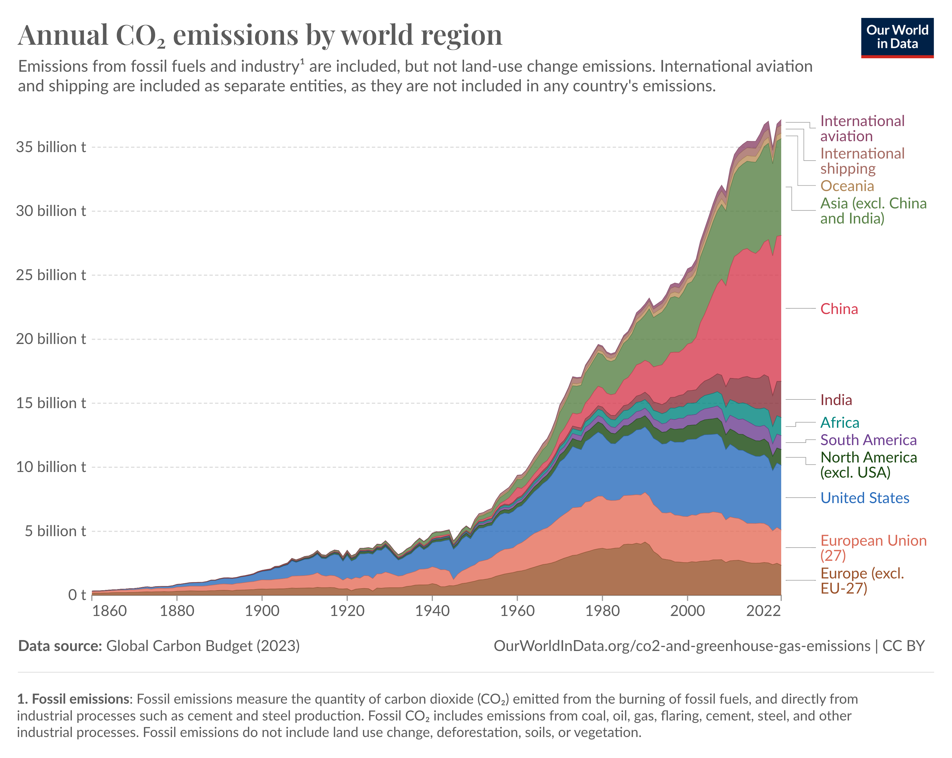

Slide 20
Our Social Nature and Inequality
Humans both selfish and social. Traditional economics models humans as selfish but social aspect matters a lot:
Why we care about inequality? Joint work and production (since prehistory) creates distribution problem.
Humans have developed a keen sense of fairness
  Left view: share equally don’t let the powerful take too much
  Right view: obey the boss, sharing equally rewards the lazy
In modern economies: we measure inequality looking at income (what people earn in 1 year) and wealth (the sum value of what a person owns)

Slide 21
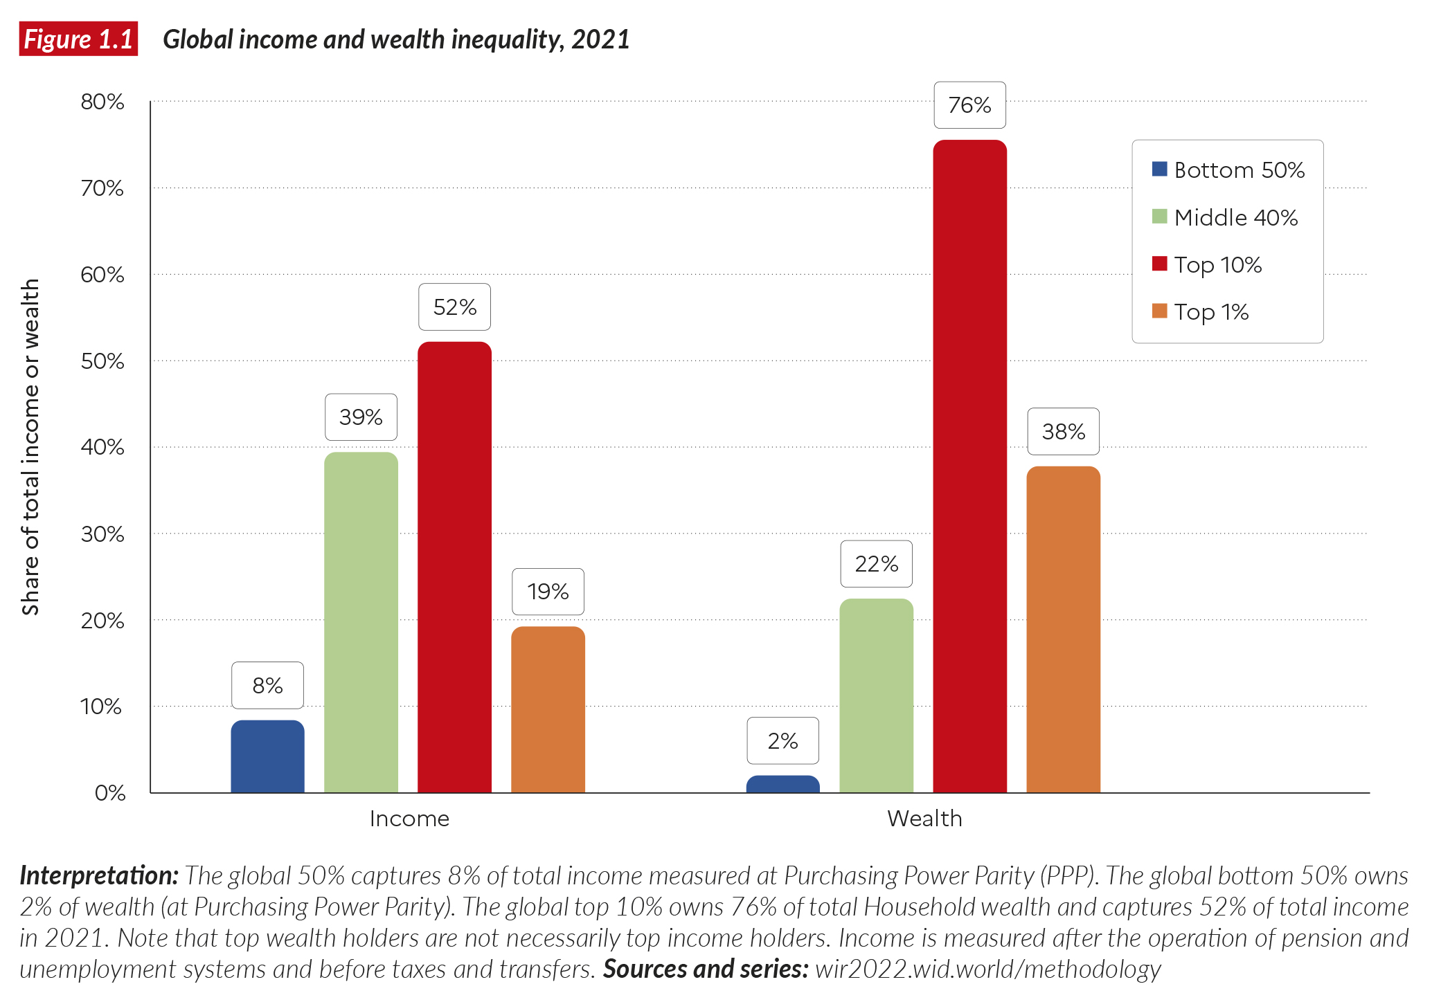

Slide 22
Income Inequality in the US has surged since 1980

Slide 23
Quiz:
  Question: Is wealth more equally distributed than income among people worldwide?
  A. Wealth is more equally distributed than income
  B. Wealth and income are equally distributed
  C. Wealth is less equally distributed than income
  D. Economists haven’t figured it out yet

Slide 24
II. Capitalism

Slide 25
Capitalism: Private Property, Firms & Markets
Private property = something is private property if the person possessing it has the right to exclude others from it, to benefit from the use of it, and to trade it with others.
Markets = a way that people exchange goods and services by means of directly reciprocated transfers (buying and selling, not gifts), voluntarily entered into for mutual benefit (unlike theft, taxation), that is often impersonal (unlike transfers among friends, family)
Firms = Economic organizations where private owners of capital (buildings, equipment) hire and direct labor to produce goods and services for sale on markets to make a profit.

Slide 26
The Capitalist Revolution
Capitalism led to growth in living standards because of:
Impact on technology: firms competing in markets had strong incentives to adopt and develop new technologies
Specialization: the growth of firms and the expansion of markets linking the entire world allowed historically unprecedented specialization in tasks and production
Developing countries’ successful growth generally jumpstarted by cheap mass production of specific goods exported to richer countries.

Slide 27
Political systems
A political system determines how governments will be selected, and how those governments will make and implement decisions.
Capitalism coexists with various political systems:
- Democracies: free elections (1 person=1 vote), free political parties and press, individual rights
- Authoritarian regimes
In advanced economies, mix of capitalism and socialism:
- 30-50% of pre-tax incomes are “socialized” through taxes to provide:
- public goods (infrastructure, police, defense, etc.)
- social state (education for kids, health for the sick, pensions for the old, income support for the poor)

Slide 29
III. Overview of the Course

Slide 30
Microeconomics
Study of economic behavior at the level of economic “agents”: this is the micro-level
How individual consumers and producers make decisions; what happens in the market for particular goods
Microeconomics shows why markets work well under traditional assumptions.
We will include much discussion of market failures

Slide 31
Macroeconomics
Study of the behavior of the economy as a whole.
What determines the behavior of overall employment, total output, and prices?
Microeconomics does not scale up well at macro level, hence the need for a different approach (Keynes revolution in the 1930s-1940s)
Government policy has a profound impact on the macroeconomy.

Slide 32
Two Key Features of Economic Analysis
Theory: Start with assumptions and derive implications. Uses mathematics/diagrams.
Empirical Evidence: Are the implications and predictions of the theory verified in real-world data? Uses data and statistics.
In Econ 2 we will discuss both theory and evidence.
Goal is to show accessible outstanding recent empirical research testing model predictions.

Slide 33
Positive vs. Normative Economic Analysis
Positive economics: What is? Example: what would happen if you tax the rich more?
Normative economics: What ought to be? Example: how much should we tax the rich?
Positive economics is a 1st step to address normative economics.
But normative economics requires to make value judgements. Example: Is it fair to take from the rich to help the poor?

Slide 34
References
CORE-The Economy 2.0, micro, Unit 1.
Ourworldindata, economic growth
World Inequality Report, 2022
Piketty, Thomas 2022, A Brief History of Equality. Harvard University Press.
Saez, Emmanuel and Gabriel Zucman. 2019. The Triumph of Injustice, Norton.

