Slide 1
Lecture 10
Labor and Wages
Economics 2 Emmanuel Saez
Fall 2024

Slide 2
I. Overview

Slide 3
The Market for Inputs to Production
Labor (workers) and capital (machines, buildings)
Demand for labor comes from profit maximization of firms
Supply of labor comes from utility maximization of workers
Helps us to understand important economic issues and developments
We start with competitive model of the labor market and discuss its (many) limitations later

Slide 4
Market for Labor
Wage
(W)
S
W*
D
L*
Employment (L)

Slide 5
We can talk about the labor market at different levels:
Market for labor for a particular occupation or industry (plumbers, software engineers, construction workers) in particular geographical area
Market for workers with particular demographic characteristics (teenagers, prime age workers, single parents)
Market for workers with particular skills (high-skilled and low-skilled, as valued by the market).

Slide 6
Why is the market for labor important?
Wages and employment are fundamental to peoples’ lives and happiness
About ¾ of national income goes to workers (remaining ¼ goes to capital owners)
Labor market analysis can help us to understand how developments will affect wages and employment
It can also help explain rising inequality

Slide 7
II. Labor Demand

Slide 8
Labor Demand Comes from Profit Maximization
What factors affect a firm’s demand for labor?
    Demand for the product it produces
    Productivity of labor
    The wage and other labor costs
Profits are maximized where MR = MC
For labor: Firms want to hire labor up to the point where the extra revenue generated by another worker is just equal to the extra cost.

Slide 9
Marginal Revenue Product of Labor (mrp_{L})
The extra revenue generated by one more worker.
It is composed of two pieces:
    Marginal product of labor (mp_{L}): The extra output produced by one more worker.
    Marginal revenue (mr): The extra revenue from selling one more unit.
    mrp_{L} = mp_{L} • mr
For competitive firms: mr = P => mrp_{L} = mp_{L} • P.

Slide 10
mrp_{L} Declines as L Increases
Recall: mrp_{L} = mp_{L} • mr.
mp_{L} declines because of diminishing returns
  extra workers in the firm become less useful without scaling capital as well
mr is either constant (for a competitive firm) or declining (for an imperfectly competitive firm).
So mrp_{L} is declining.

Slide 11
mrp_{L} for a Particular Firm
mrp_{L}
mrp_{L}
labor
An employer gets diminishing value of employing workers as adding
extra workers brings less and less mrp_{L}

Slide 12
Profit Maximization Implies:
In competitive labor market model: each individual firm takes W as given
Firms want to hire labor up to the point where: mrp_{L} = W.
For a given wage level, a firm wants to hire whatever quantity of labor has a mrp_{L} equal to that wage.
Market level demand for labor: horizontal sum of all the individual firms demand for labor

Slide 13
Labor demand for the firm in competitive labor market where wage W is given
mrp_{L}
W
mrp_{L}
L
labor
For a given wage W, employer hires labor L up to the point where marginal worker has mrp_{L} equal to W

Slide 14
Firm surplus from hiring workers and labor cost
mrp_{L}
Firm’s Surplus
W
Labor Cost
mrp_{L}
L
labor
Employer surplus is red triangle below mrp_{L} and above wage line W
Labor cost paid out to workers is the green rectangle W×L.

Slide 15
Labor Demand Curves
Individual Firm
Market
W
W
l
L

Slide 16
Labor Demand Curves
Individual Firm
Market
W
W
mrp_{L},d
MRP_{L},D
l
L

Slide 17
Quiz:
  Question: Why is the demand for labor declining with the wage?
  A. Because workers prefer higher wages
  B. Because extra workers become less and less useful for each firm
  C. Because we are considering the competitive case.
  D. Because consumers’ always have demand curves declining with prices
  E. All of the above

Slide 18
Quiz:
  Question: A given firm hires L (identical) workers all paid the same wage W. Which one below is true?
  A. Each worker gets paid its marginal contribution to revenue of the firm
  B. The firm gets more from its workers that what it pays them
  C. All workers (but one) get paid less than their contribution to the revenue of the firm
  D. All of A, B, C are true
  E. None of A, B, C are true

Slide 19
III. Labor Supply and Equilibrium in the Labor Market

Slide 20
  Poll on labor supply
  Poll: Suppose you have a paying job at UC Berkeley (e.g., library attendant or work study) 10 hours/week to help support yourself. Suppose the wage goes up from current $20/hour up to $25/hour. How would this affect your hours of work choice?
  I would want to work longer hours.
  I would want to work the same
  I would want to work shorter hours.

Slide 21
Labor supply behavior comes from utility maximization on the part of households
Households not only like goods and services, they like leisure (=time not working in the market for pay) to sleep and rest, family, chores, study (if student), plus all other true leisure activities
The mu_{Leisure} declines as the quantity of leisure increases.
  P_{Leisure} is the wage: getting 1 hour extra of leisure means cutting work by 1 hour and losing 1 hour of wage.
  Think of a household choosing between leisure and everything else.

Slide 22
Condition for Utility Maximization
  mu_{Leisure} mu_{Goods and Services}
  P_{Leisure} P_{Goods and Services}
=

Slide 23
  Effect of an Increase in the Wage = P_{Leisure}
  mu_{Leisure} mu_{Goods and Services}
  P_{Leisure} P _{Goods and} _{Services}
  Substitution Effect: When the wage rises, the consumer wants to substitute away from leisure (so work more).
  Income Effect: When the wage rises, the consumer is richer and wants more leisure (so work less) and goods
  Unlike consumer goods where income and substitution go in the same direction, here the effects go in opposite directions
  Which effect dominates is an empirical matter (see poll).
<

Slide 24
Labor Supply Curves
Individual Household
Market
W
W
l
L

Slide 25
Labor Supply Curves
Individual Household
Market
W
W
s
S
l
L
We assume here that labor supply l increases with W but empirically, it could also
decrease especially when W becomes very high. Market labor supply L is the
horizontal sum of all individual labor supply curves.

Slide 26
Labor Supply in Competitive labor market
where W is taken as given
W
S
W
L
L
At wage W, L individuals are willing to work. Last worker opportunity cost of work is exactly equal to W

Slide 27
Labor Supply in Aggregate
W
S
W
Workers’ Surplus
L
L
Workers’ surplus is green triangle above supply curve and below wage line W.

Slide 28
Equilibrium in the Competitive Labor Market
W
S
W*
D
L*
L

Slide 29
Equilibrium in the Competitive Labor Market
W
Employers’ Surplus
S
W*
Workers’ Surplus
D
L*
L
The competitive equilibrium (W*,L*) is efficient:
it maximizes the sum of employers and workers’ surpluses

Slide 30
Non-Competitive Aspects of Labor Market
Competitive labor market is pretty far from reality
In practice, wage is often set through a power struggle between employers and employees
Employer side power: monopsony (analog of monopoly but on the buyers’ side) where employer can set the wage
Employee side power: union can organize workers and set wages that employers have to pay (monopoly on the selling of labor)
  Example: University of California grad student workers strike in 2022 (organized by Union UAW)

Slide 31

University of California grad student workers
UC grad student workers (48,000 workers) is an example where there is both monopsony power and union power. Students struck successfully in Fall 2022

Slide 32
Monopsony power
Monopsony formal definition: only 1 employer hires workers on the labor market
Classical example: only one landlord that local crop workers can work for => landlord sets the wage
Monopsony firm chooses wage W that maximizes its surplus (=profits) taking into account that the supply of workers increases with W
Monopsony concept invented by Joan Robinson in the 1930s, earliest famous female economist
Real world has some monopsony power (concentrated industries, costly to switch firms, non-compete clauses)

Slide 33
Monopsony: employer chooses W to maximize its surplus subject to L=S(W)
W
Monopsony Surplus
S
W*
Deadweight loss
W
Workers’ Surplus
D
L
L*
L
Monopsony chooses W to maximize red area. It squeezes workers’ surplus (inequitable) and creates deadweight loss (inefficient)

Slide 34
Monopsony consequences
Monopsony firm sets the wage W too low: Inequitable (as employers typically richer than workers) and Inefficient (workers cut down labor supply below L*)
Monopsony is very damaging when workers have no other outside options (no other employers, and need the wage to live as in landlord example)
In practice, most firms have only some monopsony power as workers have other job options: each firm faces a pretty elastic labor supply curve (infinitely so in competitive case)
In monopsony situation, increasing the wage through a minimum wage legislation increases employment and reduces deadweight loss

Slide 35
Monopsony: Introducing a minimum wage above W is desirable both for equity and efficiency
W
Monopsony Surplus
S
W*
Deadweight loss
W_{min}
W
Workers’ Surplus
D
L
L*
L
L₂
Minimum wage above W increases workers surplus (equitable),
reduces monopsony surplus and also increases L (efficient)

Slide 36
Effect of a Minimum Wage in Competitive Labor Market
W
S
W_{min}
W*
D
L*
L

Slide 37
Effect of a Minimum Wage in Competitive Labor Market
W
S
W_{min}
W*
D
Unemployment L_{S}-L_{D}
L_{D}
L*
L_{S}
L
In competitive labor market, minimum wage above W* increases workers’ surplus
and decreases producers’ surplus (equitable) but creates unemployment (inefficient)

Slide 38
Quiz:
  Question: What is true about the minimum wage in the models we saw?
  A. It’s a form of price control that always creates inefficiency in competitive markets
  B. It can actually increase efficiency
  C. It’s good for workers’ surplus
  D. It’s bad for producers’ surplus
  E. All of A, B, C, D.

Slide 39
Minimum wage
Most countries have minimum wages
  Pro: increases pay of low skill workers
  Cons: concern that it might increase unemployment
US has very low Federal min wage of $7.25/hour (used to be much higher relative to average pay)
States, Cities can have higher min wages: CA has $16/hour. Berkeley $18.7/hour (close to highest in US)
Empirical evidence: minimum wage has small or no effects on employment: min wage reduces turnover of employees and firms pass on extra cost to their consumers

Slide 40
US Federal Min Wage has not kept up

Slide 41
Minimum wage and employment evidence
Card and Krueger (1994): in April 1992 New Jersey (NJ) raised minimum wage from $4.25 to $5.05 but Pennsylvania’s (PA) was unchanged at $4.25.
Compare effect on fast food restaurants in NJ and eastern PA by surveying 400 restaurants before and after the NJ min wage increase. Difference-in-difference estimate.
Find that rise in min wage increased employment in NJ fast-food restaurants (relative to PA). Supports the monopsony model and invalidates the competitive model.
Generated a lot of controversy. Huge literature since then has largely found that minimum wage has generally not much impact on employment

Slide 42
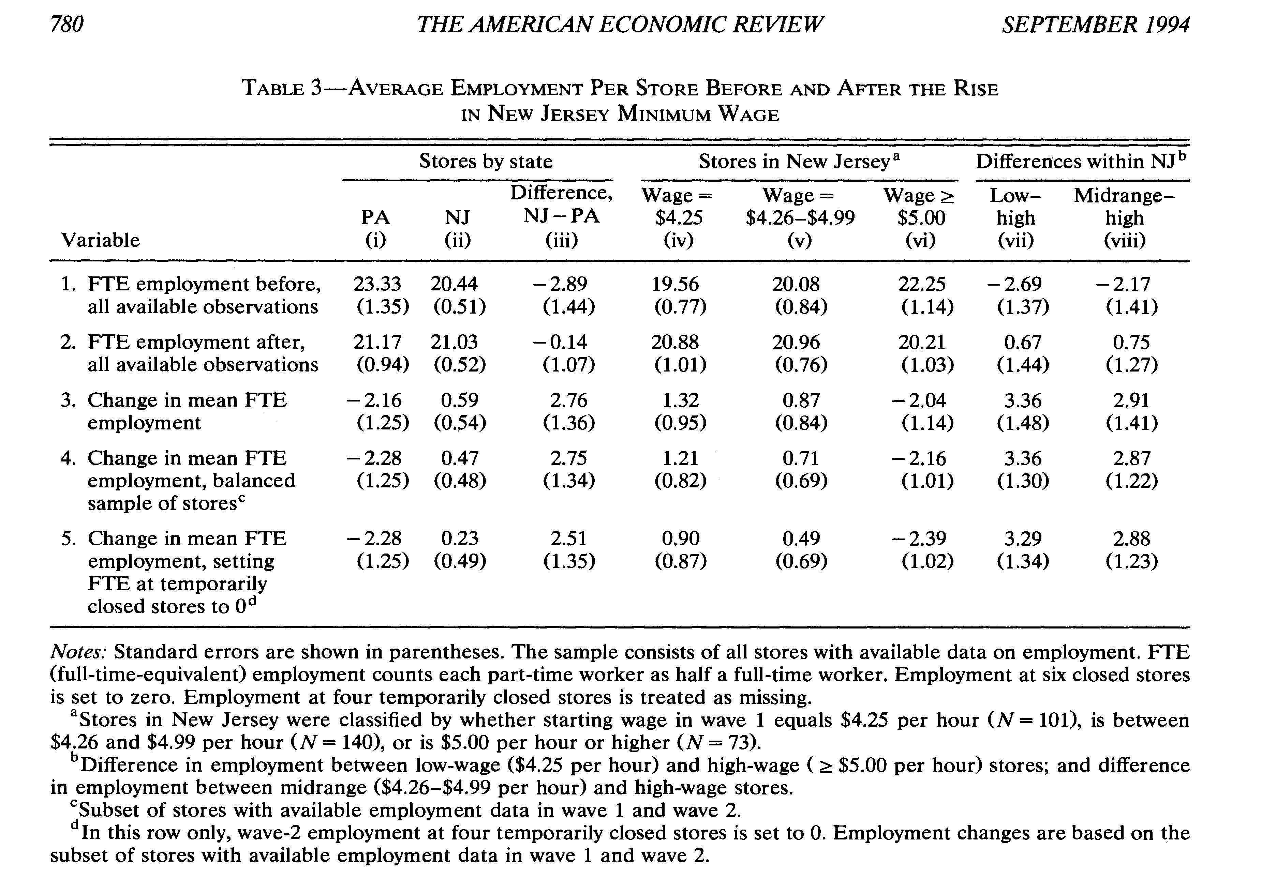
Card and Krueger (1994): in April 1992 New Jersey (NJ) raised minimum wage from $4.25 to $5.05 but Pennsylvania’s (PA) was unchanged at $4.25. # workers/fastfood increased slightly in NJ and decreased in PA: consistent with monopsony

Slide 43
  Vote on minimum wage increase
  California Proposition 32 in November 2024 elections: Increases CA minimum wage by $2 (from $16 to $18 in 2025) and indexes it to cost-of-living after. Do you support this?
  Yes, I want all workers to have living wages.
  Yes, it prevents employers from exploiting their workers
  No, it hurts the profits of employers.
  No, it interferes with the working of the free market
  I don’t care because Berkeley has a higher min wage

Slide 44
Equilibrium in the Competitive Labor Market
Wage
(W)
S
W*
D
L*
Employment (L)

Slide 45
Producer surplus
Wage
(W)
S
Employers’ Surplus
W*
D
L*
Employment (L)
Employers get surplus (profits) from employing workers at wage W because all but the last worker have a mrp_{L} above W.

Slide 46
Producer and Employer Surplus
W
Employers’ Surplus
S
W*
Workers’ Surplus
D
L*
L
The competitive equilibrium (W*,L*) is efficient:
it maximizes the sum of employers and workers’ surpluses

Slide 47
Union power
Union: workers organize as a single agent through a union. Employers can only hire workers through the union
Union chooses wage W that maximizes surplus of workers taking into account that labor demand decreases with W. Conceptually, union is a monopoly that sells labor to firms.
Union power depends a lot on legislation (how easy it is to unionize, funding of unions). In US, union power rose during the 1930s (New Deal) and has declined a lot since 1980 (Reagan). Less decline in Europe.
Firms typically dislike unions because they force them to take into account workers’ welfare instead of only profits

Slide 48
Union monopoly chooses W to maximize workers’ surplus subject to L=D(W)
W
Employers’ Surplus
S
W
W*
Deadweight loss
Workers’ Surplus
D
L
L*
L
Union squeezes employers’ surplus (equitable) and
creates deadweight loss (inefficient)

Slide 49
  Poll on Unions
  Poll: What best fits your views on Unions?
  I dislike Unions because they interfere with the working of the free market and create deadweight loss
  I dislike Unions because they hurt the profits of employers
  I like Unions because they help workers get better pay
  I like Unions because they prevent employers from exploiting their workers

Slide 50
Firms’ vs. workers’ power in the labor market
Real world has both monopsony power on the employer side and union power on the workers’ side
If wages are high and profits are low then workers have more power than firms.
If wages are low and profits are high then firms likely have more power than workers.
Unbalanced power always leads to too little employment (as workers can’t be forced to work, and employers can’t be forced to hire)
Empirically, unions reduce inequality. Not much effect on macro employment but reduce long hours per worker

Slide 51
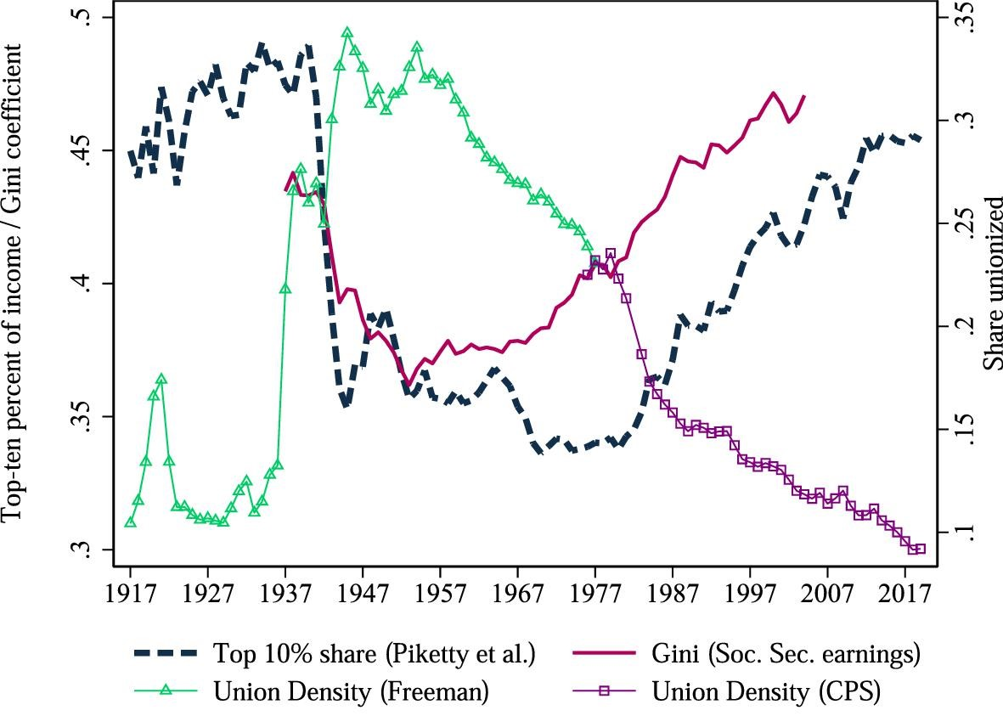

Figure I Union Density and Inequality Measures, 1917–2019
Top-share individual income inequality is from Piketty, ...
Notes:
Figure I Union Density and Inequality Measures, 1917–2019
Top-share individual income inequality is from Piketty, Saez, and Zucman (2018). Union density is the number of unionized workers as a share of the nonagricultural workforce from Historical Statistics of the United States, together with individual union density as a share of employed civilian workers ages 16 to 65 from the Current Population Survey. We discuss these data sources in detail in Section II.B and Online Appendix E.
Unless provided in the caption above, the following copyright applies to the content of this slide: © The Author(s) 2021. Published by Oxford University Press on behalf of the President and Fellows of Harvard College.This article is published and distributed under the terms of the Oxford University Press, Standard Journals Publication Model (https://academic.oup.com/journals/pages/open_access/funder_policies/chorus/standard_publication_model)

Slide 52
IV. Social Determinants of Labor Market

Slide 53
Social determinants of labor supply
Early industrialization: long-hours and low pay. Pay eventually catches up with productivity.
Hours of work regulated by union agreements, then overtime and vacation mandates
Youth labor is regulated by labor laws/education mandates
Old age labor regulated by retirement programs
Female market labor driven by norms + child care policy

Slide 54
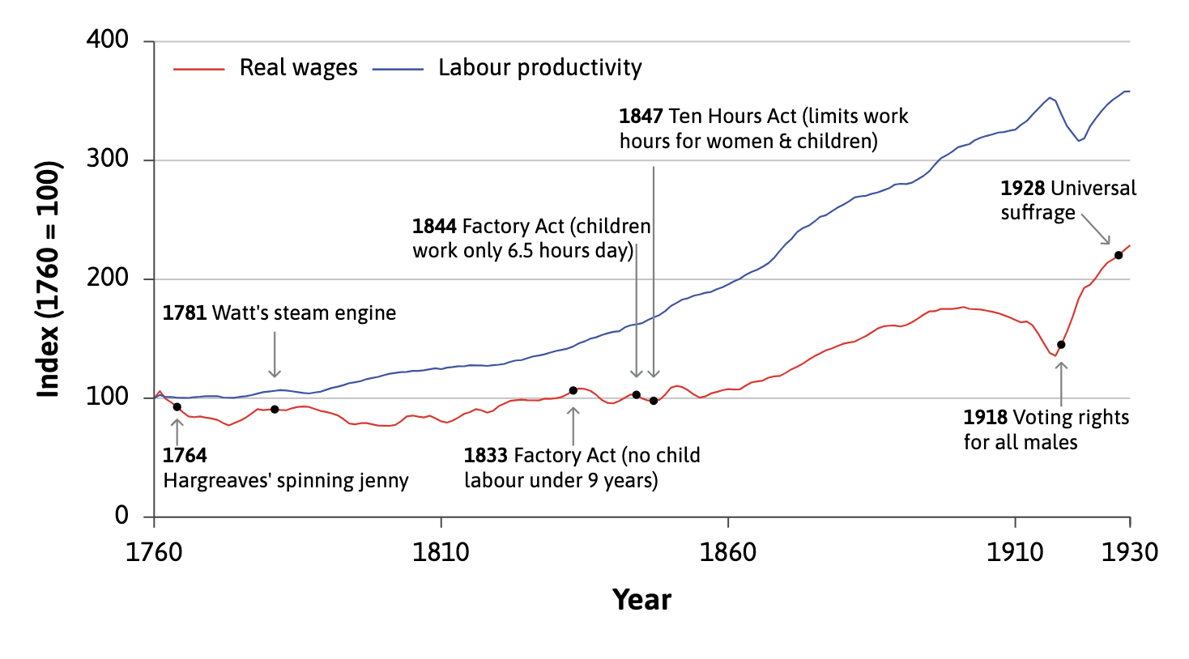
British Industrialization: Real wage vs. Production per worker
Source is Allen (2001). Wages lag behind productivity for 50 years in first industrialization

Slide 55
From subsistence work to industrialization:
Supply curve of workers for industry
W
Supply S
W_{s}
L_{T}
L
W_{s} is subsistence wage in agricultural sector. Supply curve is flat at W_{s} up to L_{T} (no subsistence workers left)

Slide 56
Industrialization and Wages:
Labor Demand in Industrial Sector Appears
W
Employers’ Surplus
S
D
W*=W_{s}
•
L*
L_{T}
L
Industry can get workers by paying subsistence wage W_{s}

Slide 57
Industrialization and Wages:
Industry becomes more productive and grows
W
Employers’ Surplus
S
D
W*
W*=W_{s}
•
L_{T}
L
L*
As long as L* ≤ L_{T,} industry can get workers by paying subsistence
wage W_{s}

Slide 58
Industrialization and Wages:
Labor Demand in Industrial Sector Expands
W
Employers’ Surplus
S
W*
•
Workers’ Surplus
W_{s}
D
L*=L_{T}
L
Wage goes above W_{s} only after there are no subsistence workers left

Slide 59
Quiz:
  Question: Why are workers failing to get any gain from industrialization early on in the model?
  A. Because industrialists are exploiting them
  B. Because the new industry is competitive
  C. Because there are subsistence workers in agriculture
  D. All of the above
  E. None of the above

Slide 60
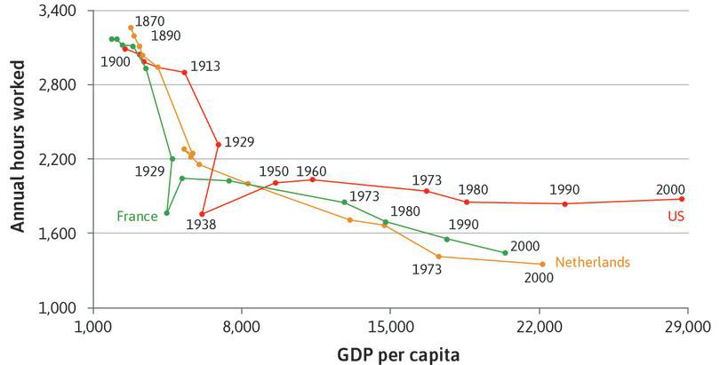
Decline of hours of work in the long-run: 40h/week=2000h/year

Slide 65
Quiz:
  Question: With economic development, who do you think humans should work less to enjoy more leisure or harder to take advantage of their increased productivity?
  A. We should work less
  B. We should work the same
  C. We should work more

Slide 66
V. Examples of Labor Market Analysis

Slide 67
Example 1: Increase in Machines or Technological Progress
Consider the market for high-skilled workers.
Computer technology spread rapidly across many industries in the late 1980s and 1990s.
What would you expect this to do to the employment and wages of high-skilled workers whose jobs use computers (such as architects, engineers, and scientists)?

Slide 68
Example 1: Increase in Machines or Technological Progress (continued)
The addition of machines or technological progress (or, often, both together) will increase the MP_{L}.
This implies that the labor demand curve shifts out.
Wages and employment of workers using the machines will rise.

Slide 69
Effect of an Increase in Capital (Computers)
Market for High-Skilled Workers
W
S₁
W₁
D₁
L₁
L

Slide 70
Effect of an Increase in Capital (Computers)
Market for High-Skilled Workers
W
S₁
W₂
W₁
D₂
D₁
L₁
L₂
L

Slide 71
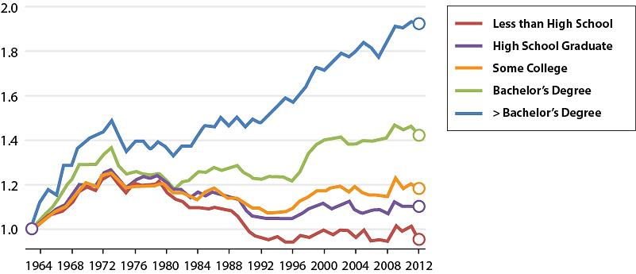
Real Wages of Full-Time Male Workers by Educational Level
Source: David Autor, “Skills, Education, and the Rise of Earnings Inequality among the “Other 99 Percent”.

Slide 72
Example 2: Increased Immigration of Low-Skilled Workers
Suppose that immigration of low-skilled workers increases.
What would you expect this to do to the wages and employment of low-skilled workers?

Slide 73
Effect of Increased Immigration of Low-Skilled Workers
Market for Low-Skilled Workers
W
S₁
W₁
D₁
L₁
L

Slide 74
Effect of Increased Immigration of Low-Skilled Workers
Market for Low-Skilled Workers
W
S₁
S₂
W₁
W₂
D₁
L₁
L₂
L

Slide 75
Empirical Evidence on the Impact of Immigration
Problems with previous studies:
    Many looked at wages and the number of immigrants by city.
    But, perhaps there were both labor demand and labor supply changes.
    Sometimes immigrants came to a city because labor demand was expanding, and sometimes for family or political reasons
    Possible to find no correlation between immigration and wages, even if the supply effects were as theory predicts.

Slide 76
Empirical Evidence on the Impact of Immigration
David Card paper uses a natural experiment:
    Mariel Boatlift (May-September 1980).
    125,000 Cubans migrated to the U.S.
    Almost all went to Miami.
    No issue of immigrants choosing to go where the labor market was expanding.
    Excellent data on wages and employment before and after the influx of immigrants.

Slide 77
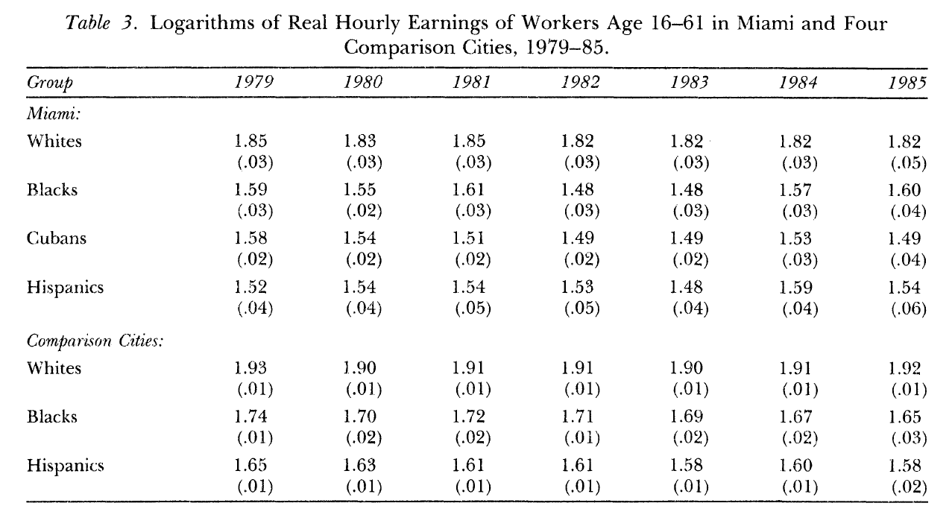
Card Paper on the Effects of the Mariel Boatlift
Bottom line: Huge influx of Cubans in 1980 did not affect wages of other groups
Source: David Card, “The Impact of the Mariel Boatlift on the Miami Labor Market”

Slide 78
Card’s Explanation for Why Wages Didn’t Fall
Some migration to Miami that otherwise would have occurred didn’t because of the boatlift.
Labor demand may have been quite elastic.
    Miami had a number of industries that used low-skilled workers and could expand easily.

Slide 79
Effect of Increased Immigration of Low-Skilled Workers
Market for Low-Skilled Workers
W
S₁
S₂
W₁
W₂
D₁
L₁
L₂
L
If labor demand is very elastic, a shift out in labor supply would reduce wages only slightly.

Slide 80
References
CORE-The Economy, Unit 6.
Principles of Economics, Chapters 13 and 20.
Allen, Robert C. 2001. ‘The Great Divergence in European Wages and Prices from the Middle Ages to the First World War’. Explorations in Economic History 38 (4): pp. 411–447.
Card, David. "The impact of the Mariel boatlift on the Miami labor market." Ilr Review 43, no. 2 (1990): 245-257.
Card, David, and Alan B. Krueger. "Minimum wages and employment: A case study of the fast food industry in New Jersey and Pennsylvania." (1994).
Farber, Henry S., Daniel Herbst, Ilyana Kuziemko, and Suresh Naidu. "Unions and inequality over the twentieth century: New evidence from survey data." Quarterly Journal of Economics 136, no. 3 (2021): 1325-1385.
Saez, Emmanuel “Public Economics and Inequality: Uncovering Our Social Nature", AEA Papers and Proceedings, 121, 2021

