Slide 1
Lecture 15
Long-run Economic Growth
Economics 2 Emmanuel Saez
Fall 2024

Slide 2
I. Output and Long-Run Growth

Slide 3
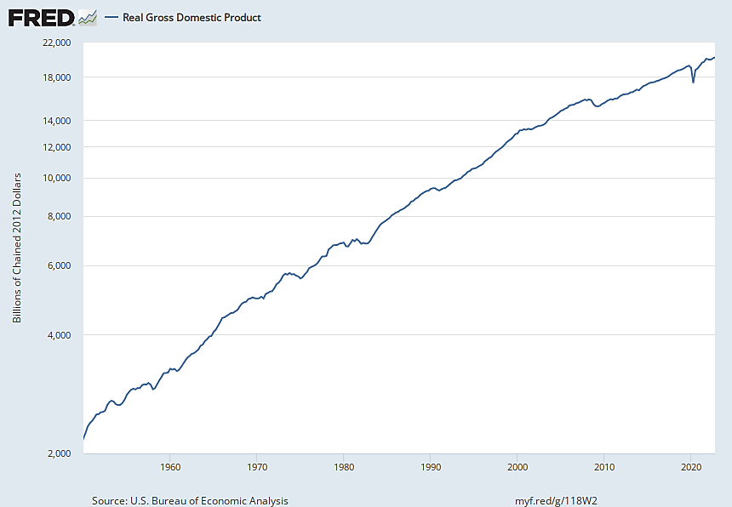
Real GDP in the U.S., 1950–2022
Source: FRED (Federal Reserve Economic Data); data from Bureau of Economic Analysis.
Notes:
As discussed last time, 2 key features:
General upward trajectory over the long run.
Fluctuations.
= the 2 key subjects of macroeconomics.
Today is 1st of 3 lectures on long-run trend.
Where we’re headed:
Potential Output and Long-Run Economic Growth
Explaining the Variation in the Level of Y*/POP across Countries / Explaining the Growth in Y*/POP over Time: N*/POP, K*/N*, T
Dig into the “T” piece

Slide 4
The Critical Importance of Potential Output to Long-Run Outcomes
In the short run (in recessions and booms), the economy’s use of its available resources can be above or below normal; this is central to short-run fluctuations.
In the long run, output is determined by the economy’s available productive resources.
We call the amount of output the economy produces when using its resources at normal rates “potential output” (or “normal output”), denoted Y*.
Notes:
[Go thru slide. I covered the substance of this last time, but not with this slide.]
[2:17]

Slide 5
History of Economic Growth
Before 19th century, agriculture is the main economic activity, almost no growth in GDP per capita, mostly population growth
Industrialization starts first in the United Kingdom in 19th century and then spreads to Europe and Western offshoots
In 20th century, most other regions develop (with some exceptions mostly in sub-Saharan Africa)
In 21st century, still enormous disparities in GDP per capita across countries
Notes:
I want to show you that last point in the context of an example.
Suppose: …
Then: [next slide]

Slide 6
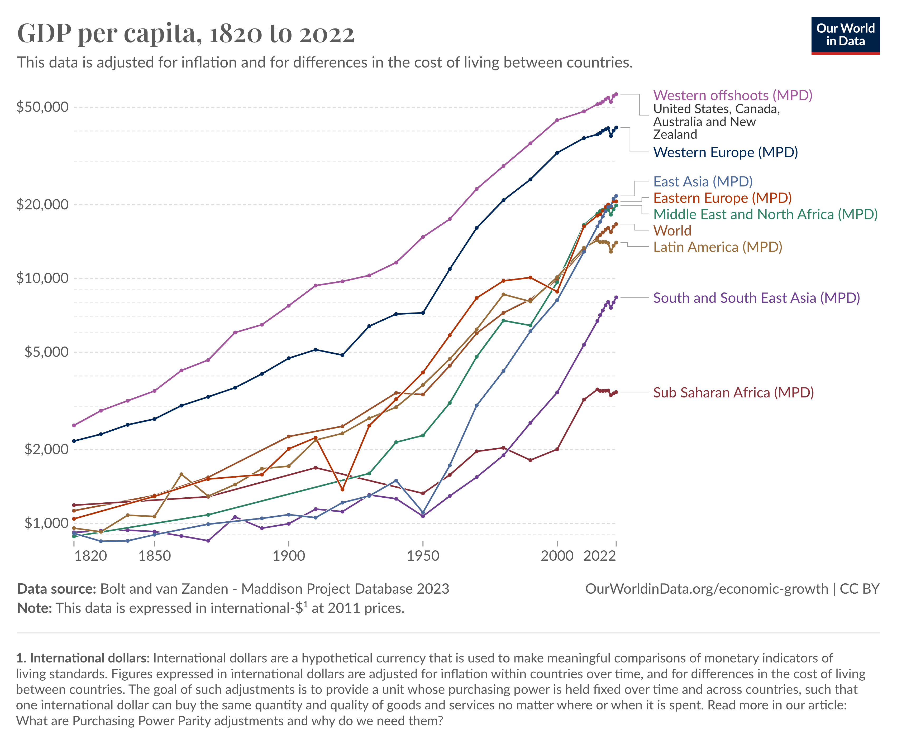
Notes:
Growth over time (and differences in growth).
Resulting differences in levels [click for highlighting]
[2:25]

Slide 7
Issues Relating to Potential Output (GDP)
The level of potential output per person.
    This is an indicator of standards of living.
    It differs enormously across countries.
    What are the reasons for this variation?
The growth rate of potential output per person over time.
    In many (but not all) countries, it has grown enormously over time.
    Over time, small differences in normal growth can have large impacts on standards of living.
Notes:
Importantly, we’ll talk about both the level and the growth rate of potential output.
(Again, it’s potential Y that determines Y in long-run.)
First bullet and subbullets: By subbullets:
Why the level is important (and, it’s an indicator, not a perfect measure)
E.g., U.S. =~ $40K/person; poorest countries in Africa =~ $1K/person.
Our key question.
Second bullet and subbullets:
1st sub: E.g., U.S. =~ 12x over past 150 years.
2nd: We saw this at the end of last lecture.
Our key question: Why not everywhere? Why so much variation.
To show you the variation: -> NEXT SLIDE.

Slide 8
The Long-Run Consequences of Small Differences in Growth Rates
Suppose countries A and B start with the same real income per person.
But annual growth in real income per person is 1 percentage point higher in A than in B (for example, 1% vs. 0%, or 2% vs. 1%).
For example, Argentina GDP per capita about the same as Western Europe in early 20th century
Notes:
I want to show you that last point in the context of an example.
Suppose: …
Then: [next slide]

Slide 9
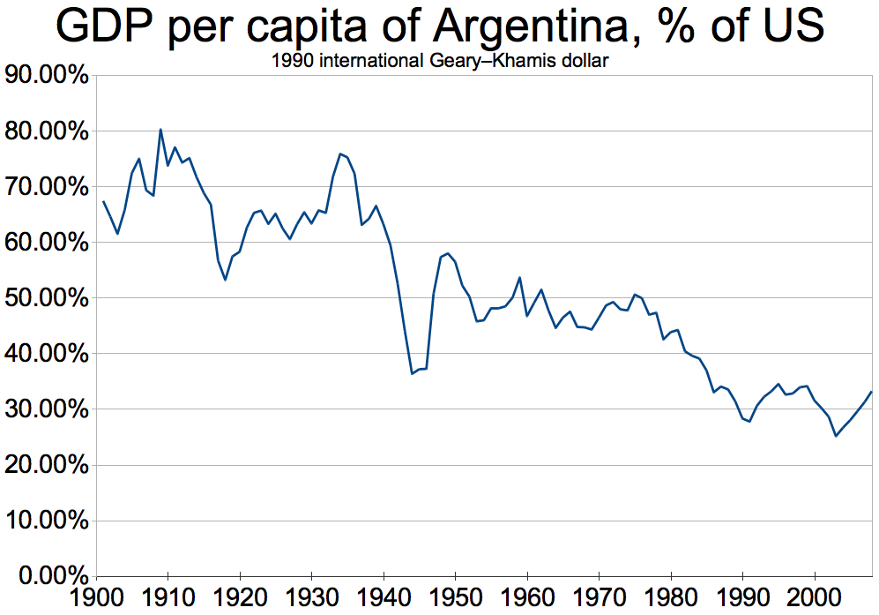
Argentina was a rich country in 1900 but lost ground relative to advanced economies
over the next 120 years.

Slide 10
Suppose country A grows 1% faster than country B each year
After 1 year:
After 2 years:
After 70 years:
After 2 centuries:
It is 1% higher.
It is slightly more than 2% higher
(1.01•1.01 = 1.0201. So it is 2.01% higher.)
It is twice as high (1.01⁷⁰ ≈ 2).
It is more than 7 times higher
(1.01²⁰⁰ ≈ 7.3).

Slide 11
Quiz
China’s real GDP/capita has been growing faster than the United States since 1980: about 8% vs. 2% growth per year. If this continues what will happen in the long-run?
A. China’s GDP/capita will catch up to the US GDP/capita
B. China’s GDP/capita will surpass the US GDP/capita
C. China’s GDP/capita will eventually be more than 10 times higher than the US GDP/capita
D. All of the above
E. None of the above. The US will stay ahead of China

Slide 12
Historical Context:
Malthusian Pre-Industrial Stagnation

Slide 13
Malthusian Trap in Agricultural Economies
10K+ years ago: Hunters/gatherers live in an ecological subsistence equilibrium (population density depends on resources just like other species)
10K years ago: Humans invent agriculture: much higher food production allows for population growth
But with fixed land, additional workers become less and less productive
  Productivity gains are swallowed by population growth
  Malthus (1798): impossible to increase standards of living in the long-run
Notes:
I want to show you that last point in the context of an example.
Suppose: …
Then: [next slide]

Slide 14
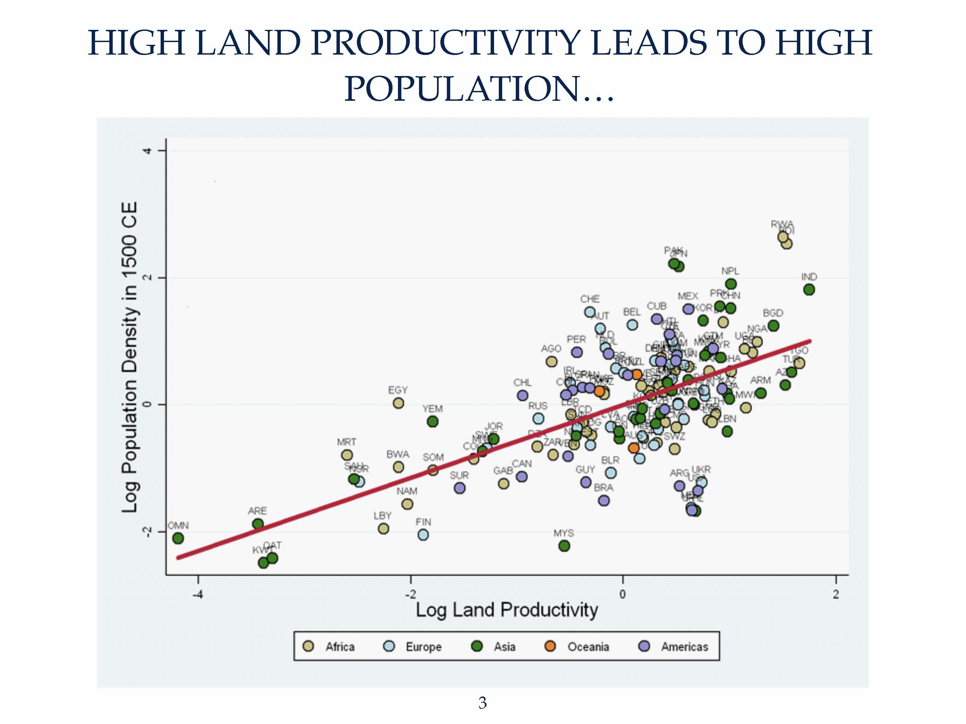
Source: Ashraf and Galor (2011)

Slide 15
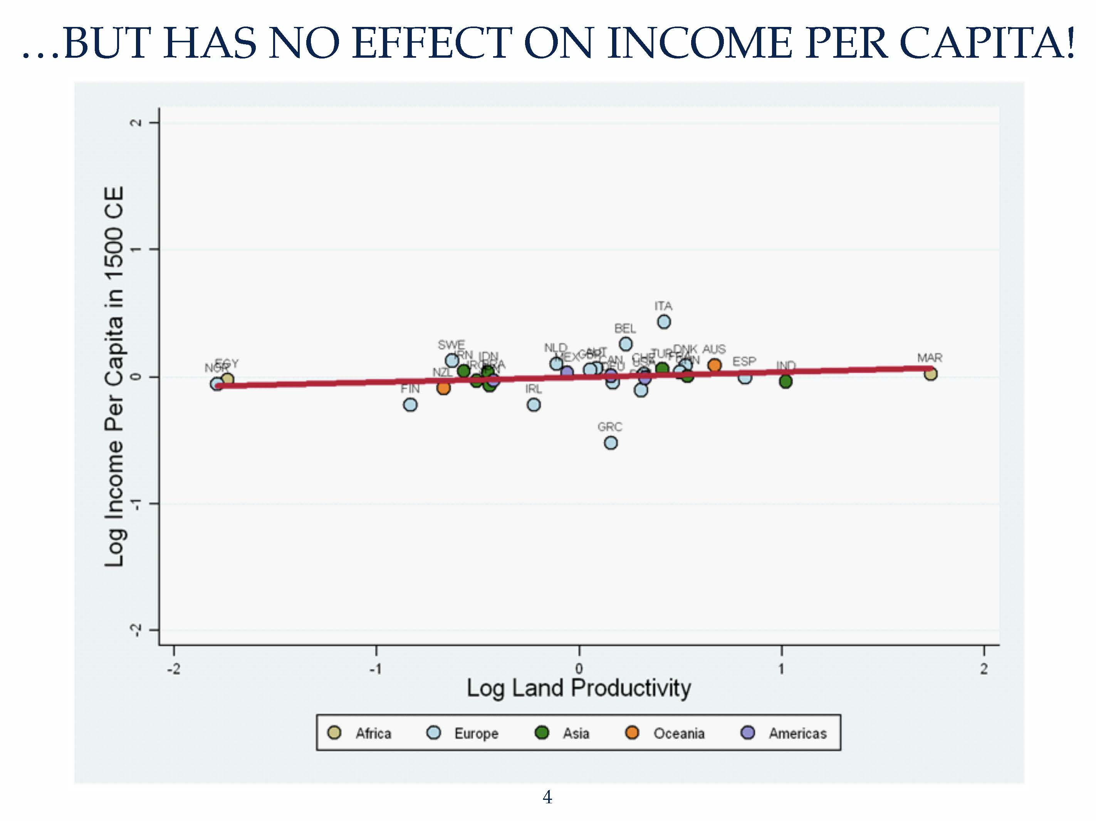
Source: Ashraf and Galor (2011)

Slide 16
Source: Clark (2005)

Slide 17
Real Wages of Laborers in England 1250-1450
Source: Clark (2010)
Notes:
Bring back Ld/Ls IV diagram!
What’s a good IV to plot Ld line???

Slide 18
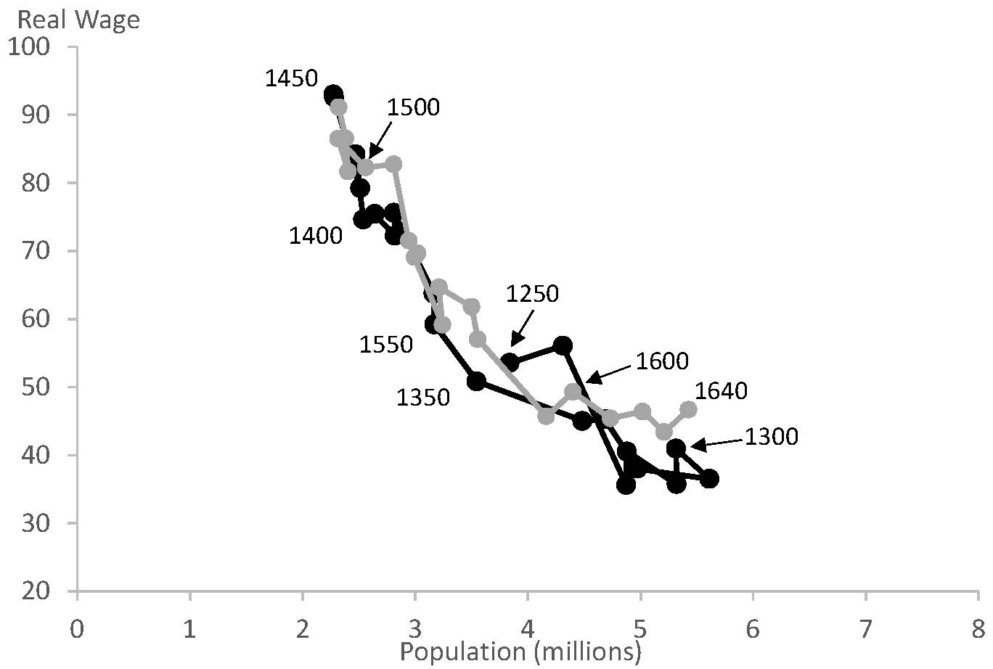
Real Wages of Laborers in England 1250-1640
Source: Clark (2010)

Slide 19
Quiz
Are these movements depicting a stable demand curve for labor in England from 1250 to 1640?
A. Yes: with lower wages, landlords are willing to hire more labor to work the land
B. Yes: there wasn’t much technological progress so the demand curve didn’t shift
C. Yes: only the supply curve of workers shifts in and out
D. All of the above
E. No: it’s about people dying when wages are too low and families growing when wages are better

Slide 20
Real Wages of Laborers in England 1290-1860

Slide 21
Quiz
Both population and wage increase in England after 1800. Why?
A. Industrialization generates fast growth
B. The demand curve for labor shifts out as workers are more productive
C. The supply of workers increases as better wages allow the population to grow
D. All of the above

Slide 22
Industrialization
Agriculture: production is done with workers and fixed land
Industry: production is done with workers and capital but capital (machines, factories) is not fixed and can expand
Sustained growth becomes possible: population growth no longer reduces productivity.
Productivity gains after 1800 large enough to beat (slow) population growth
Demographic transition in 20th century: higher incomes no longer associated with more children (family planning, women’s empowerment)

Slide 23
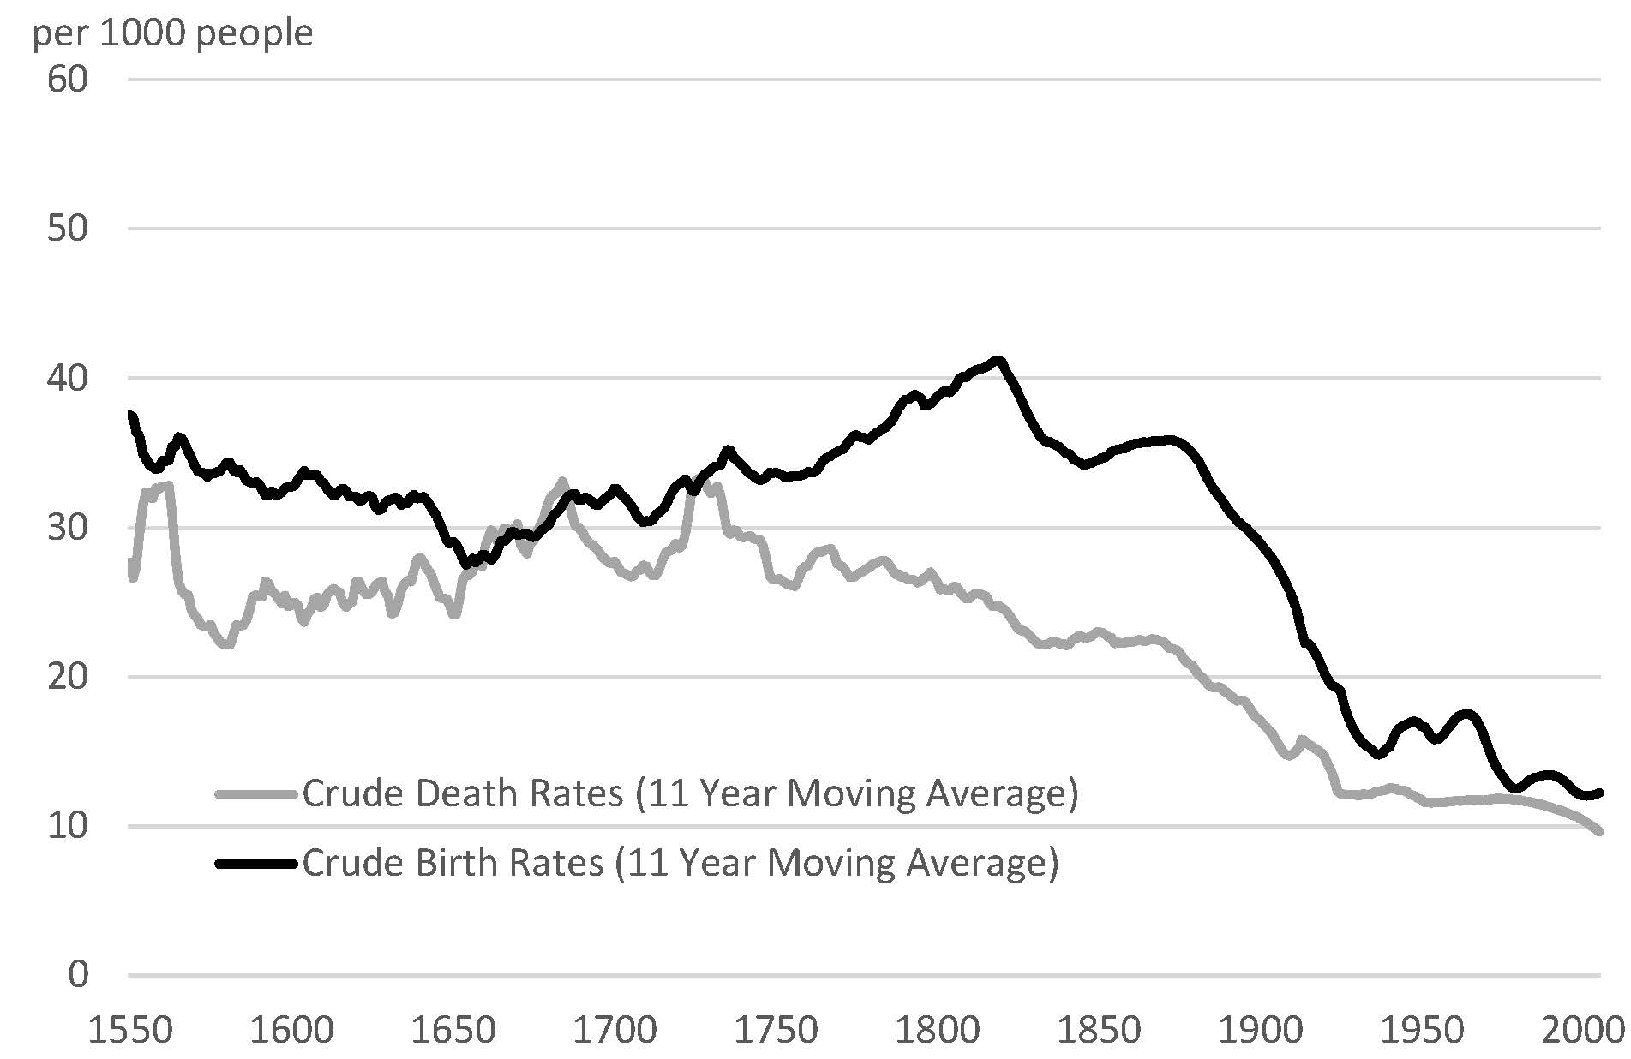
Demographic Transition in England

Slide 24
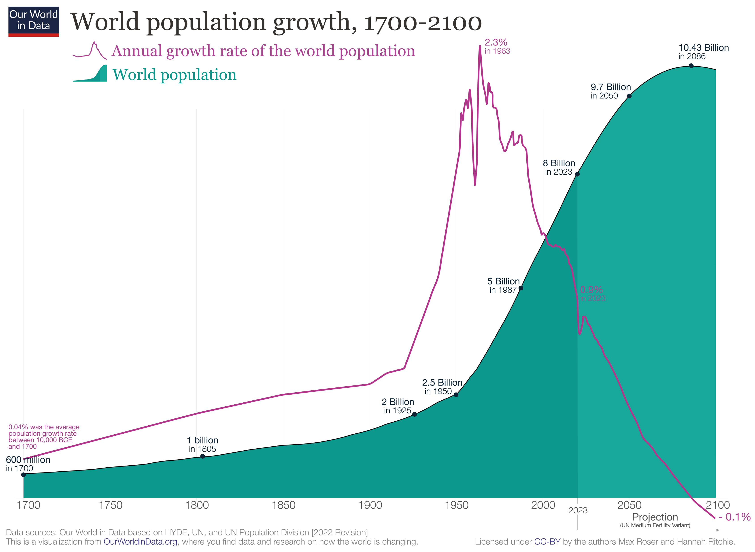


Slide 25
III. Modern Economies

Slide 26
Aggregate Production Function Framework
The Three Key Determinants of Potential Output:
Labor
Capital
Technology
Notes:
Want to remind you of our framework for thinking about potential output per person.
[After putting up whole slide]
We interpret both K and T broadly. [ASK them to remind]
Plan: Tech today, Labor Th., Capital week from today.

Slide 27



Decomposition of Potential Output per Person
where:
    Y* is potential output;
    POP is population;
    N* is normal employment.
    is the normal employment-to-population ratio.
    is normal average labor productivity.
Notes:
[Walk thru slowly]
First step

Slide 28



Determinants of Average Labor Productivity
    is normal capital per worker.
    T is technology.
    Production per worker is an increasing function of capital per worker and technology

Slide 29


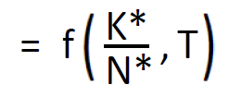
Aggregate Production Function
(1)
(2)
(3)
•
Notes:
[Slow]
Putting together.

Slide 30
Capital
Aids to the production process that were created in the past.
Components of Capital:
    Conventional physical capital (machines, buildings, computers).
    Infrastructure (roads, telecommunications systems, dams) is also part of physical capital.
    Human capital (education, job training)

Slide 31
Technology
The methods for producing output (goods and services).
More broadly: Everything that affects how much output per worker we produce using a given amount of capital per worker.
Components of Technology:
    Production techniques
    Management techniques
    Economic institutions
    Local culture

Slide 32
IV. Explaining the Variation in the Level of Potential Output per Person across Countries

Slide 33
Contribution of the Employment-to-Population Ratio
It can certainly matter, but its effects are inherently limited.
It doesn’t vary that much across countries.
Main differences due to age structure, gender norms:
  Elderly people work less (especially in richer countries)
  Young people work less (due to education surge)
•

Slide 34
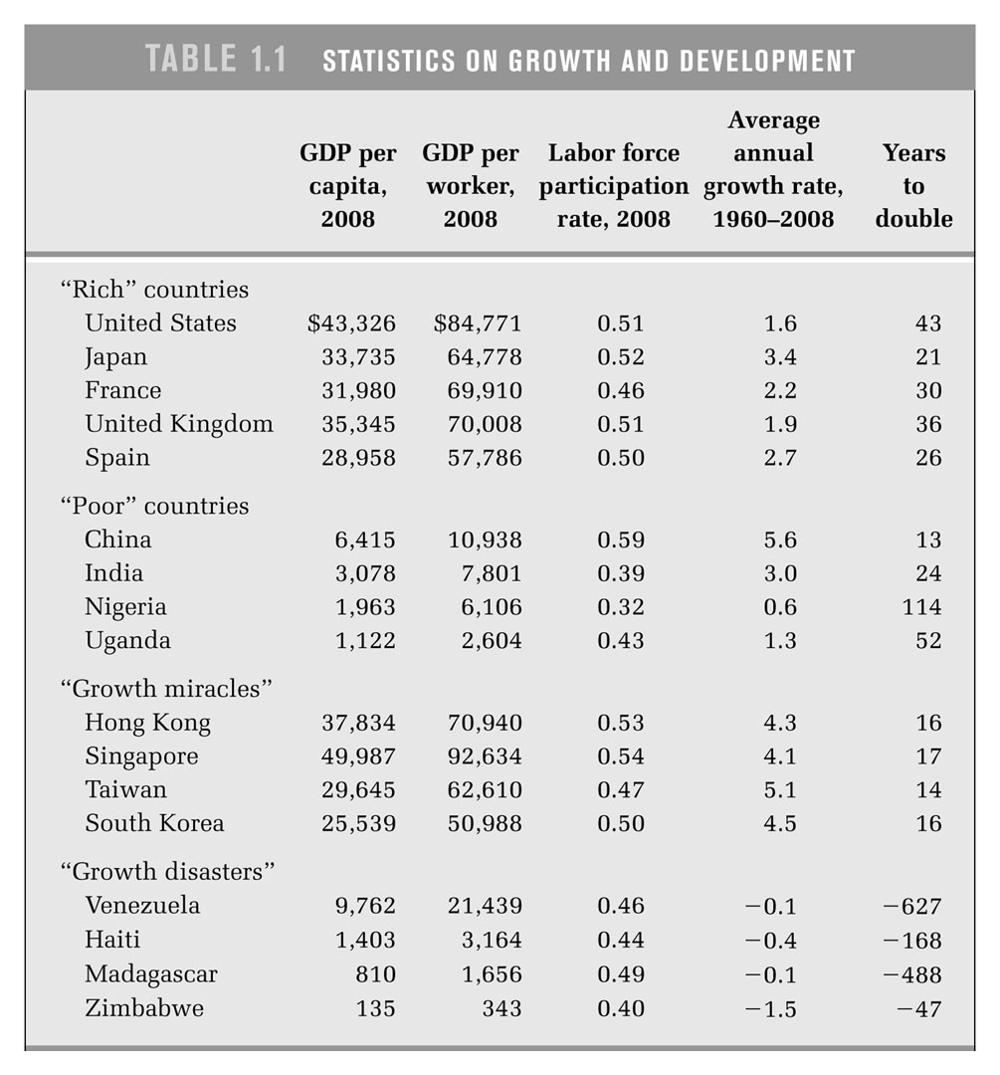
Source: Charles Jones and Dietrich Vollrath, Economic Growth. Year 2008

Slide 35
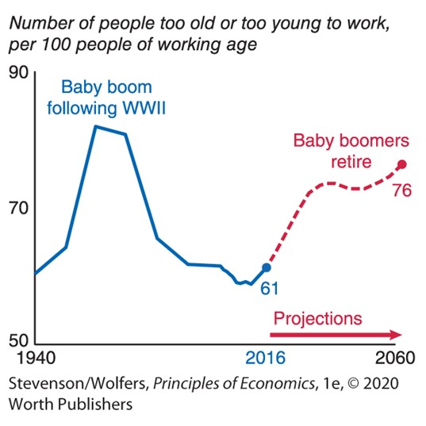
Dependency Ratio in the United States

Slide 36
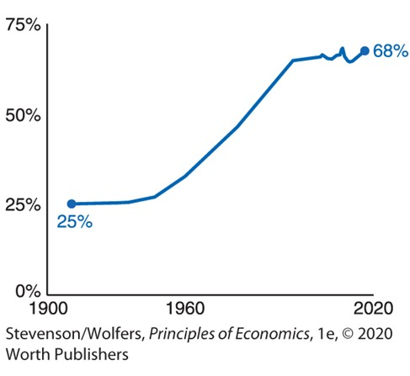
Share of US Working-Age Women Who are Employed

Slide 37
Contribution of Capital per Worker
Physical and human capital vary a lot across countries.
Educational attainment grows with development
Physical capital grows like output in the long-run
  Generally stock of physical capital (buildings, machines, equipment) is about 3 years of output Y*
•

Slide 38
GDP Statistics for Selected Countries (2008)
Physical Capital Average years
GDP per Capita per Worker of Education
“Rich” countries
U.S.A 43,326 292,614 13.2
Japan 33,735 297,337 11.4
France 31,980 327,397 10.7
U.K. 35,345 222,377 12.8
“Poor” countries
China 6,415 57,700 7.0
India 3,078 20,373 5.2
Nigeria 1,963 8,516 5.2
“Growth miracles”
Hong Kong 37,834 293,414 11.3
Singapore 49,987 309,148 10.5
Taiwan 29,645 179,589 10.6
Korea 25,539 234,288 11.6
“Growth disasters”
Venezuela 9,762 91,882 8.2 Zimbabwe 135 1,288 7.0
Sources: Jones and Vollrath, Economic Growth ; United Nations; Penn World Tables.
Notes:
Not quite the same set of countries.
Current literary rate in Niger is 31%.
(Next lowest is Nigeria—62%.)
Notes to myself:
Education is workers 25+
Source is https://hdr.undp.org/en/indicators/103006
Literacy is for 15+. A mix of undp and googling. Recent data.
Taiwan education number is a rough estimate.

Slide 39
Contribution of Technology
The types of technology that vary significantly across countries are not so much knowledge, but ability to deploy knowledge, institutions and culture.
And this variation is an important source of the variation in normal output per capita.
•

Slide 40
Economists’ View: Three Key Features for Economic Success
(1) Property rights + (2) Market-based system for producing/allocating resources + (3) government quality (bureaucratic quality, rule of law, low corruption, low risk of expropriation)
  Market is a powerful decentralized mechanism to reward producers of valuable goods (Friedrich Hayek)
  Example: North vs. South Korea divergence since 1948
  Caveat: some countries succeed economically even when government can arbitrarily confiscate (e.g. China)

Slide 41
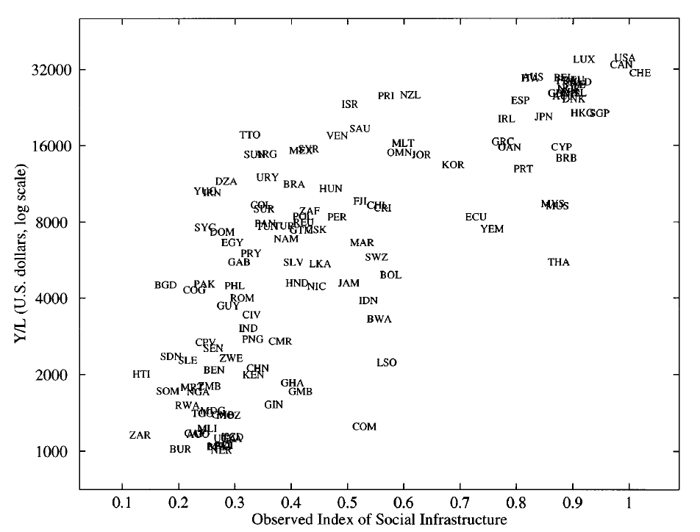
Average Labor Productivity and Social Infrastructure
Social infrastructure index: government quality + openness to trade
This is a correlation not necessarily causation.
Source: Hall and Jones (1999), “Why Do Some Countries Produce So Much More Output per Worker than Others?”

Slide 42
Can Increases in K*/N* Explain Growth? The Case of Physical Capital
An increase in K*/N* will raise Y*/POP, and there have been periods when capital accumulation was important to growth.
But, diminishing returns means that doubling K*/N* less than doubles Y*/POP.
Observed increases in K*/N* tend to follow Y*/N*, i.e. more valuable production tends to require more valuable capital equipment.

Slide 43
Can Increases in K*/N* Explain Growth?
The Case of Human Capital
Human capital has increased substantially over the past 100+ years.
The increases account for a substantial amount of the observed rise in Y*/POP over time.
Gethin (2024) is a brand new study looking at the impact of education on growth worldwide.

Slide 44
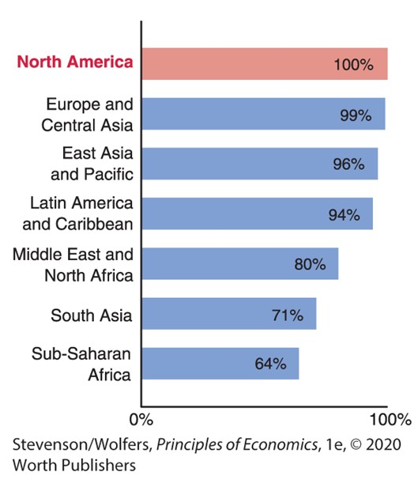
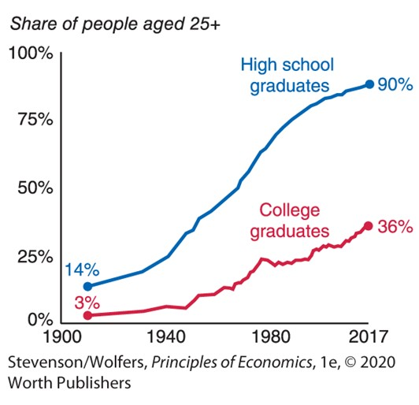
Adult Literacy and Graduation Rates
Adult Literacy Rates Vary Across Regions
U.S. High School and College Graduation Rates
Notes:
Lecture tips:
Give students a few moments to look at the graphics, and then ask them to comment on what they see and how they think the trends impact labor productivity.
Tie this into the earlier discussion about GDP growth rates in the United States versus other regions of the world.
2016 Data from: World Development Indicators.

Slide 45
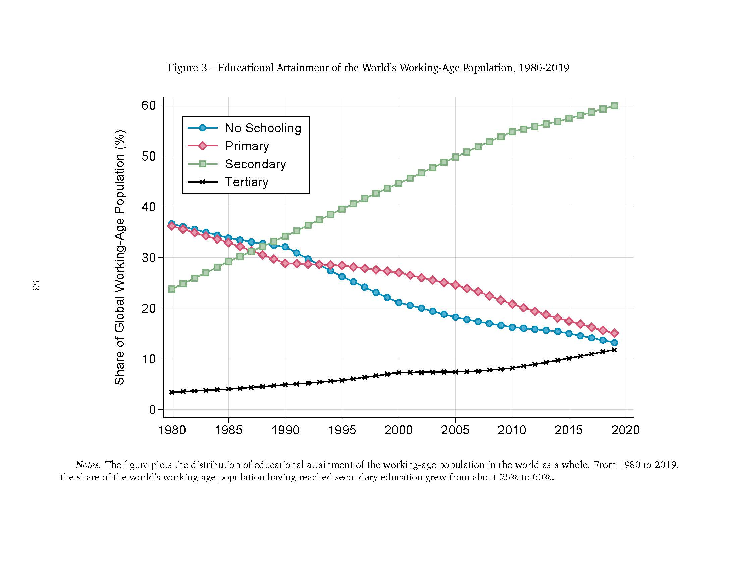
Source: Gethin (2024). Primary=elementary school (age 6-12), Secondary=high-school (age 12-18), Tertiary=university (age 18+)

Slide 46
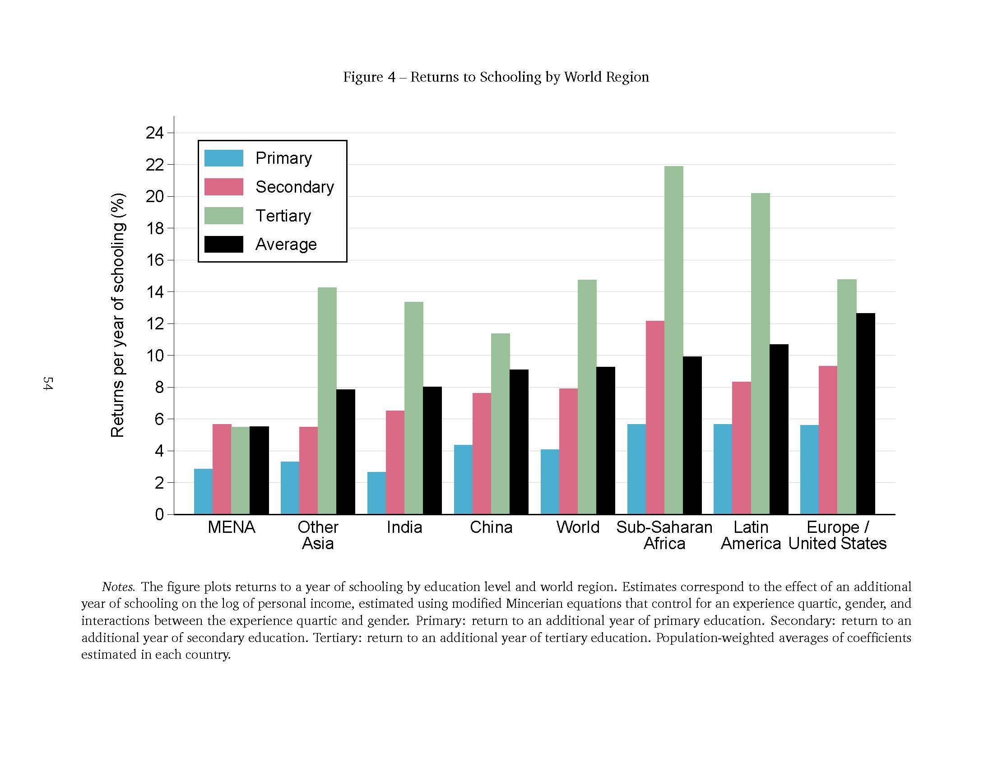
The graph displays the extra-earnings in % for having 1 extra year of education in the primary range (blue), secondary (red), tertiary (green), and average (black).
Source: Gethin (2024).

Slide 47
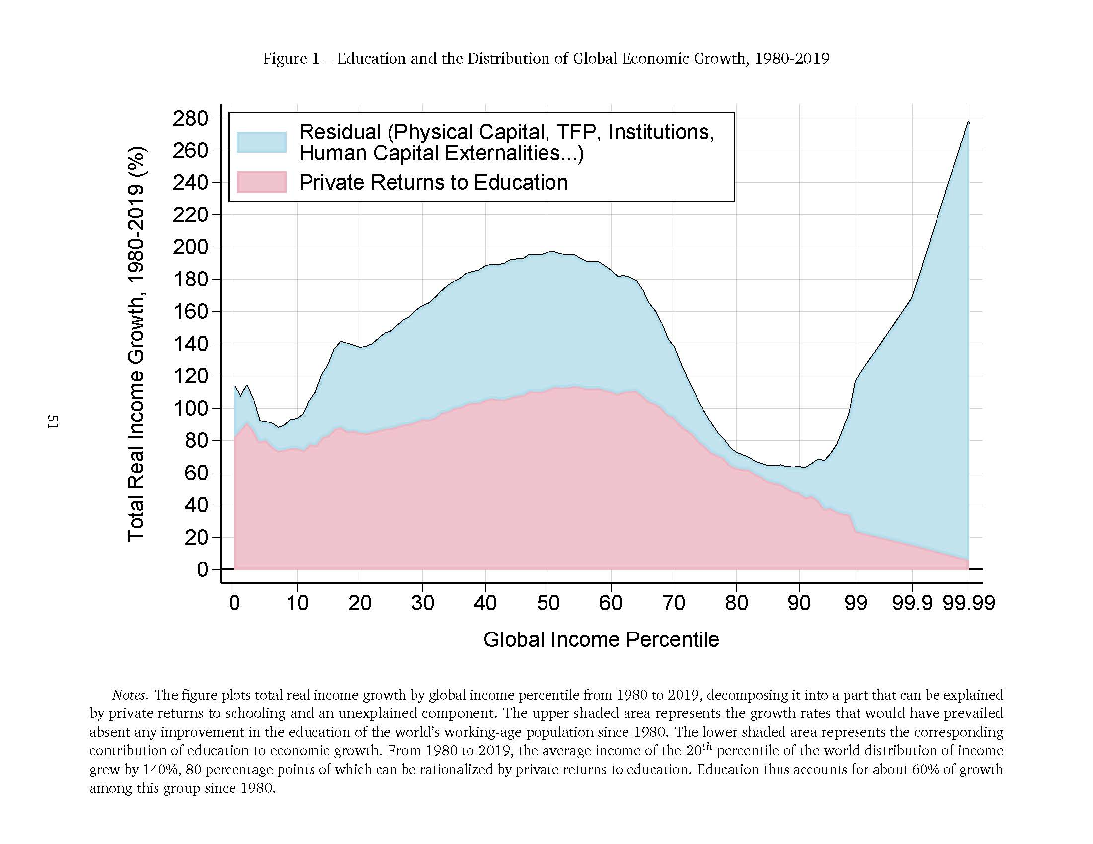
Source: Gethin (2024).

Slide 48
Technological change is a key determinant of economic growth
Argument by elimination: What is not explained by N*/POP or K*/N*, must be explained by T.
•

Slide 49
IV. Sources of Technological Progress

Slide 50
Many Factors Are Likely to Affect The Amount of Invention and Innovative Activity
The strength of inventors’ property rights.
Government subsidies or direct funding of research and innovation.
Greater competition; lower barriers to entry.
National emergencies.
The scale of the market (explains why international trade helps growth)
Education.
Consumer tastes for novelty.
Cultural attitudes toward innovation.
…
Notes:
ASK!
Scrap from lecture notes:
stronger property rights. A patent says that the inventor gets the property right to his or her invention. No one can just steal their invention; they have to pay for the right to use it.
We see evidence for this phenomenon. Most studies find that increasing patent protection, increases the equilibrium level of invention.
Increased competition and wars might also make new inventions rise.-If either firms or the government feels a more pressing need for invention, they will be willing to pay more …
National emergencies.
Luck. Sometimes there just happen to be a lot of good inventions for no obvious reason. Sometimes a Thomas Edison is born, and sometimes one isn't.
education. If there are more people who have the training to be inventors, …
This is one argument for why the U.S. came up with lots of inventions in the 1800s. We were early adopters of universal schooling. Also, American schooling emphasized practical education such as math and science, instead of Greek and Latin. Many economic historians think that this increased inventions.
Culture (U.S. history)
Other? (A student said: Consumer tastes—if people always want something new and different, ….)/

Slide 51
Does the Free Market Produce the Socially Optimal Amount of Inventive Activity?
Almost certainly not: Inventions appear to have large positive externalities
This is especially true for basic science.
Notes:
ASK!
[Scrap from lecture notes: - Almost certainly not: Inventions almost certainly benefit people other than the inventors.
- [Tie to T, not T/N*, in production function.]
- This is probably especially true of basic science (vs., say, McDonald’s).

Slide 52
Policies to Encourage Technological Progress
Increase education.
Subsidize research and development, particularly for basic science.
And remember that better institutions are a form of technological progress—which is especially relevant to poor countries.
Notes:
- If inventions have positive externalities, then government policies to encourage them may be desirable.
- And regardless, if we’re interested in understanding/raising growth, natural to be interested in policies that would increase invention.
ASK! The list of factors that could affect the equilibrium level of invention suggests some things that the government could do to increase it.
Government could choose to provide more education or to give incentives. Subsidizing scientific education would shift out the supply curve of inventors.
Government could directly subsidize research and development. Maybe tax breaks for research and development costs. Or public spending on basic scientific research, so that inventors would have more scientific knowledge to build on. This would also lower the costs of inventing and shift out the supply curve of invention.
The government could make property rights more secure. Especially true in less developed countries. Government can write and enforce laws protecting intellectual property. Can be an inexpensive way to stimulate invention.
D. Special Considerations for Poor Countries
We want to remember the crucial role of institutions.
For poor countries, poor institutions are a crucial factor holding them back. Therefore, improving institutions would be a kind of technological change.
Developing more stable governments, encouraging free markets and free trade could bring about substantial jumps in average labor productivity.

Slide 53
Messages about Cross-Country Income Differences
Differences in the normal employment-to-population ratio are not very important.
Variations in normal capital per worker (both physical and human) and in technology are both very important.
A reasonable approximation is that normal capital per worker and technology are each responsible for half of cross-country income differences.
The most important type of variation in technology is not variation in knowledge or know-how, but variation in institutions.

Slide 54
References
CORE-The Economy, Chapter 16.
Principles of Economics, Chapter 19.

