Slide 1
Lecture 16
Saving and Investment in the Long Run
Economics 2 Emmanuel Saez
Fall 2023

Slide 2
I. Introduction

Slide 3



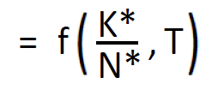

Aggregate Production Function
(1)
(2)
(3)
•

Slide 4
Capital and Investment
Capital: The accumulated stock of aids to the production process that were created in the past.
    Investment:
        Changes in the capital stock.
        That is, the construction or purchases of new machines and structures.

Slide 5
Other Reasons for Being Interested in These Issues
Helps us understand the determination of the long-run or normal real interest rate.
Helps us understand the determination of capital income.
The investment demand function is important to understanding short-run macroeconomic fluctuations.

Slide 6
II. Saving and Investment

Slide 7
The Uses of Potential Output
Recall that GDP Y*=C*+I*+G+NX*
Consumption (C*) [65-70% of US GDP]
Investment (I*) [15-20% of US GDP]
Government purchases (G) [15-20%]
Net Exports = Exports - Imports (NX*) [-3%]
Stars denote normal, long-run values.
For now, we will assume that NX* = 0

Slide 8
Equilibrium Condition
Y* = C* + I* + G
We can rearrange this as:
Y* − C* − G = I*
I* is normal investment demand.
Y* − C* − G is normal national saving supply (S*).
Thus, equilibrium requires S* = I*.
  Simplest example for intuition: economy is one farm producing wheat: wheat is consumed or saved as seeds for next year crop

Slide 9
Private and Public Saving
If we want, we can decompose saving into public and private saving:
S* = Y* − C* − G
= Y* − C* − G + (T − T)
(where T is net tax revenue=taxes-transfers)
= (Y* − T − C*) + (T − G)
Private Saving Public Saving

Slide 10
3 Different Ways of Writing the Equilibrium Condition
Y* − C* − G = I*
S* = I*
(Y* − T − C*) + (T − G) = I*

Slide 11
The Role of the Real Interest Rate
The key variable that equilibrates national saving and investment in the long run is the real interest rate.

Slide 12
The Nominal vs. the Real Interest Rate
    The nominal interest rate is just the stated interest rate—the interest rate measured in terms of dollars, with no adjustment for changes in prices.
    We denote it by i.
    The real interest rate is interest rate measured in terms of purchasing power—that is, adjusted for changes in prices.
    We denote it by r.
Notes:
#0: Recall: The interest rate is the percentage increase in your balance if you didn’t make any deposits or withdrawals.
#1: “measured in dollars” is what “nominal” always means.
#2: E.g., if the nominal i. rate is 10%, that means if you deposit $100 in the bank, after a year you will have 10% more dollars (so, $110).
#4: E.g., suppose we’re in a world where the only good or service is chocolate bars. If the real i. rate is 10%, that means if you deposit $100 in the bank, after a year the amount of goods and services you can purchases will be 10% greater.
[E.g., if you deposit $100 in the bank today and if a chocolate bar costs $1 today and the real interest rate is 10%, after a year you’ll have enough to buy 110 chocolate bars. = interest rate in terms of purchasing power.]
[2:39]

Slide 13
The Relation between the Real Interest Rate (r) and the Nominal Interest Rate (i)
The nominal interest rate has two components, compensation for inflation and the real interest rate:
i = r + π,
where π is the inflation rate.
If we like, we can rearrange this as:
r = i − π.
Aside: If we want to be precise, the relevant inflation variable is the expected rate of inflation, not the actual rate of inflation.
Notes:
After first bullet: pi is the symbol economists typically use for inflation (which, you will recall, is the %age change in the overall price level.
After r = i – pi: 2 comments:
***1. Don’t think in terms of these equations.
Think in terms of the concepts of what i and r are.
E.g., although r = i – pi is true, it’s usually not the best way to analyze what determines the real i. rate.***
*** 2. Why do we often want to focus on the r. i. rate?
In general, the r. i. rate shows the value of time preference.
- What you have to pay to cmpnste someone for loaning you money.
- The π part of the n. rate compensates lenders for Δs in prices.
Last bullet: Notice: From the way that I just explained this, you can see that the π variable is technically the expected Δ in prices, not the actual Δ.
- Typically, people have to commit to loans or decisions before we know what π actually is.
- Therefore, they have to make a reasoned guess of what π will be.

Slide 14
The Relation between the Real Interest Rate (r) and the Nominal Interest Rate (i)—Example
Suppose i = 10% and π = 10%.
Then the nominal interest rate (the percent return you get in dollars) is 10%.
But the real interest rate (the percent return you get in terms of the purchasing power of what you saved) is 0.
Notes:
Be explicit that this is a loan you’re making.
AFTER 2ND: ASK what r is.
[2:45]

Slide 15
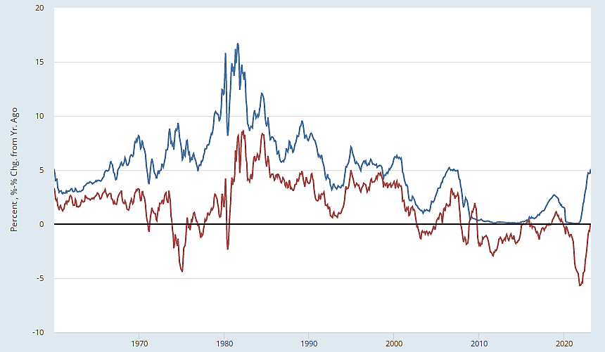
Nominal and Real Interest Rates (1-year nominal interest rate, and 1-year nominal rate minus 1-year inflation rate)
Nominal
Real
Source: FRED.
Notes:
Note to myself: Uncrop to see the series I used. Convert the interest rate from daily to monthly (or specify monthly in FRED)..

Slide 16
III. National Saving and the Real Interest Rate

Slide 17
The Supply of Saving
Recall: Normal national saving (S*) = Y* − C* − G.
Y* is determined by K*/N*, technology, and N*/POP.
We take G as given.
So: To understand what determines S*, we need to understand what determines C*.
How do people make decisions about consuming, saving, or borrowing?

Slide 18
Quiz
How do you think about how much of your monthly income you decide to spend vs. save and how does this relate to the interest rate to get on your savings?
A. I don’t care about the interest rate, I just spend all the income I have, and can’t afford to save anything.
B. I can save some of my income but how much I save has nothing to do with the interest rate
C. If the interest rate is higher, I cut down my consumption and save more.
D. If the interest rate is higher, I increase my consumption and save less.

Slide 19
The Real Interest Rate and the Opportunity Cost of Current Consumption
Think of a household trying to maximize its utility from consumption today and consumption in the future.
If the real interest rate rises, the opportunity cost of consuming today rises: What you give up to consume today is higher because the real return you would earn on saving is higher than before.
That is, the real interest rate is a component of the opportunity cost of current consumption.

Slide 20
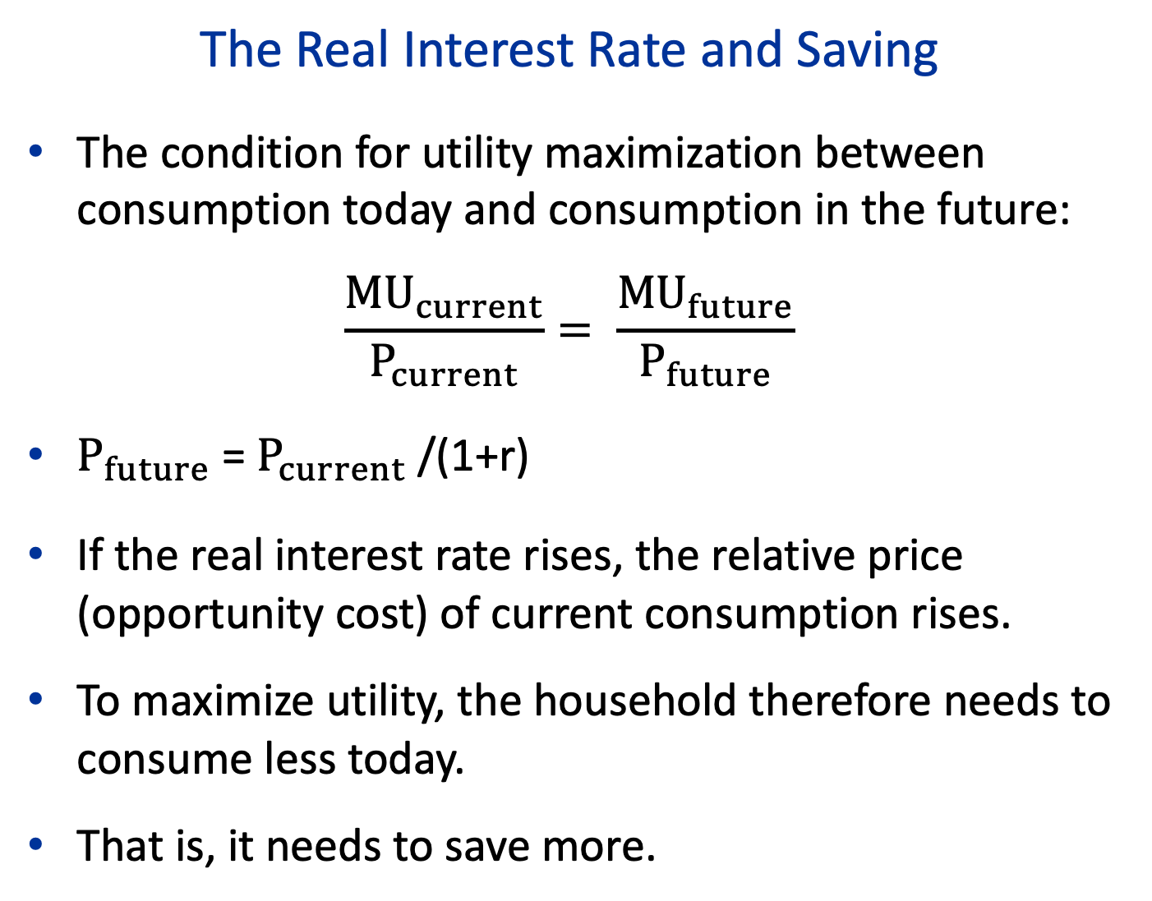
The Real Interest Rate and Saving
The condition for utility maximization between consumption today and consumption in the future:
$$\frac{{MU}_{current}}{P_{current}}= \frac{{MU}_{future}}{P_{future}}$$
$P_{future}$= $P_{current}$/(1+r)
If the real interest rate rises, the relative price (opportunity cost) of current consumption rises.
To maximize utility, the household therefore needs to consume less today.
That is, it needs to save more.

Slide 21
The Supply of Saving
r*
Saving (S*)
Recall: S* = Y* − C* − G

Slide 22
The Supply of Saving
r*
S
Saving (S*)
Recall: S* = Y* − C* − G

Slide 23
Quiz
How does the interest rate on your student loans will affect your spending after your graduate?
A. It won’t affect my spending because I don’t have student loans
B. Higher student loan payments will force me to cut down my other spending
C. Higher student loan payments won’t affect my spending, I’ll just save less and spend the same
D. Higher student loan payments won’t affect my spending, I’ll just borrow more on my credit card

Slide 24
Why does the interest rate affect macro spending and saving in practice?
Borrowers are low income while lenders are high income
Low income people tend to spend everything they earn (can’t afford to save)
High income people tend to save a large fraction of any extra income they make
A higher interest rate gives more income to lenders and correspondingly less to borrowers
Borrowers cut spending by more than lenders increase their spending => macro spending goes down and macro saving goes up

Slide 25
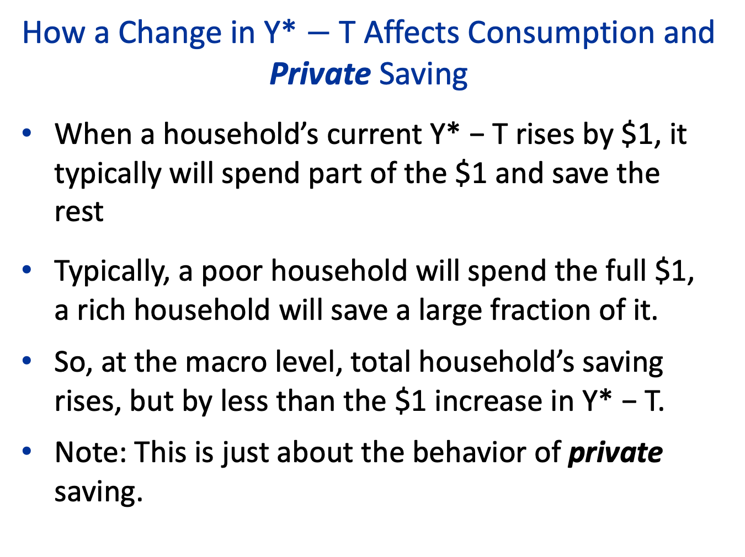
How a Change in Y* $−$T Affects Consumption and Private Saving
When a household’s current Y* − T rises by $1, it typically will spend part of the $1 and save the rest
Typically, a poor household will spend the full $1, a rich household will save a large fraction of it.
So, at the macro level, total household’s saving rises, but by less than the $1 increase in Y* − T.
Note: This is just about the behavior of private saving.

Slide 26
A Note on How We Model the Government
Recall: We take G as given.
This means that we assume it doesn’t respond to other variables.
So, for example, when we consider the effects of a change in T, we assume G doesn’t change.
Aside: This is just a specific example of ceteris paribus from early in the semester.

Slide 27
Example: A Tax Cut
r*
S₁
Saving (S*)
Recall: S* = Y* − C* − G

Slide 28
Private and Public Saving and a Tax Cut
Recall: S* = (Y* − T − C*) + (T − G)
Private Saving Public Saving
Suppose there is a tax cut. At a given r*:
T − G falls by the full amount of the tax cut.
Y* − T − C* rises as part of the tax cut is saved but by less than the amount of the tax cut
So S* falls at a given r*.

Slide 29
Example: A Tax Cut
r*
S₂
S₁
Recall: S* = Y* − C* − G
Saving (S*)
Tax cut reduces public saving 1-1 but increases private saving
less than 1-1: total savings S* falls

Slide 30
IV. Investment Demand and the Real Interest Rate

Slide 31
Profit Maximization and Investment Demand
    Recall: Firms want to purchase capital up to the point where:
    PV(Stream of MRP_{K}’s) = Purchase Price
    Because a rise in the interest rate reduces PV(Stream of MRP_{K}’s), it reduces the profit-maximizing amount of purchases of new capital goods.
    That is, investment demand is a decreasing function of the interest rate.

Slide 32
Why Investment Demand Depends on the Real Interest Rate: A Rise in Expected Inflation
    Recall: The firm buys new capital until:
    PV(Stream of MRP_{K}’s) = Purchase Price
Suppose the nominal interest rate (i) rises only because expected inflation rises.
The denominators in PV(Stream of MRP_{K}’s) are higher.
But, because future MRP_{K}’s depend on future prices, the numerators are also correspondingly larger.
As a result, PV(Stream of MRP_{K}’s) doesn’t fall, and so the firm’s investment demand doesn’t change.

Slide 33
Why Investment Demand Depends on the Real Interest Rate: A Rise in the Real Interest Rate
    The firm buys new capital until:
    PV(Stream of MRP_{K}’s) = Purchase Price
Suppose i rises because r rises, with no change in expected inflation.
The denominators in PV(Stream of MRP_{K}’s) are higher.
There’s no compensating effect on future MRP_{K}’s.
As a result, PV(Stream of MRP_{K}’s) at a given amount of investment falls, and so the firm’s investment demand falls.

Slide 34
Investment Demand Curve
r*
I
Investment (I*)

Slide 35
V. The Determinants of Investment and the Real Interest Rate in the Long Run

Slide 36


The Long-Run Saving and Investment Diagram
r*
S
$r_{1}^{∗}$
I
$I_{1}^{∗}$
S*, I*

Slide 37
The U.S. Budget Deficit in Recent Years (Excluding 2020–2021)
Year % of GDP
2016 3.1
2017 3.4
2018 3.8
2019 4.6
2020 ----
2021 ----
2022 5.4
Source: FRED.

Slide 38

A Tax Cut and “Crowding Out”
r*
S₁
$r_{1}^{∗}$
I₁
${ I}_{1}^{∗}$
S*, I*

Slide 39


A Tax Cut and “Crowding Out”
r*
S₂
S₁
$r_{2}^{∗}$
$r_{1}^{∗}$
I₁
$I_{1}^{∗}$
S*, I*
$$I_{2}^{∗}$$

Slide 40
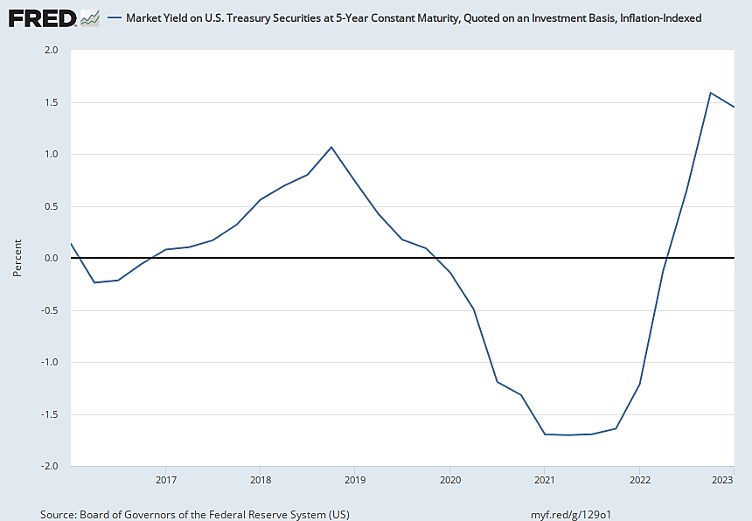
An Estimate of the Real Interest Rate, 2016–present
Source: FRED.

Slide 41
A New Technology That Raises Future MRP_{K}’s
r*
S₁
$r_{1}^{∗}$
I₁
${ I}_{1}^{∗}$
S*, I*

Slide 42


A New Technology That Raises Future MRP_{K}’s
r*
S₁
$r_{2}^{∗}$
$r_{1}^{∗}$
I₂
I₁
$$I_{1}^{∗}$$
S*, I*
$$I_{2}^{∗}$$

Slide 43
References
CORE-The Economy, Chapter 16.
Principles of Economics, Chapter 21.

