Slide 1
Lecture 14
Macroeconomic measurement
Economics 2 Emmanuel Saez
Fall 2024

Slide 2
I. Macroeconomics versus Microeconomics

Slide 3
Macroeconomics
Definition:
The study of the aggregate economy.
Concerned with:
Total output.
Aggregate price level and inflation.
The unemployment rate.
The overall level of interest rates; the exchange rate; overall exports and imports.

Slide 4
II. Real GDP

Slide 5
Real Gross Domestic Product (Real GDP)
The market value of the final goods and services newly produced in a country during some period of time, adjusted for price changes.

Slide 6
Economists’ Definition of “Real”
Adjusted for changes in prices or equivalently, keeping prices constant
Another way to say it: Measured in terms of goods and services, rather than dollars.
In contrast, “nominal” means measured in terms of dollars.

Slide 7
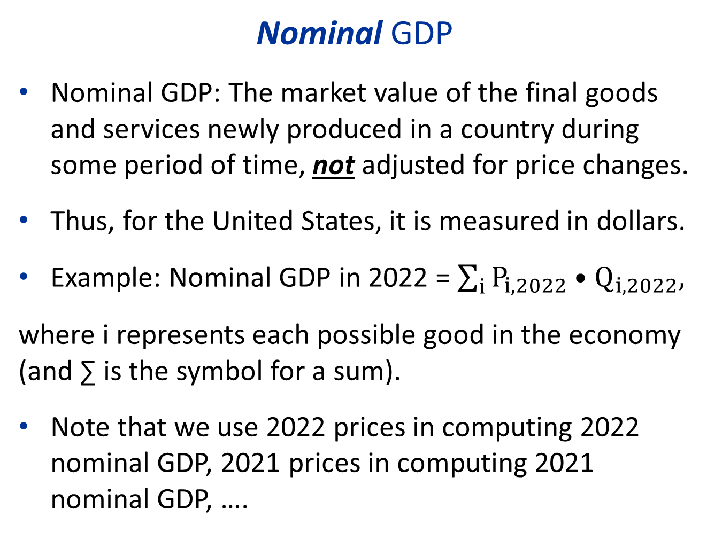
Nominal GDP
Nominal GDP: The market value of the final goods and services newly produced in a country during some period of time, not adjusted for price changes.
Thus, for the United States, it is measured in dollars.
Example: Nominal GDP in 2022 = $\sum_{i}{P_{i,2022}•Q_{i,2022},}$
where i represents each possible good in the economy (and ∑ is the symbol for a sum).
Note that we use 2022 prices in computing 2022 nominal GDP, 2021 prices in computing 2021 nominal GDP, ….

Slide 8
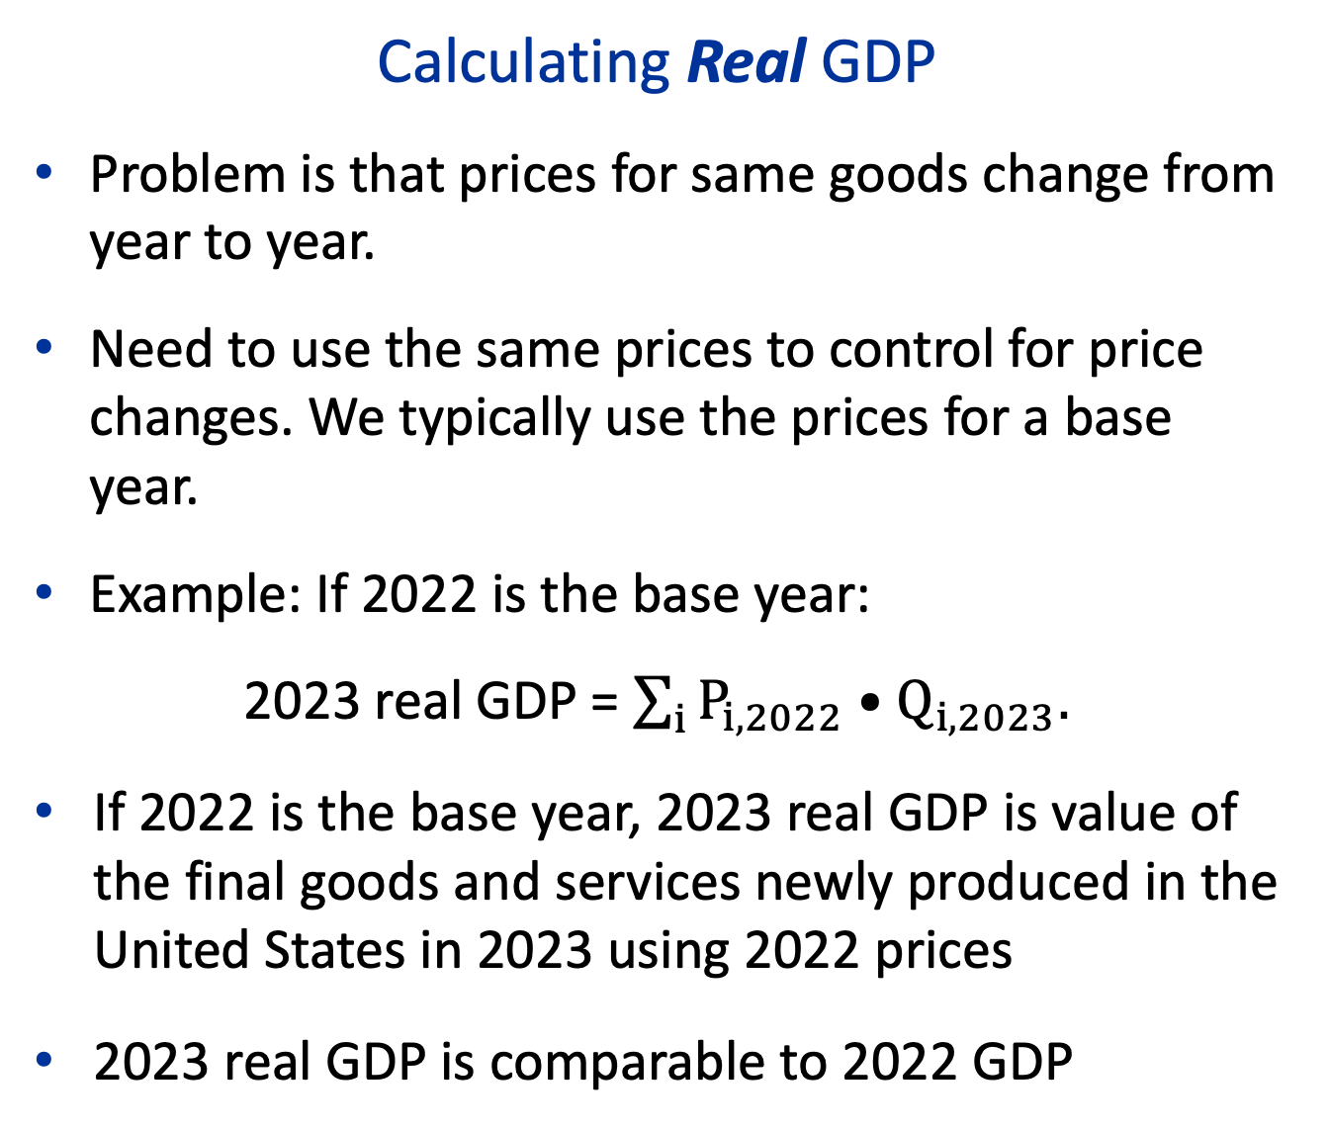
Calculating Real GDP
Problem is that prices for same goods change from year to year.
Need to use the same prices to control for price changes. We typically use the prices for a base year.
Example: If 2022 is the base year:
2023 real GDP = $\sum_{i}{P_{i,2022}•Q_{i,2023}.}$
If 2022 is the base year, 2023 real GDP is value of the final goods and services newly produced in the United States in 2023 using 2022 prices
2023 real GDP is comparable to 2022 GDP

Slide 9
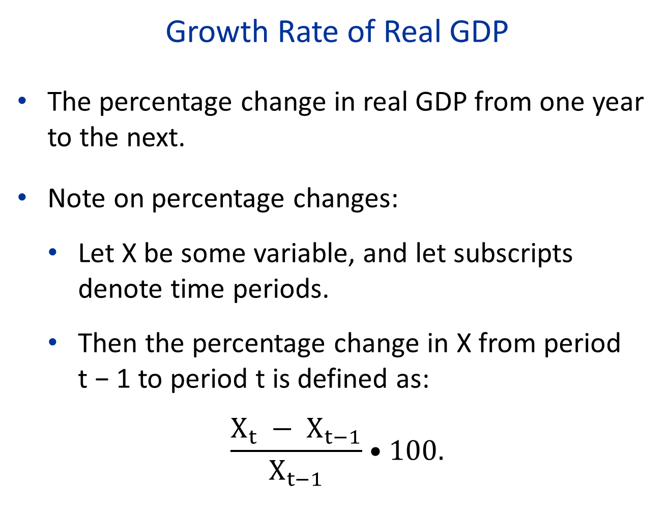
Growth Rate of Real GDP
The percentage change in real GDP from one year to the next.
Note on percentage changes:
Let X be some variable, and let subscripts denote time periods.
Then the percentage change in X from period
t − 1 to period t is defined as:
$$\frac{X_{t} − X_{t−1}}{X_{t−1}}•100.$$

Slide 10
Measuring GDP
GDP = market value of the final goods and services newly produced in a country during some period of time
Key points:
Final goods and services.
Newly produced.
Within the country.
In some period of time.

Slide 11
Three Approaches to Measuring GDP
Expenditure: Use market prices and the quantities of final goods: Y=C+I+G+NX
  Can divide into private consumption (C), investment (I), government purchases (G), and net exports (NX).
Production (value added): follow goods/service through each stage of production and count value added at each stage:
  Timber $500 → Lumber $1000 → Furniture $2000
Income: Income from producing goods and services within the country:
  Can divide into labor income and capital income

Slide 12
GDP vs. National Income
GDP is Gross Domestic Product
Capital assets (buildings, machines, etc.) wear off over time: this is called depreciation of capital
NDP is Net Domestic product = GDP – Depreciation of capital = about 90% of GDP.
National income = NDP + net foreign income
  Net foreign income = foreign income earned by residents – domestic income paid to foreigners
  For most rich countries, net foreign income is small but can be large in developing countries where companies are owned mostly by foreigners who get the profits
  National income makes more sense than GDP for inequality

Slide 13
What’s NOT in GDP
Unpaid labor that produces services
  caring for family, housework, volunteer work not in GDP
Illegal trade
  Drug trafficking, bootlegging
Used goods that are resold
  Counted when first produced. Resold goods count only as value added if it’s a business (e.g. used car business)
Environmental damage
  It is a form of “environmental capital” damage that does not get counted nor depreciated even in NDP
Imputed rent of homeowners is in GDP however

Slide 14
Quiz A
Suppose I mine a new bitcoin using $50K of electricity and computer power and sell it on the market for $65K and make a profit of $15K. What does that add to GDP?
A. The full $65K amount. Bitcoin is not different from mining for gold.
B. Only the $50K of electricity and computer power because those are the only real goods
C. Only the $15K profit I made because electricity and computer power are intermediary goods in the process of production
D. $0K because bitcoins don’t have inherent value
E. None of the above

Slide 15
Quiz B
Suppose I have a bitcoin that I bought last year for $30K. This year, I am selling it for $65K and hence I make a gain of $35K. What does this add to GDP this year?
A. The full $65K amount.
B. Only the $30K that was the value of bitcoin last year.
C. Only the $35K profit I made because that’s the value added
D. $0K because nothing new was produced
E. None of the above

Slide 16
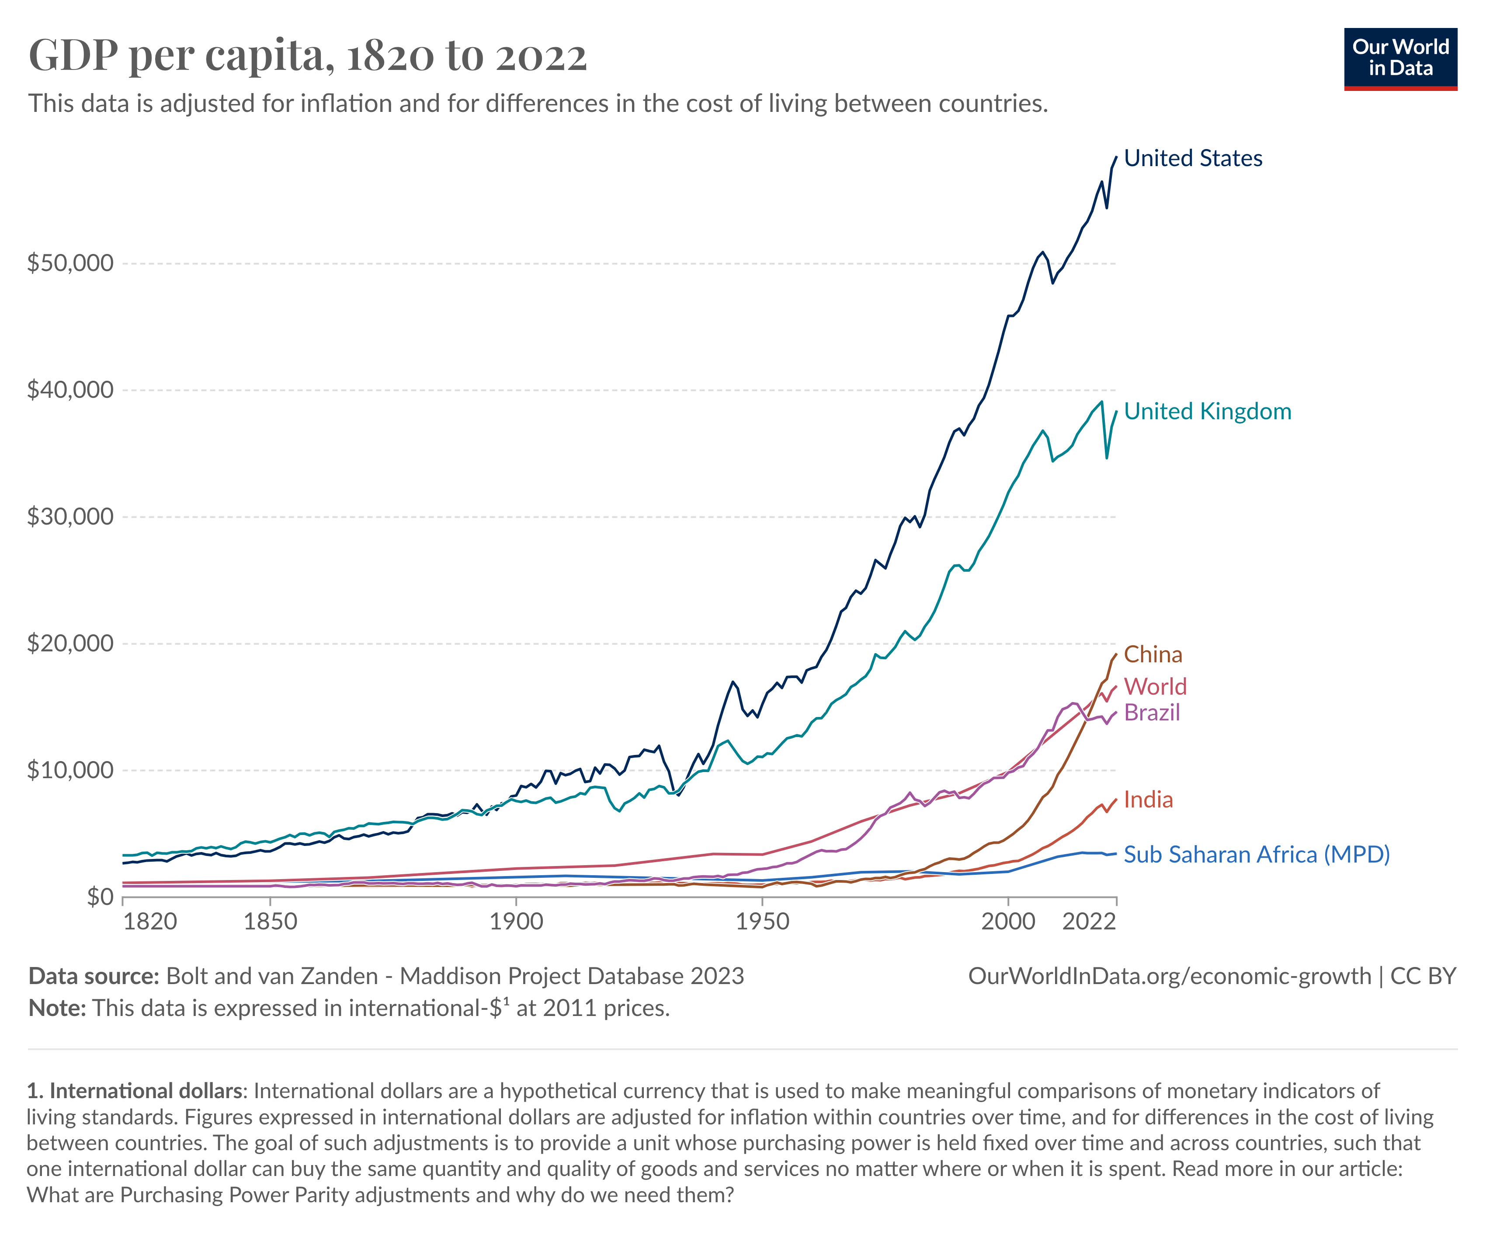
Real GDP per Person over Time and Regions
Source: Our World in Data; data from the Maddison Project.
Notes:
[notes are a little outdated]
- Can see that some countries have remained very poor.
- Comparison of the West and Africa makes it clear how crucially important growth is.
- The reason that the U.S. is so rich and comfortable today is that we have been growing at a pretty steady rate for a century and a half.
- Small increases every year add up to a dramatic improvement in our standard of living after a century.
- I’ll come back to this. [2:35]
e. Because growth has such a huge effect on the quality of human existence, it is one of the key phenomena that macroeconomics tries to explain.
We will look particularly at what causes one country to grow and some other not to.
Want to return to our picture of real GDP in the U.S. [NEXT]

Slide 17
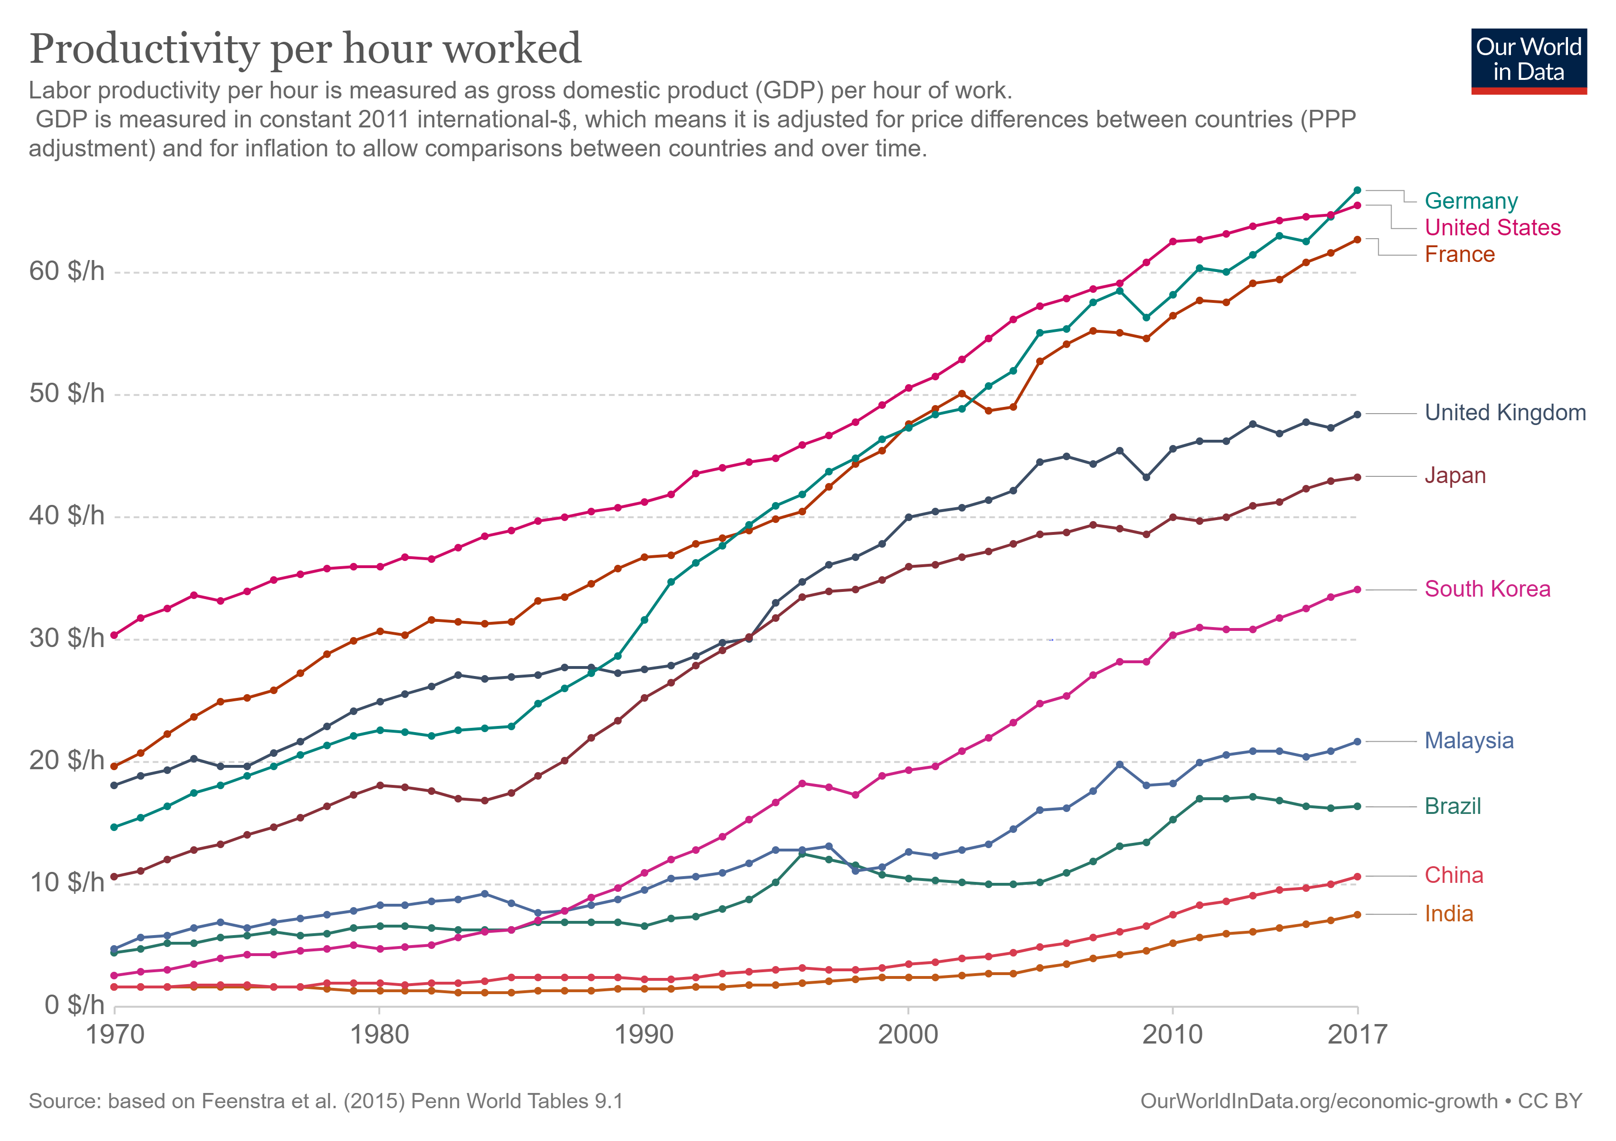
Labor Productivity
Notes:
[notes are a little outdated]
- Can see that some countries have remained very poor.
- Comparison of the West and Africa makes it clear how crucially important growth is.
- The reason that the U.S. is so rich and comfortable today is that we have been growing at a pretty steady rate for a century and a half.
- Small increases every year add up to a dramatic improvement in our standard of living after a century.
- I’ll come back to this. [2:35]
e. Because growth has such a huge effect on the quality of human existence, it is one of the key phenomena that macroeconomics tries to explain.
We will look particularly at what causes one country to grow and some other not to.
Want to return to our picture of real GDP in the U.S. [NEXT]

Slide 18
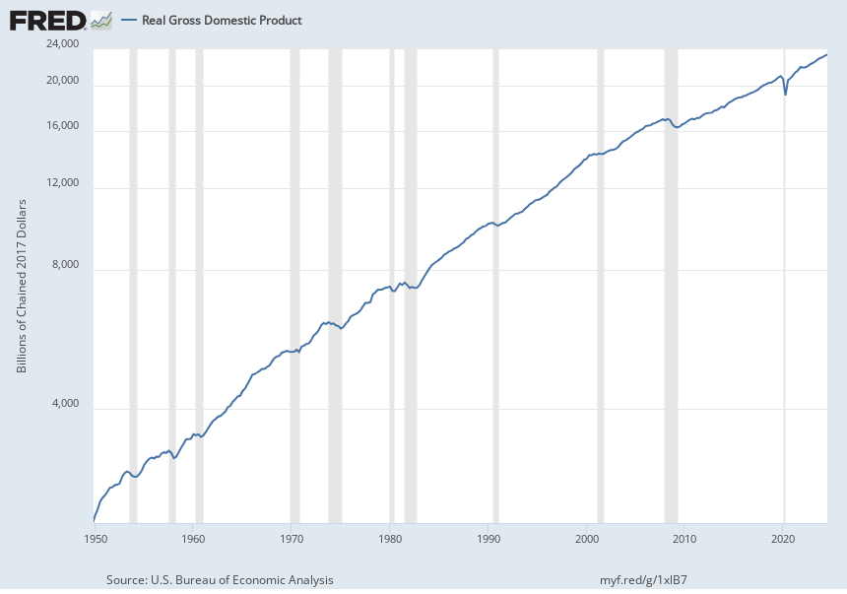
Real GDP in the U.S., 1950–2024 (in 2017 $)
Source: FRED (Federal Reserve Economic Data); data from Bureau of Economic Analysis.
Note the log scale for Real GDP. Straight line would mean same growth rate year to year
Notes:
B. Facts
- Here is a picture of real GDP since 1950. [FIGURE 6]
- Quarterly data [explain].
- A comment on the source: “FRED”.
- The scale is logarithmic. [EXPLAIN / EXPLAIN WHY]
ASK: Anything you notice / find interesting / would like to understand better?
- Looking at this picture of real GDP shows you two crucial facts.
1. One is that output has been growing over time.
a. Real output is simply getting bigger over time.
b. The amount of growth is very large.
Real GDP has gone up by about a factor of 8.
c. Per capita
- Not just in absolute terms.
- Obviously at the same time, our population has been growing as well.
- But if we divide GDP by population, you see that our GDP per person is much higher today than in 1950. [NEXT]

Slide 19
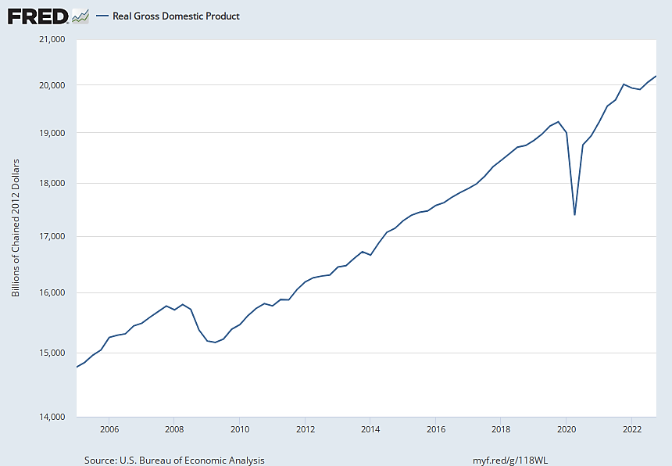
U.S. Real GDP, 2005–2022
Source: FRED; data from Bureau of Economic Analysis. Shaded red denotes recession when real GDP is falling.
Notes:
- Great Recession: Real GDP fell almost exactly 4%. [highlight]
-In the pandemic: Real GDP fell almost exactly 10%. [highlight]
c. If our picture went back further you would see some even more extreme short-run fluctuations.
In the 1930s we experienced what was known as the Great Depression. [NEXT]
[2:40]

Slide 20
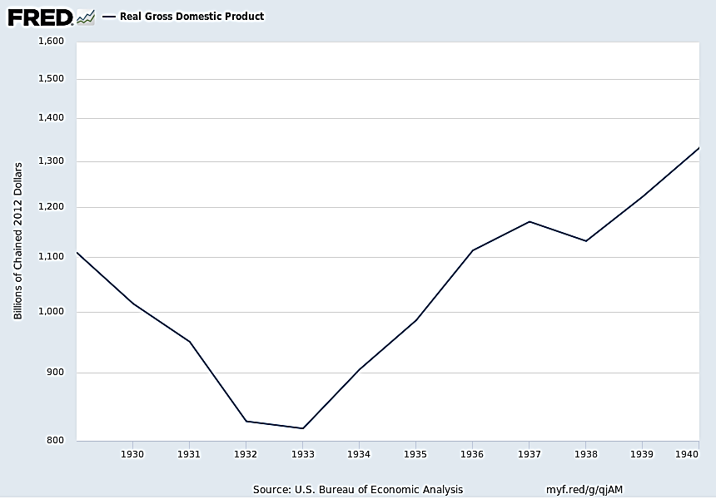
U.S. Real GDP, 1929–1940
Source: FRED; data from Bureau of Economic Analysis. Great Depression for 1929-1933 is the largest recession the US ever experienced since 1900
Notes:
- Real GDP fell 26%. (Note the diff. scales of the 2 diagrams!)
2. Recessions matter because they are times when we’re not producing as much as we’re capable of.
- We produce less of the things that give us pleasure – we are inside the production possibilities curve.
- Part of not producing as much as we are able is that we are not using all of our available workers. As a result, there is unemployment, which is very painful for people. [NEXT]

Slide 21
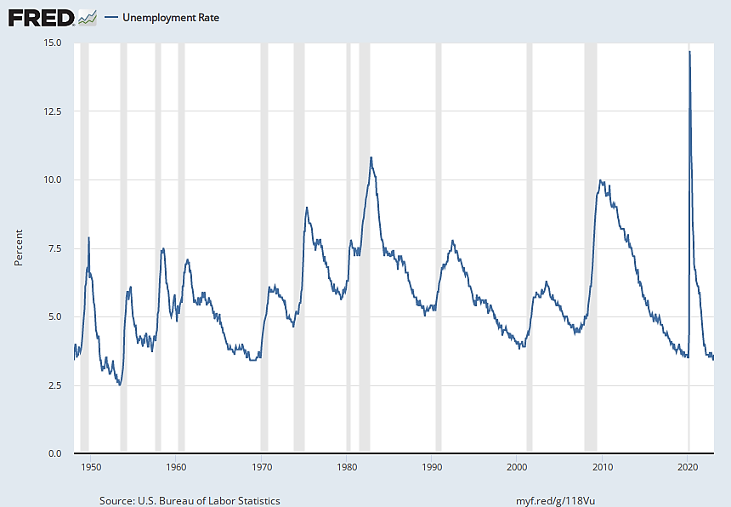
U.S. Unemployment Rate, Jan. 1948–Feb. 2023
Source: FRED; data from Bureau of Labor Statistics. Shaded areas show recessions:
Unemployment rate rises sharply during each recession: labor becomes under-utilized
Notes:
EXPLAIN SHADED PARTS/FLAG THE VERY END]
C. We also care about booms.
1. Booms matter because when output is above our long-run trend, prices tend to rise.
- That is, we experience inflation.
3. Therefore, another topic that macroeconomics deals with is what causes short-run fluctuations.
- Why do we have these wiggles around the upward trend?
We’ll talk about all 3 of these episodes we’ve just discussed, + about recessions and booms more generally, over the coming weeks.
[2:42]

Slide 22
III. Inflation
Notes:
III. Measures of the Aggregate Price Level and Inflation
A second key variable that macroeconomists talk a lot about is the overall or aggregate level of prices.
[> NEXT]

Slide 23
Overview
Inflation refers to growth in the average or overall level of prices.
Thus to describe how we measure inflation, we need to start by describing how we measure the overall (or aggregate) price level.
The most common measure is the Consumer Price Index (or CPI).
Notes:
GO THRU SLIDE

Slide 24
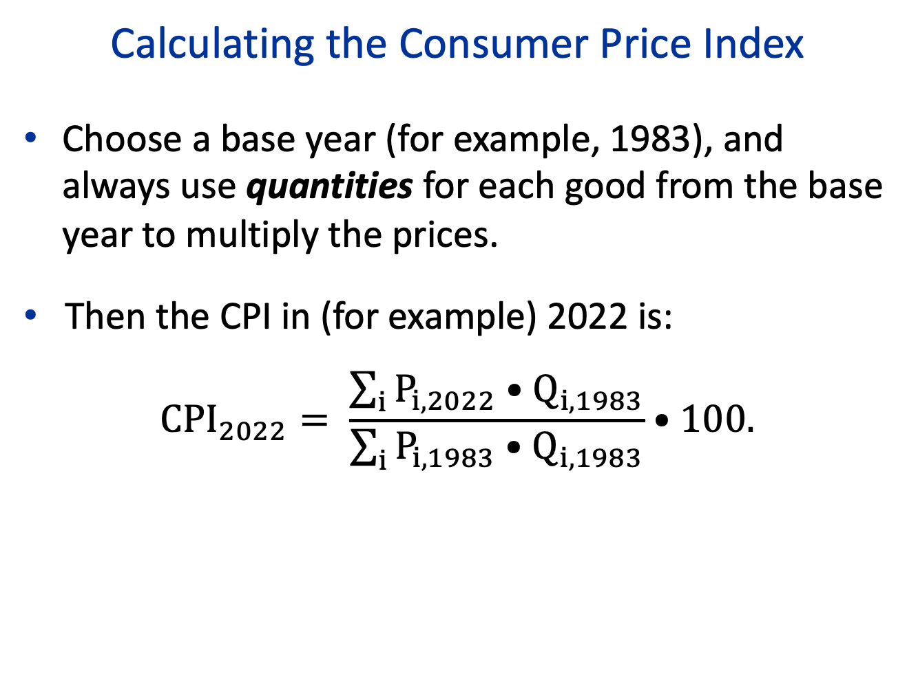
Calculating the Consumer Price Index
Choose a base year (for example, 1983), and always use quantities for each good from the base year to multiply the prices.
Then the CPI in (for example) 2022 is:
$${CPI}_{2022}= \frac{\sum_{i}{P_{i,2022}•Q_{i,1983}}}{\sum_{i}{P_{i,1983}{•Q}_{i,1983}}}•100.$$

Slide 25
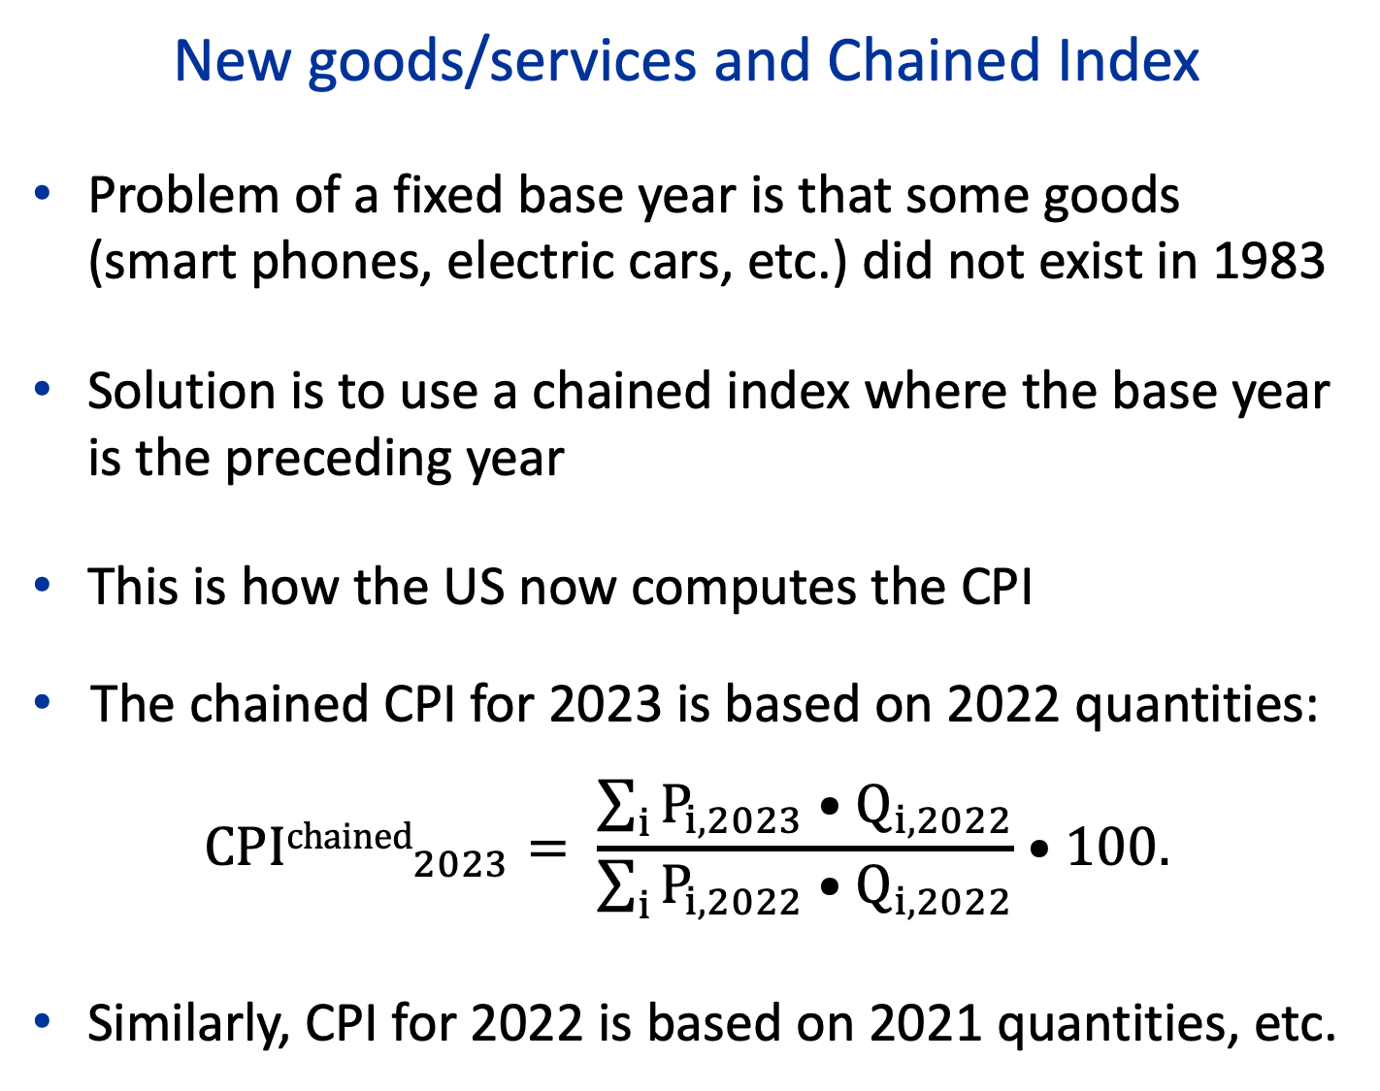
New goods/services and Chained Index
Problem of a fixed base year is that some goods (smart phones, electric cars, etc.) did not exist in 1983
Solution is to use a chained index where the base year is the preceding year
This is how the US now computes the CPI
The chained CPI for 2023 is based on 2022 quantities:
$${CPIchained}_{2023}= \frac{\sum_{i}{P_{i,2023}•Q_{i,2022}}}{\sum_{i}{P_{i,2022}{•Q}_{i,2022}}}•100.$$
Similarly, CPI for 2022 is based on 2021 quantities, etc.

Slide 26
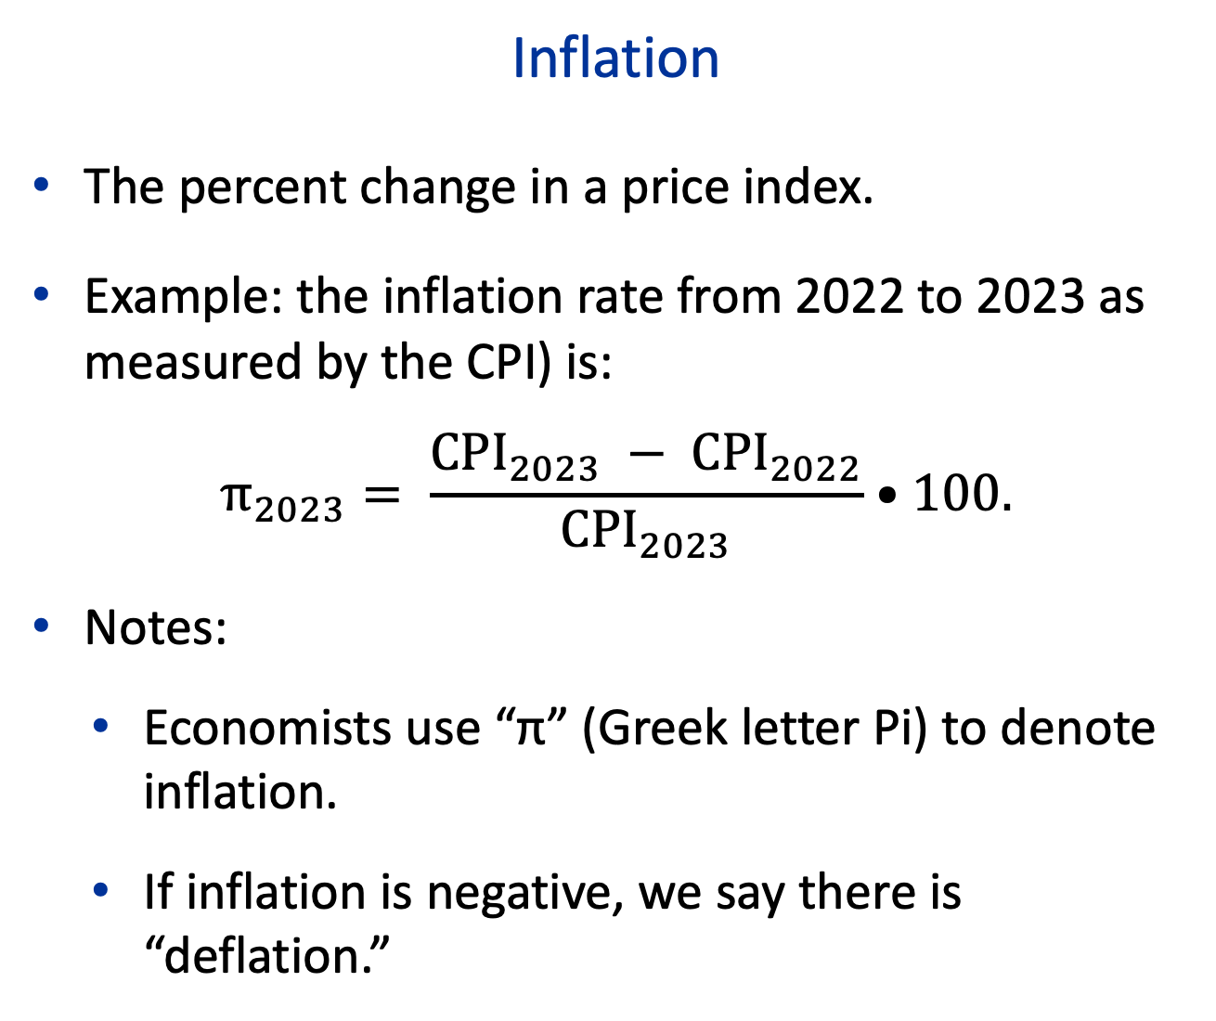
Inflation
The percent change in a price index.
Example: the inflation rate from 2022 to 2023 as measured by the CPI) is:
$$π_{2023}= \frac{{CPI}_{2023} − {CPI}_{2022}}{{CPI}_{2023}}•100.$$
Notes:
Economists use “π” (Greek letter Pi) to denote inflation.
If inflation is negative, we say there is “deflation.”

Slide 27
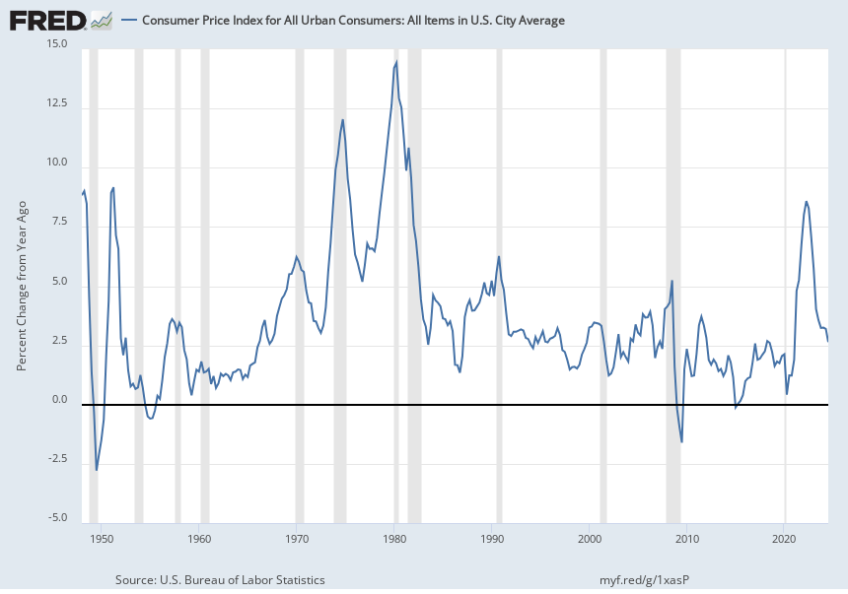
U.S. Inflation (Percent Change from 1 year ago in the Consumer Price Index), 1948–2024Q3
Source: FRED; data from Bureau of Economic Analysis.

Slide 28
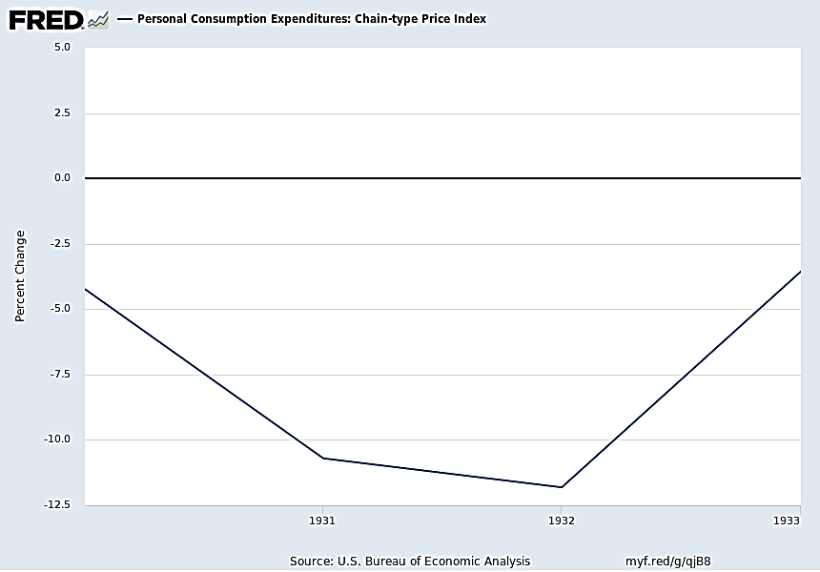
U.S. Inflation (Percent Change in the Price Index for Personal Consumption Expenditures), 1930–1933
Source: FRED; data from Bureau of Economic Analysis.

Slide 29
Poll on Inflation
How do you feel about the recent inflation episode in 2022-23 when prices increased by about 10% more than normal
A. I don’t care because if prices increases, incomes also increase so nothing real changes
B. I get upset because my expenses increase but my disposable income doesn’t
C. I like it because my disposable income has actually increased faster than my expenses
D. I get disoriented not knowing anymore how much things cost, and whether sellers are taking advantage of us.
E. I did not even know that there had been excess inflation.

Slide 30
Why Do We Care about Inflation?
An argument for not caring
  In aggregate: expenditure = income (your expenditure is somebody’s income) so inflation means that both expenditures and incomes are higher
Arguments for caring:
Redistribution
Psychology
Efficiency

Slide 31
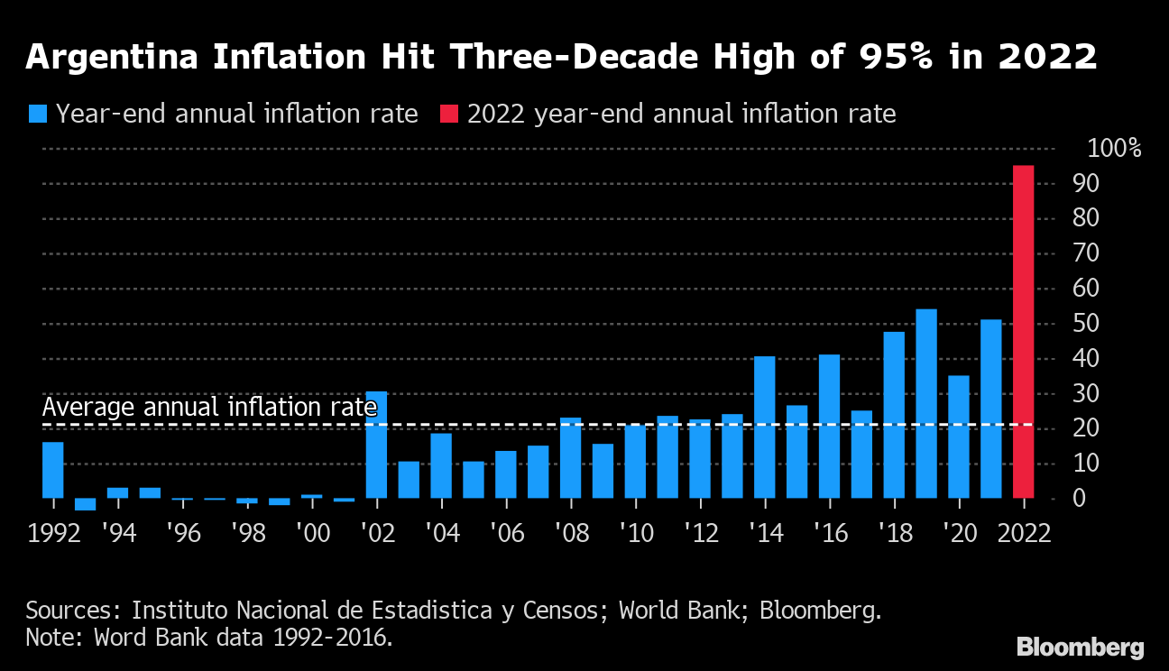
Inflation can be chronically high in some cases
Example: Argentina since 2002

Slide 32
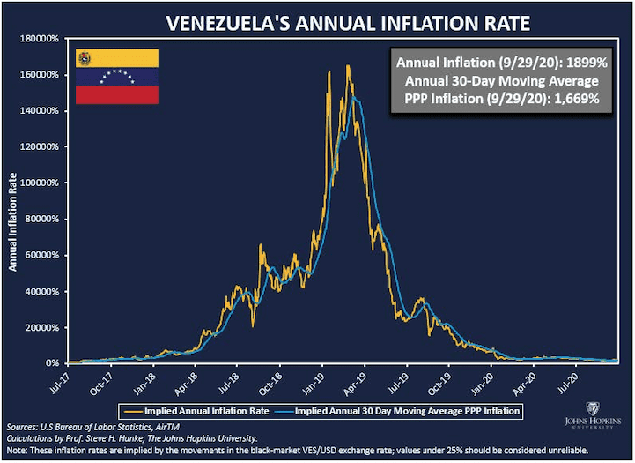
And can sometimes devolve into hyperinflation (generally short)
Example: Venezuela 2018-2020

Slide 33
The Nominal vs. the Real Interest Rate
    The nominal interest rate is just the stated interest rate—the interest rate measured in terms of dollars, with no adjustment for changes in prices.
    We denote it by i.
    The real interest rate is interest rate measured in terms of purchasing power—that is, adjusted for changes in prices.
    We denote it by r.
Key Equation: r = i − π.
Example: If i=5% but π=5%, then r=0%. Inflation eats up the full nominal return i so that real return r is zero
Notes:
#0: Recall: The interest rate is the percentage increase in your balance if you didn’t make any deposits or withdrawals.
#1: “measured in dollars” is what “nominal” always means.
#2: E.g., if the nominal i. rate is 10%, that means if you deposit $100 in the bank, after a year you will have 10% more dollars (so, $110).
#4: E.g., suppose we’re in a world where the only good or service is chocolate bars. If the real i. rate is 10%, that means if you deposit $100 in the bank, after a year the amount of goods and services you can purchases will be 10% greater.
[E.g., if you deposit $100 in the bank today and if a chocolate bar costs $1 today and the real interest rate is 10%, after a year you’ll have enough to buy 110 chocolate bars. = interest rate in terms of purchasing power.]
[2:39]

Slide 34
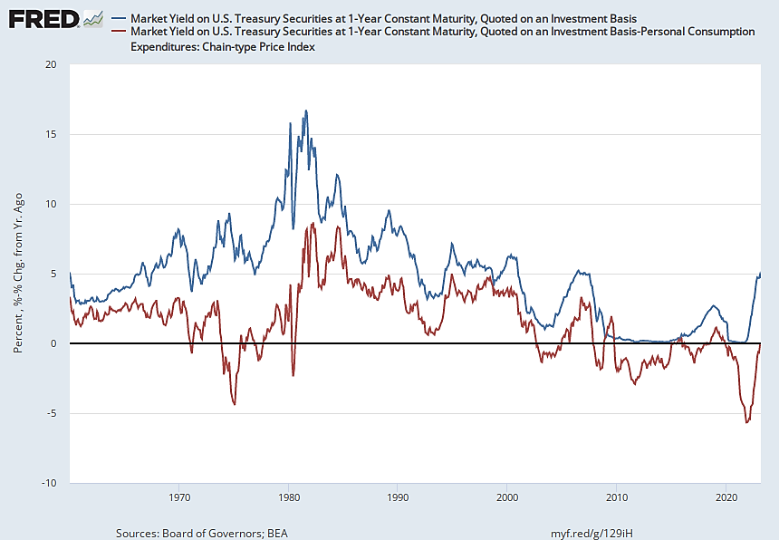
Nominal and Real Interest Rates (1-year nominal interest rate, and 1-year nominal rate minus 1-year inflation rate)
Nominal
Real
Source: FRED. This shows the nominal and real interest rate on 1 year Treasury bills (debt that the US federal government issues)
Notes:
Note to myself: Uncrop to see the series I used. Convert the interest rate from daily to monthly (or specify monthly in FRED)..

Slide 35
Why Consumption/Saving Choices and Investment Depend on the Real Interest Rate r
    Consumer: saving $1 now gives $1+i in nominal $ in one year but purchasing value is only $(1+i)/(1+π) ≈ $1+i-π = $1+r in today’s $.
    Firm: Investing $I for a capital asset (e.g. computer) today and getting $MRP_{K} next year from computer use
      Present Value PV = nominal MRP_{K}/(1+i)
      But nominal MRP_{K} = real MRP_{K} × (1+π) as nominal MRP_{K} grows with inflation as well
      PV= real MRP_{K} × (1+π)/(1+i)=real MRP_{K}/(1+r)
      Firms’ investment decision depends only on real values

Slide 36
V. Unemployment

Slide 37
Definitions
Unemployed: The number of people who are not working and who are actively looking for work.
Employed: The number of people who are working
Vacancies: The number of job openings from firms
Labor force: Employed + unemployed
Activity rate = labor force / population
Unemployment rate u = unemployed/labor force
Vacancy rate v = job openings / labor force

Slide 38
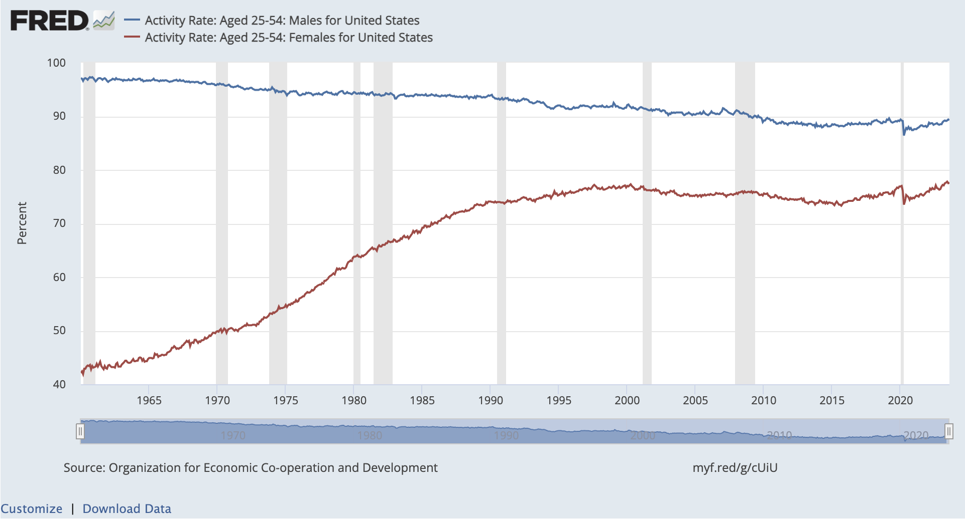
In the US, sharp increase in prime age female activity rate since 1960. Some decrease for men. Labor force includes employed plus unemployed looking for work which explains why activity rate does not fall during recessions.
Source: Fred stats, Fred Blog article

Slide 39
U.S. Unemployment Rate, Jan. 1948–Feb. 2023
Source: FRED; data from Bureau of Labor Statistics. Shaded areas show recessions.

Slide 40
Source: US unemployment rate in log-scale reached all time high of 25% during Great Depression and low of 1% in 1945

Slide 41
US vacancy rate (orange) and unemployment rate (blue) move in opposite directions (Beveridge Curve). Source is Michaillat and Saez ‘24

Slide 42
Types and Sources of Unemployment
Cyclical unemployment
  Caused by output being below potential during recessions
Structural unemployment
  Caused by job rationing due to permanent causes (e.g., minimum wage or unions in perfect competitive model)
Frictional unemployment
  Caused by turnover and job search
Normal or natural unemployment consists of structural and frictional unemployment.

Slide 43
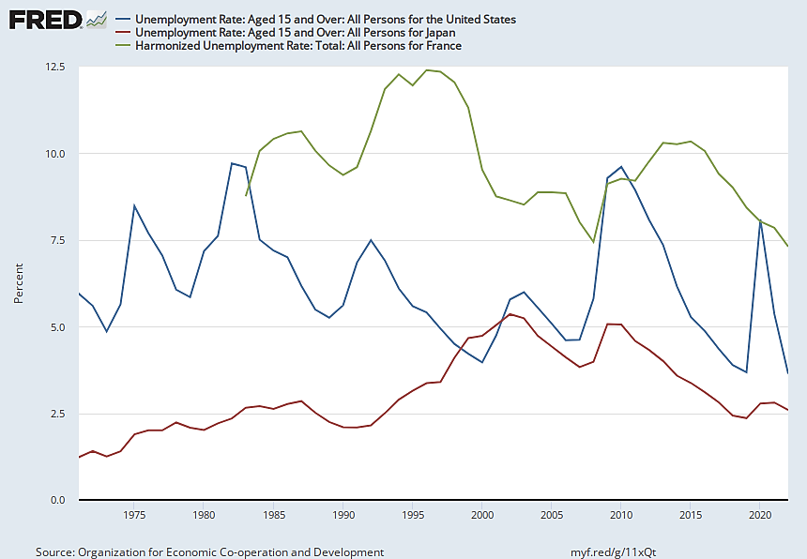
Unemployment 1971–2022, U.S., Japan, and France
France
U.S.
Japan
Source: FRED; data from the OECD.

Slide 44
Frictional Unemployment
It takes time to match workers and jobs.
At the micro level, the economy is constantly changing with lots of jobs getting destroyed and new jobs created
As a result, at any time there are both unemployed workers and job vacancies for employers are trying to fill.
This process is sometimes described as “churn.”

Slide 45
The Natural Rate of Unemployment
The economy’s normal or usual unemployment rate.
The natural rate of unemployment is more than zero.
Vacancies (jobs that firms try to fill) move in the opposite direction as unemployment (Beveridge curve).
  In recessions: too few vacancies, too much unemployment
  In booms: too many vacancies, too little unemployment
Labor market is efficient when number of vacancies are the same as number of unemployed (unemployment wastes resources but so does trying to fill vacancies)

Slide 46
Source: Michaillat and Saez (2024): labor market too slack when unemployed
exceed vacancies (common) and too tight when vacancies exceed
unemployed (rare)

Slide 47
References
CORE-The Economy, Chapter 13.
Principles of Economics, Chapters 17 and 18.

