Slide 1
Lecture 16
Short-run Macro Fluctuations
Economics 2 Emmanuel Saez
Fall 2024

Slide 2
I. Overview of Short-Run Fluctuations

Slide 3
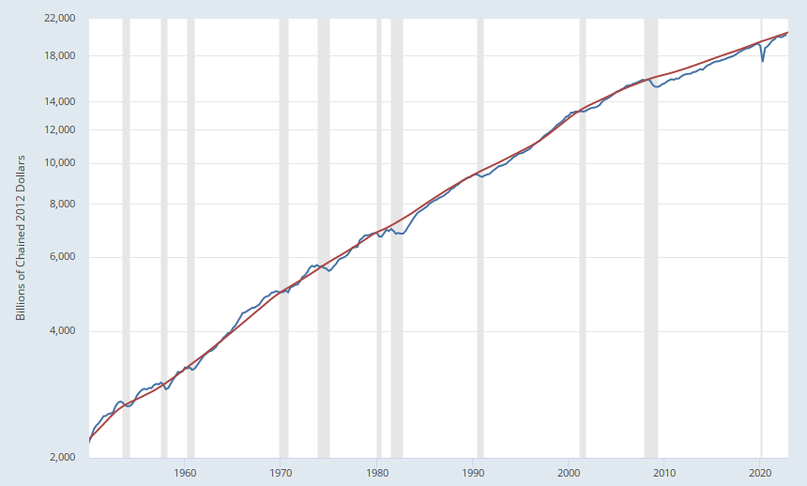
Actual and Potential Real GDP in the U.S.
Potential GDP
GDP
Source: FRED (Federal Reserve Economic Data); data from BEA and CBO.

Slide 4
Short-Run Fluctuations
Times when output moves above or below potential (booms and recessions).
Recessions are costly and very painful to the people affected, especially the unemployed
Short-run fluctuations look tiny relative to long-term growth:
  Rational model: people should care about long-term growth not short-term fluctuations (Robert Lucas)
  Real world: short-run fluctuations matter a lot to people (affect elections). Losses are a lot more salient than gains to people.

Slide 5
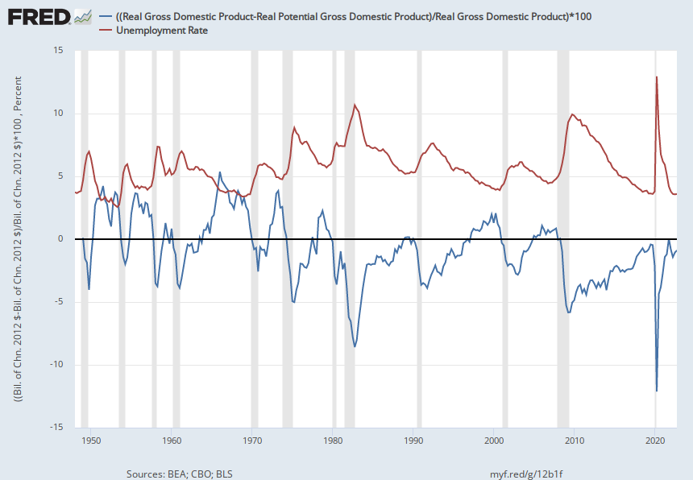
Deviation of GDP from Potential
and the Unemployment Rate
Unemployment Rate
Percent
Deviation of GDP from Potential
Source: FRED; data from Bureau of Labor Statistics, BEA, CBO.

Slide 6
Unemployment and Well-being
Unemployment has negative impacts on the unemployed over and beyond economic income loss
Self-reported happiness/satisfaction/self-esteem drops sharply upon becoming unemployed
Unemployment associated with higher levels of depression and anxiety, more medications, and more physician visits (Linn et al. 1985)
Half of American households don’t have any savings at hand to cushion blow from lost earnings
  Liquid wealth is safety against economic “shocks”

Slide 7
Plan for Our Study of Short-Run Fluctuations
This lecture: discuss the framework.
Then turn to the role of government budget policy (taxes and government spending)
Then turn to monetary policy and the Federal Reserve.
Then expand the framework to understand inflation and the eventual return to potential output.

Slide 8
II. The Key Role of Demand

Slide 9
Key Determinant of Output in the Short Run
In the long run, output (GDP) is equal to potential output.
    Potential output is determined by normal capital, labor, and technology.
In the short run, output can be above, below, or equal to potential output.
    Short-run output is determined primarily by demand: what consumers, firms, and government are purchasing

Slide 10
The Composition of GDP
Recall that GDP Y=C+I+G+NX
Consumption (C) [65-70% of US GDP]
Investment (I) [15-20% of US GDP]
Government purchases (G) [15-20%]
Net Exports = Exports - Imports (NX) [-3%]

Slide 11
Three Terms that Mean the Same Thing
Planned aggregate expenditure.
Planned spending.
Planned aggregate demand.
All three terms refer to the total amount that people/businesses/govt in the economy plan to buy.
In the short run, if planned aggregate expenditure changes, output changes.

Slide 12
Why is Output Determined by Demand in the Short Run?
Prices don’t change quickly or thoroughly enough to keep output at potential.
Due to limited information, long-term contracts, dislike of “unfair” price changes by consumers, dislike of wage cuts by workers, or other factors.
Keynesian revolution in economics: after the Great Depression, Keynes built a framework to account for short-run macro fluctuations still in use in textbook macro

Slide 13
Mom-and-Pop Restaurant Analogy
Short-run: Prices in the restaurant are fixed and hence restaurant produces more or less simply based on demand fluctuations (busy vs. quiet days)
Long-run: Prices adjust so that restaurant owners have normal workload: If demand is high, they increase prices to reduce it. If demand is low, they cut prices to increase it.
If prices adjusted perfectly and immediately, there would be no short-term business fluctuations (absent a real shock like weather for agriculture or COVID).
Keynes key contribution: need different analysis in short run vs. long run.

Slide 14
III. Planned Aggregate Expenditure

Slide 15
Components of Planned Aggregate Expenditure (PAE)
Recall that GDP is Y=C+I+G+NX
Consumption (C)
Planned investment (I^{p})
Government purchases (G)
Net exports (NX) = Exports - Imports
PAE = C + I^{p} + G + NX

Slide 16
Quiz
Why are net exports = exports minus imports part of GDP?
A. Because imports are consumed domestically but bought from abroad
B. Because exports are domestic production that is sold abroad.
C. Because imports are already counted in C but exports are not
D. All of the above
E. None of the above

Slide 17
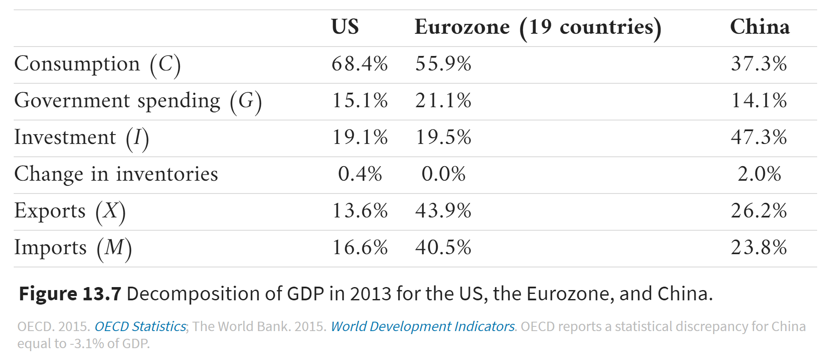
Components of Aggregate Demand (GDP)

Slide 18
Short Run versus Long Run
In the short run:
    PAE can be more than, less than, or equal to Y*.
    Output responds to match PAE.
In the long run:
    Output is at Y* (determined by normal capital, labor, and technology).
    PAE adjusts to equal Y*.
    Movement in r* (long-run interest rate) brings this about.

Slide 19
IV. Determinants of Each Component of PAE

Slide 20
Determinants of Planned Investment (I^{p})
Real interest rate (r). A rise in the real interest rate reduces planned investment.
Expectations about future demand (“animal spirits”)
We talk about “planned investment” because we are leaving out the unplanned investment in inventories that happens when PAE is different from actual output.
Note: inventory are goods produced but not yet sold (counted as investment in GDP)

Slide 21
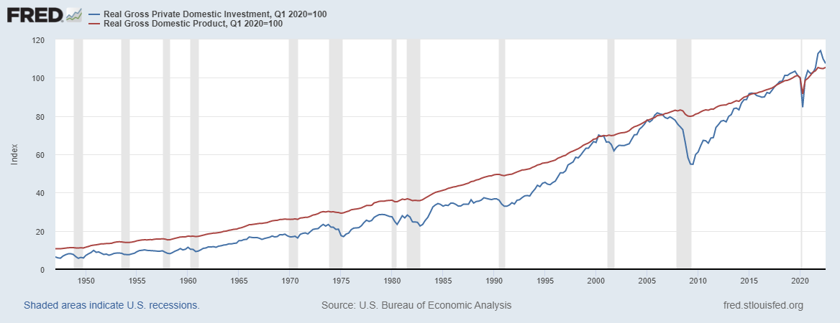
Investment fluctuates more than GDP over the business cycle

Slide 22
Determinants of Government Purchases (G)
Politics.
Wars, natural disasters.
We take G as given.

Slide 23
Quiz
Among those, which one is not part of G?
A. The salary of a public school teacher in California
B. A new military plane bought by the US army.
C. An unemployment benefit check received by an unemployed person in Oregon
D. Funds spent by the City of Berkeley repairing its streets
E. All of the above are part of G

Slide 24
Determinants of Net Exports (NX)
Net exports = Exports minus Imports
For now we are assuming they are just given.
Will discuss the economic determinants later in the course.

Slide 25
Determinants of Consumption (C)
Real interest rate (r): A rise in the real interest rate reduces current consumption (savings’ lecture)
Expectations about future income (“consumer confidence”)
Wealth: A rise in wealth (e.g. stock market boom) increases consumption.
Disposable (or after-tax) income: A rise in disposable income increases consumption.

Slide 26
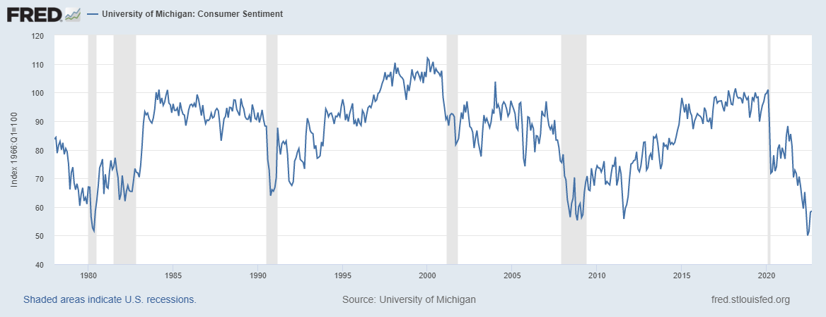
Consumer Sentiment Index
The University of Michigan Survey of Consumer Sentiment Index is an economic
indicator which measures the degree of optimism that consumers feel about
the overall state of the economy and their personal financial situation.

Slide 27
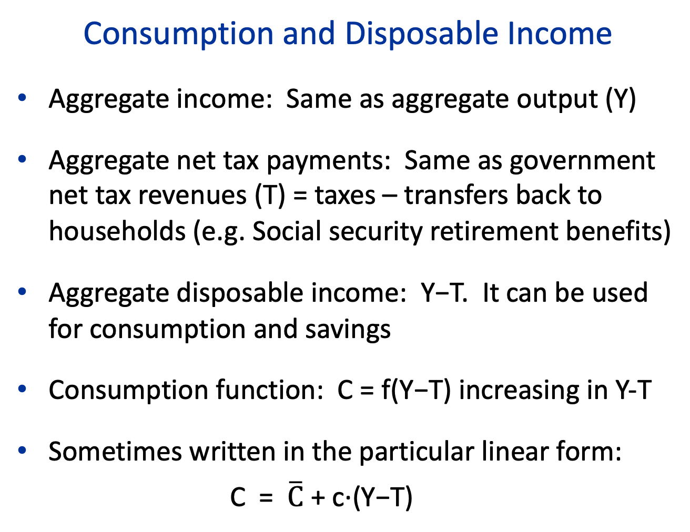
Consumption and Disposable Income
Aggregate income: Same as aggregate output (Y)
Aggregate net tax payments: Same as government net tax revenues (T) = taxes – transfers back to households (e.g. Social security retirement benefits)
Aggregate disposable income: Y−T. It can be used for consumption and savings
Consumption function: C = f(Y−T) increasing in Y-T
Sometimes written in the particular linear form:
C = $\overline{C}$ + c·(Y−T)

Slide 28
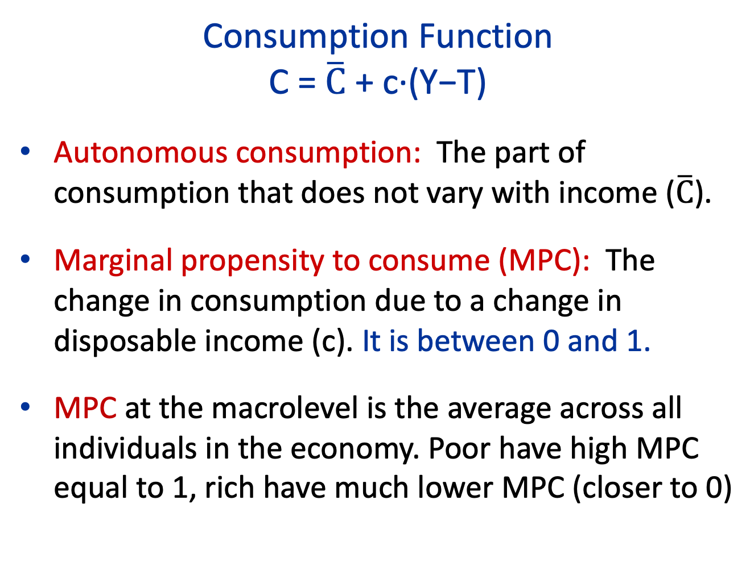
Consumption Function
C = $\overline{C}$ + c·(Y−T)
Autonomous consumption: The part of consumption that does not vary with income ($\overline{C}$).
Marginal propensity to consume (MPC): The change in consumption due to a change in disposable income (c). It is between 0 and 1.
MPC at the macrolevel is the average across all individuals in the economy. Poor have high MPC equal to 1, rich have much lower MPC (closer to 0)

Slide 29
Quiz: what is your MPC?
Suppose UC Berkeley gives you an extra fellowship of $5000 this academic year only. How would this change your spending this academic year?
A. I would just spend the full $5000 extra this year (MPC=1). And even then, I’d struggle to meet my needs.
B. I would spend $4000 extra this year and save $1000 for future years (MPC=.8). I’d like to build up a small cushion of savings in case anything bad happens.
C. I would spend $2500 extra this year and save $2500 for the future. Half and Half seems like a fair rule (MPC=.5)
D. I would save the full $5000 because I already have too much income relative to my spending needs (MPC=0).

Slide 30

Consumption Function
C = $\overline{C}$+ c·(Y−T)
C
Y−T

Slide 31

Consumption Function
C = $\overline{C}$ + c·(Y−T)
C
C
slope = c
C
Y−T

Slide 32
V. Determination of Output in the Short Run

Slide 33
45-degree Line
Captures the equilibrium condition that Y = PAE.
Also reflects the empirical reality that output responds to planned spending in the short run.
  Useful analogy: mom-and-pop Berkeley restaurant faces fluctuations in demand (time of day, day of the week, special events, etc.). How many meals they sell (output) is entirely demand driven (as they don’t adjust prices based on short-run demand)
  When demand is low, they are partly idle. When demand is high, they get (overly) busy

Slide 34
45-degree Line
PAE
Y

Slide 35
45-degree Line
PAE
Y=PAE
45°
Y

Slide 36
Expenditure Line
Captures the fact that planned aggregate spending is a function of total income (which is the same as total output).
Recall that PAE = C + I^{p} + G + NX.
PAE is a function of Y because one component (Consumption) depends on Y.

Slide 37
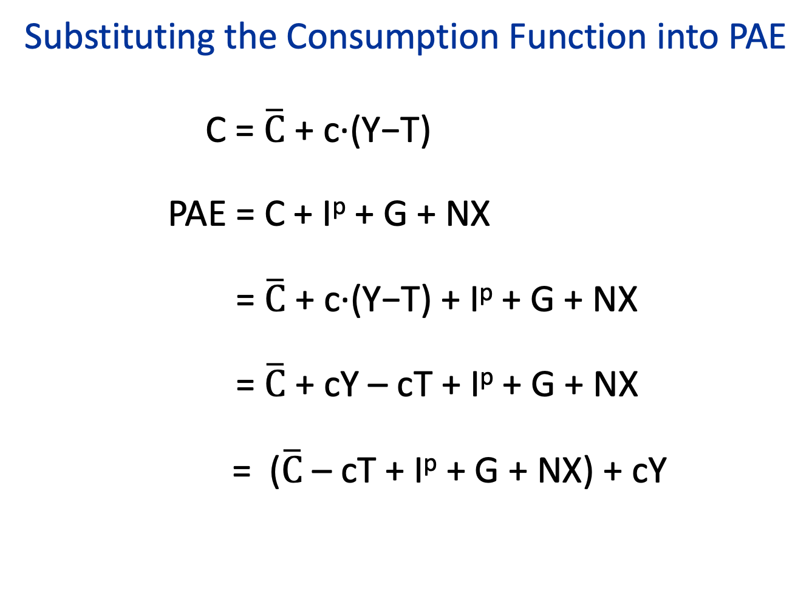
Substituting the Consumption Function into PAE
C = $\overline{C}$ + c·(Y−T)
PAE = C + I^{p} + G + NX
= $\overline{C}$ + c·(Y−T) + I^{p} + G + NX
= $\overline{C}$ + cY – cT + I^{p} + G + NX
= ($\overline{C}$ – cT + I^{p} + G + NX) + cY
Autonomous Spending

Slide 38
Expenditure Line
PAE
PAE
The slope is the MPC.
The intercept is autonomous spending.
Y

Slide 39
Determination of Output in the Short Run
Output in the short run is determined by the intersection of the 45-degree line and the expenditure line.

Slide 40
Determination of Short-Run Output
PAE
Y

Slide 41
Determination of Short-Run Output
PAE
Y=PAE
PAE
Y₁
Y
Sometimes called the “Keynesian Cross” diagram.

Slide 42
How does the economy get to short-run equilibrium?
PAE
Y=PAE
PAE
Y₁
Y

Slide 43
How does the economy get to short-run equilibrium?
PAE
Y=PAE
PAE
Y₁
Y₂
Y

Slide 44
How does the economy get to short-run equilibrium?
PAE
Y=PAE
PAE
Y₁
Y₂
Y

Slide 45
How does the economy get to short-run equilibrium?
PAE
Y=PAE
PAE
Y₃
Y₁
Y₂
Y

Slide 46
How does the economy get to short-run equilibrium?
PAE
Y=PAE
PAE
Y₃
Y₁
Y₂
Y

Slide 47
How does the economy get to short-run equilibrium?
PAE
Y=PAE
PAE
At Y₃, unintended inventory depletion leads firms to increase production.
At Y₂, unintended inventory increase leads firms to cut production.
Y₃
Y₁
Y₂
Y

Slide 48
Determination of Short-Run Output
PAE
Y=PAE
PAE
Y₁
Y

Slide 49
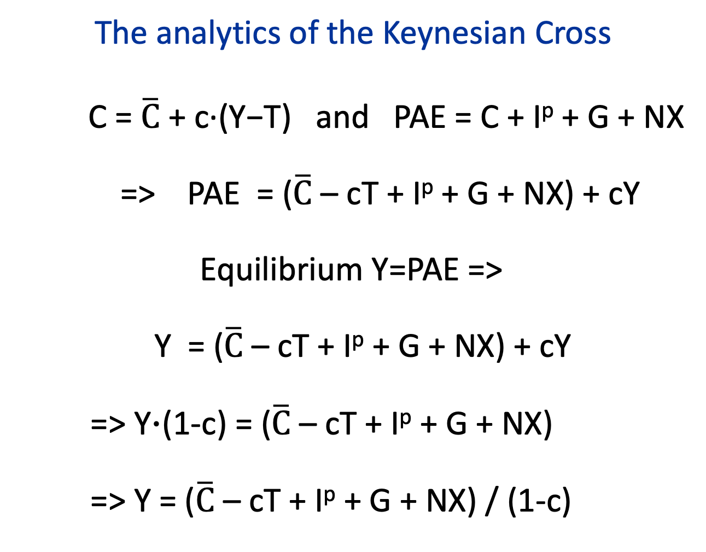
The analytics of the Keynesian Cross
C = $\overline{C}$ + c·(Y−T) and PAE = C + I^{p} + G + NX
=> PAE = ($\overline{C}$ – cT + I^{p} + G + NX) + cY
Equilibrium Y=PAE =>
Y = ($\overline{C}$ – cT + I^{p} + G + NX) + cY
=> Y⋅(1-c) = ($\overline{C}$ – cT + I^{p} + G + NX)
=> Y = ($\overline{C}$ – cT + I^{p} + G + NX) / (1-c)
Autonomous Spending

Slide 50
Long-Run Equilibrium
PAE
Y

Slide 51
Long-Run Equilibrium
PAE
Y=PAE
PAE
Y*
Y
In the long run, Y=PAE and PAE cross at Y* (potential output) with prices adjusting to make Y=PAE happen at Y*

Slide 52
Moving to Long-Run Equilibrium Y*=normal output
PAE
Y=PAE
PAE long-run
PAE short-run
Y₁
Y*
Y
In short-run, PAE and Y=PAE cross at Y₁ (not necessarily Y*).
In the long run, prices adjust to shift PAE so they cross at Y*

Slide 53
Output Determination in Short Run vs. Long-Run
Output in the short run is determined by the intersection of the 45-degree line and the expenditure line = Keynesian analysis
Output in the long run is equal to Y*: prices adjust to move the PAE curve so that PAE=Y happens at Y* = classical analysis
  Keynesian analysis looks trivial/absurd from a classical analysis where price is key mechanism of adjustment
  Keynesian analysis was a true paradigm shift in economic analysis

Slide 54
VI. Shifts in the Expenditure Line

Slide 55
Crucial Determinant of Short-Run Fluctuations: Shifts in the Expenditure Line
Expenditure line (PAE) shows how planned spending varies with output.
Anything that changes planned spending other than output, will shift the curve.
If the expenditure line shifts, short-run equilibrium output will change.

Slide 56
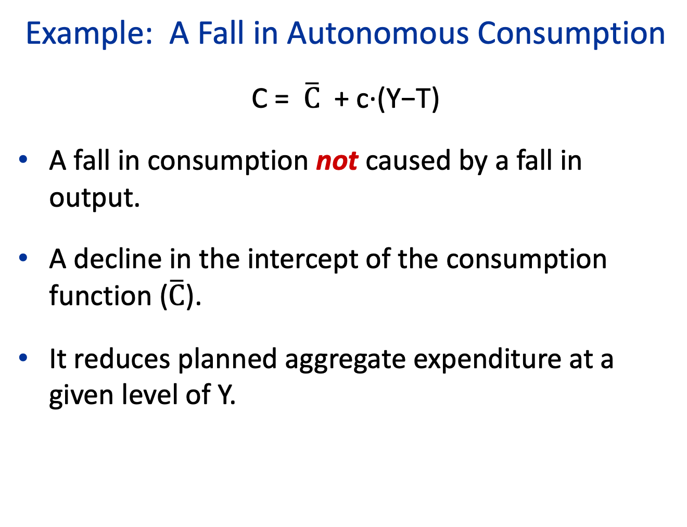
Example: A Fall in Autonomous Consumption
C = $\overline{C}$ + c·(Y−T)
A fall in consumption not caused by a fall in output.
A decline in the intercept of the consumption function ($\overline{C}$).
It reduces planned aggregate expenditure at a given level of Y.

Slide 57
Great Crash of the Stock Market in October 1929
Source: Federal Reserve Bank of St. Louis, FRED.

Slide 58
Why Might a Fall in Stock Prices Reduce Consumer Spending (at a Given Level of Output)?
Reduction in wealth makes consumers feel poorer.
Fall in stock prices makes consumers pessimistic (lowers consumer confidence).
Stock price volatility causes uncertainty and leads to “wait and see” behavior.

Slide 59
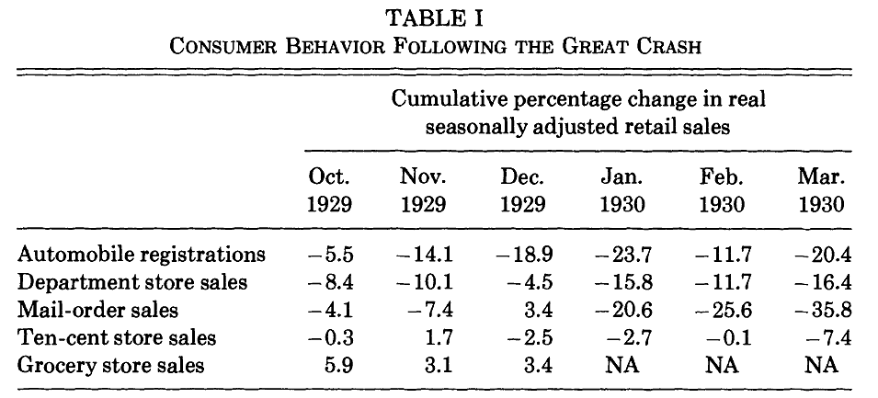
The Collapse of Consumer Spending in 1929-30 relative to pre-crash September 1929
Source: Christina Romer, “The Great Crash and the Onset of the Great Depression.” Crash led to immediate collapse in demand for durable goods (like autos, furniture) but not everyday necessities like groceries. Collapse in demand then led to collapse in production.

Slide 60

A Fall in Autonomous Consumption $\overline{C}$
PAE
Y=PAE
PAE₁
Y*
Y

Slide 61

A Fall in Autonomous Consumption $\overline{C}$
PAE
Y=PAE
PAE₁
PAE₂
Y₂
Y*
Y

Slide 62
Real GDP, 1909–1939
1929
Source: Christina Romer, “The Prewar Business Cycle Reconsidered,” and BEA.

Slide 63
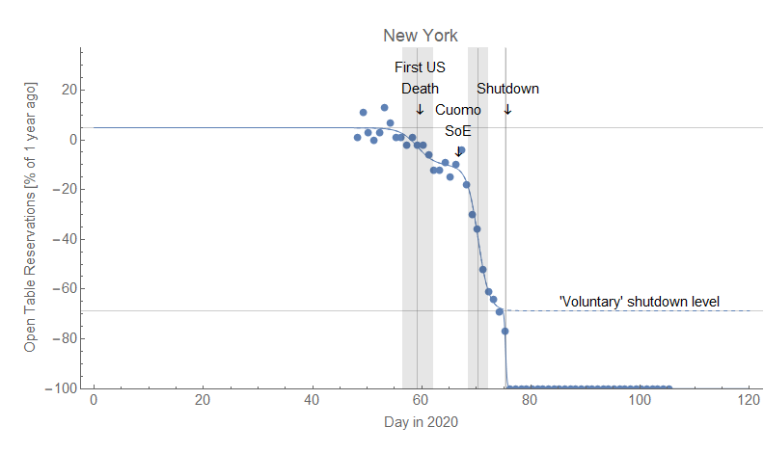
OpenTable Reservations in NYC

Slide 64
The Multiplier Effect
PAE
Y=PAE
PAE₁
PAE₂
Y₂
Y*
Y

Slide 65
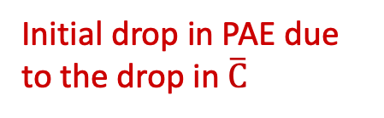
The Multiplier Effect
PAE
Y=PAE
PAE₁
PAE₂
Initial drop in PAE due to the drop in $\overline{C}$
Decline in Y is larger because of the multiplier effect
Y₂
Y*
Y
The initial drop in PAE is magnified by the fact that as Y declines, C declines further.

Slide 66
Multiplier Effect
A change in PAE changes output by more than the initial change in PAE.
Why? Because changes in output affect consumer spending and reinforce (or multiply) the initial change in PAE.
Existence of the multiplier effect explains why moderate changes in planned spending cause more substantial changes in output.

Slide 67
The analytics of the Keynesian Cross
C = $\overline{C}$ + c·(Y−T) and PAE = C + I^{p} + G + NX
=> PAE = ($\overline{C}$ – cT + I^{p} + G + NX) + cY
Equilibrium Y=PAE =>
Y = ($\overline{C}$ – cT + I^{p} + G + NX) + cY
=> Y⋅(1-c) = ($\overline{C}$ – cT + I^{p} + G + NX)
=> Y = ($\overline{C}$ – cT + I^{p} + G + NX) / (1-c)
Autonomous Spending

Slide 68
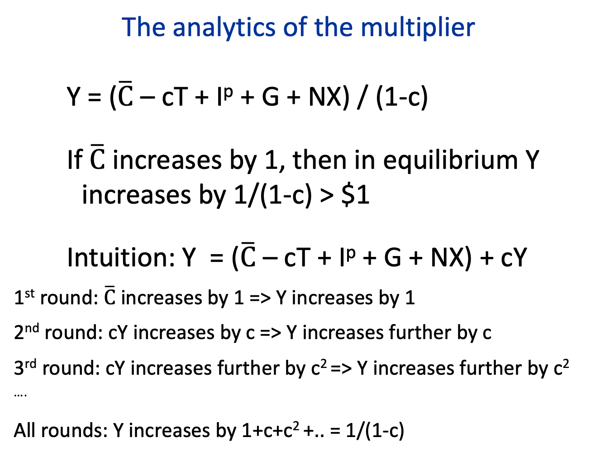
The analytics of the multiplier
Y = ($\overline{C}$ – cT + I^{p} + G + NX) / (1-c)
If$\overline{C}$ increases by 1, then in equilibrium Y increases by 1/(1-c) > $1
Intuition: Y = ($\overline{C}$ – cT + I^{p} + G + NX) + cY
1st round: $\overline{C}$ increases by 1 => Y increases by 1
2nd round: cY increases by c => Y increases further by c
3rd round: cY increases further by c² => Y increases further by c²
….
All rounds: Y increases by 1+c+c² +.. = 1/(1-c)

Slide 69
References
CORE-The Economy, Chapter 13.
Principles of Economics, Chapter 24.

