Slide 1
Lecture 18
Monetary Policy
Economics 2 Emmanuel Saez
Fall 2024

Slide 2
I. Overview

Slide 3
Determination of Short-Run Output: The “Keynesian Cross”
PAE
Y=PAE
PAE
Y₁
Y

Slide 4
Two More Things that Can Shift PAE
Monetary Policy: Actions taken by the central bank to affect nominal and real interest rates.
Disruptions in Financial Markets: Specifically, a financial crisis.

Slide 5
II. Interest Rates, Money, and the Federal Reserve

Slide 6
Different Interest Rates
In practice, many different (nominal) interest rates.
Interest rates depend especially on:
The riskiness of the bond or loan:
  Riskier bonds pay higher interest because they may default. Loans to businesses (corporate bonds) typically riskier than loans to government (govt bonds).
Its maturity (time horizon).
  Example: 10-year US bond: you loan $100 to US government, you get interest i=5% each year. US govt repays you $100 after 10 years (bond matures)
However, different nominal interest rates generally move together. We talk about “The interest rate”
Notes:
Why riskiness matters:
- If the lender is less likely to be repaid, they’re going to charge a higher i. rate to be compensated for that risk.
A couple of reasons that the maturity of a bond or loan matters:
- First, if the maturity is longer, the lender's wealth will be tied up for longer. So they’ll want a higher i. rate to be compensated for that.
- Second, one alternative to making a long-term loan is to make a short-term loan, use what you earn from that to make another short-term loan, and so on.
- That implies that the interest rate you’d need to be willing to make a long-term loan will be affected by what you expect to happen to short-term interest rates.
- I’ll come back to this in a moment.

Slide 7
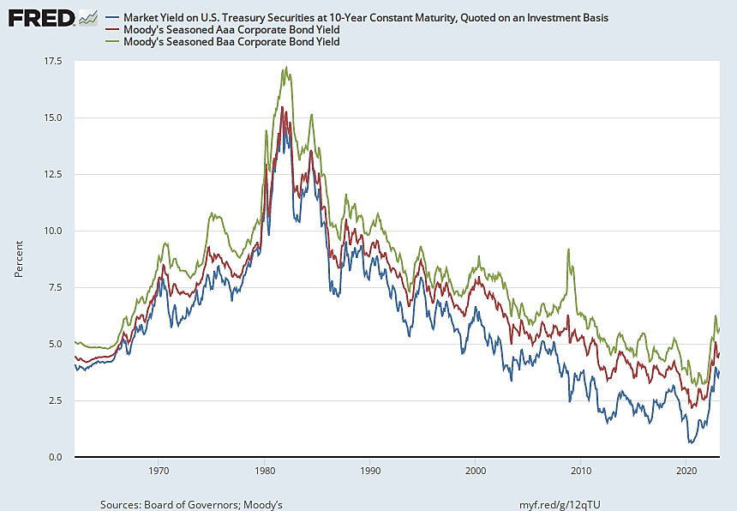
Interest Rates on Bonds of Different Riskiness
Riskiness of bonds is evaluated by financial firms using letters: (Moody’s, S&Ps, Fitch): AAA is safest, AA, A, BBB, …, C, D are riskiest (junk bonds)
Notes:
Similar maturities.
But different riskiness.
I. rate on riskier = higher.
Generally move together (highlight).
But, not always (highlight).

Slide 8
Quiz on interest and risk
Suppose you have $10K to save for one year. Which bond would be most attractive to you?
A. A safe Federal Government Treasury bond that pays an interest rate of 5% (risk of default is zero).
B. An BBB corporate bond with interest rate of 10% but where I can lose it all with 5% chance (if company goes bankrupt).
C. A CCC junk corporate bond with interest rate of 15% but where I can lose it all with 10% chance (if company goes bankrupt)
D. I am indifferent between A, B, C.

Slide 9
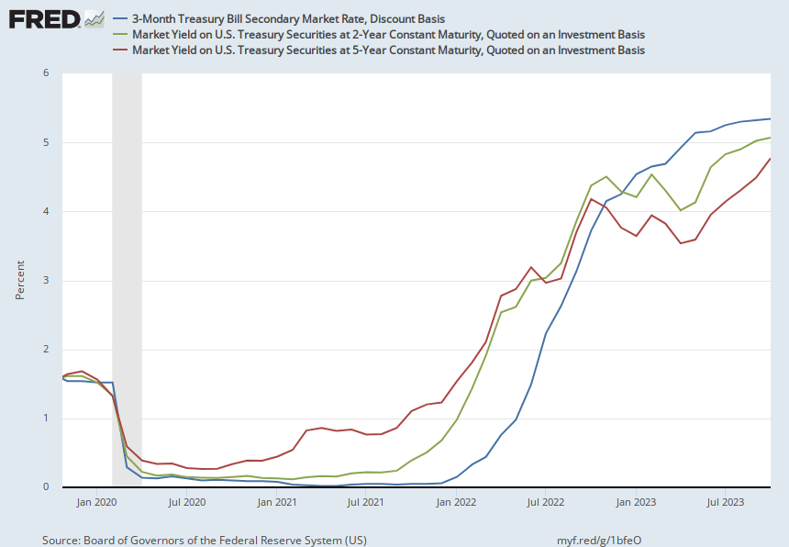
Interest Rates on Bonds of Different Maturities
In principle: interest on long-term maturity bond of 2 or 5 years reflects expected average interest on short-term bonds over the next 2 or 5 years

Slide 10
Bonds with Different Maturities
1) You save $1 in a 1-year Treasury bond with annual interest i₁. After 1 year, you get $1+i₁
Suppose you re-save in a 1-year Treasury bond next year that will pay interest i_{1n} where n denotes “next year”.
You get (1+i₁)(1+i_{1n})≈1+i₁+i_{1n}
2) You save $1 in 2-year Treasury bond with annual interest i₂. After 2 years, you get ≈ $1+2i₂
You are indifferent between the 2 options if i₂ = (i₁+i_{1n})/2
i₁ and i₂ today tell us what the market expects for i_{1n}

Slide 11
Quiz
3-year Treasury bonds currently pay annual interest 4% but 1-year Treasury bonds pay 4.5%. This means that:
A. The market expects interest on 1-year treasury bonds to increase in the next two years
B. The market expects interest on 1-year treasury bonds to decrease in the next two years
C. The market expects interest on 1-year treasury bonds to stay the same in the next two years
D. None of the above necessarily

Slide 12
Money
Money is an asset that has 3 characteristics:
  Medium of exchange (=can be used to make purchases)
  Unit of account (=all prices are quoted in the money unit)
  Store of value (=wealth can be held in the form of money)
Historically: money was precious metals (gold and silver coins and ingots).
Today: money is currency=cash (coins, paper bills)+ balances in checking accounts. Money typically does not pay interest but can be used for purchases
  M0=cash ($2 trillion), M1=M0+checking accounts ($5T), M2=M1+savings accounts ($15T)
Notes:
Re #3:
Can also do the other way, and so take money out of circulation.
Re #4:
Recall: Fiscal policy: Actions taken by the government to change the budget surplus.
Monetary policy: Actions taken by the central bank to affect nominal and real interest rates.
Often hear things like, I can’t believe the Fed spent a trillion dollars bailing out the financial system. M.p. affects the economy (as we’ll see), but it doesn’t involve direct payments to anyone.)

Slide 13
Quiz
How many of the money characteristics (medium of exchange, unit of account, store of value) does the crypto currency bitcoin have?
A. 0
B. 1
C. 2
D. 3

Slide 14
Commercial Banks and Money
Commercial Bank is a business that:
  Takes and safeguards deposits (e.g. checking accounts)
  Uses 90% of these funds to provide loans (e.g. mortgages, consumer credit loans, business loans). 10% is reserve.
Banks borrow short (depositors can cash out anytime) and lend long (loans are for years)
  Risk of bank run if depositors all cash out [Diamond-Dybvig]. Federal government provides insurance (FDIC) to all deposits since 1933 to eliminate bank run risks
  Bank activity “creates” money as both depositor and borrower have access to the same funds.
Notes:
Re #3:
Can also do the other way, and so take money out of circulation.
Re #4:
Recall: Fiscal policy: Actions taken by the government to change the budget surplus.
Monetary policy: Actions taken by the central bank to affect nominal and real interest rates.
Often hear things like, I can’t believe the Fed spent a trillion dollars bailing out the financial system. M.p. affects the economy (as we’ll see), but it doesn’t involve direct payments to anyone.)

Slide 15
The Federal Reserve and Monetary Policy
The Fed (=US Central Bank) is the only institution that is allowed to put money (dollars) into circulation.
It does this by printing money (literally and now mostly electronically) and trading it for financial assets (most often short-term U.S. government debt = US Treasury bills or bonds).
These actions are called “open-market operations.”
Note: when the Fed does this, it isn’t adding to government spending or making transfer payments to banks or individuals (it isn’t engaging in fiscal policy).
Notes:
Re #3:
Can also do the other way, and so take money out of circulation.
Re #4:
Recall: Fiscal policy: Actions taken by the government to change the budget surplus.
Monetary policy: Actions taken by the central bank to affect nominal and real interest rates.
Often hear things like, I can’t believe the Fed spent a trillion dollars bailing out the financial system. M.p. affects the economy (as we’ll see), but it doesn’t involve direct payments to anyone.)

Slide 16
Fed (US Central Bank) has 3 functions
Price stability: Ensure that price inflation stays low and stable around 2% per year
Maximum employment: Ensure that the economy is at the normal output Y* with efficiently low (but non-zero) unemployment (say around 4%)
Financial stability: Fed is also lender of last resort for banks. Can loan any amount to any financial institution.
The first two sometimes referred to as dual-mandate
Notes:
Re #3:
Can also do the other way, and so take money out of circulation.
Re #4:
Recall: Fiscal policy: Actions taken by the government to change the budget surplus.
Monetary policy: Actions taken by the central bank to affect nominal and real interest rates.
Often hear things like, I can’t believe the Fed spent a trillion dollars bailing out the financial system. M.p. affects the economy (as we’ll see), but it doesn’t involve direct payments to anyone.)

Slide 17
Money production and government
Money is a useful tool for unit of account and exchanges
Historically: gold/silver had to be mined => costly to produce money
Today: money is produced at essentially zero cost by central bank
Great innovation which also gives government the powerful tool of monetary policy to stabilize the business cycle
Notes:
Re #3:
Can also do the other way, and so take money out of circulation.
Re #4:
Recall: Fiscal policy: Actions taken by the government to change the budget surplus.
Monetary policy: Actions taken by the central bank to affect nominal and real interest rates.
Often hear things like, I can’t believe the Fed spent a trillion dollars bailing out the financial system. M.p. affects the economy (as we’ll see), but it doesn’t involve direct payments to anyone.)

Slide 18
Downside risk of money mismanagement
Excess money creation can sometimes debase the currency (sustained inflation, hyperinflation).
Generally happens when government directly sells government debt to the central bank in exchange of new money to fund government expenses
This is called monetization of government debt which mixes fiscal and monetary policy
Making the central bank independent from the rest of government mitigates this risk (US Fed, EU central bank are largely independent)
Notes:
Re #3:
Can also do the other way, and so take money out of circulation.
Re #4:
Recall: Fiscal policy: Actions taken by the government to change the budget surplus.
Monetary policy: Actions taken by the central bank to affect nominal and real interest rates.
Often hear things like, I can’t believe the Fed spent a trillion dollars bailing out the financial system. M.p. affects the economy (as we’ll see), but it doesn’t involve direct payments to anyone.)

Slide 19
Modern Monetary Policy Analysis: Fed Controls the Short-Run Nominal Interest Rate
Fed uses two tools to move nominal interest rates (“conventional” monetary policy):
Fed chooses interest rate i paid on banks’ “reserves” (as reserves held by banks are deposited at Fed). Higher i makes reserves more attractive to banks (reduces bank loans and hence money)
Fed buys/sells Treasury bills (=short-term govt bonds) through open-market operations:
  Fed creates money by buying Treasury bills in exchange of newly created money (and conversely)
  Buying Treasury bills lowers the interest govt needs to pay on them (and conversely)
Notes:
I’ll just sketch the intuition for why these affect i. rates that are relevant to econ. decisions.
That is, i. rates that people get on their savings and pay on loans.
A. i. rate on reserves:
Think of the bank with some cash on hand. (= “reserves.”)
The Fed will pay it some interest on those reserves.
That’s not an i. rate that directly affects individuals’ decisions.
But it affects those i. rates.
Think of the bank considering lending out the money instead of holding on to it as reserves.
Fed raises i. on reserves: opportunity cost of making a loan rises. …
So i{reserves} rises => i. rates in the economy rise.
A specific example of: i’s generally move together.
B. Supply of reserves:
Intuition is a little harder.
Think of how large a premium over the i. rate on reserves the bank will charge on its loans.
If there are very few reserves in the system, so each bank has relatively little, banks are going to really value those reserves. (E.g., meeting unexpected withdrawals.) => Charge a large premium on loans.
Conversely, if a lot of reserves, banks will likely have all they need to meet any plausible short-run needs => Willing to lend at only a small premium over i. rate on reserves.
So: Fewer reserves => i on loans up.
C. Bottom line: - The particular interest rate that the Fed targets is called the federal funds rate.
- It is the rate at which banks borrow from one another overnight.
- It is a very short-term interest rate on very safe assets.
- When you hear that the Fed has decided to do this or that to the federal funds rate, you can be sure that it will move as the Fed plans.

Slide 20
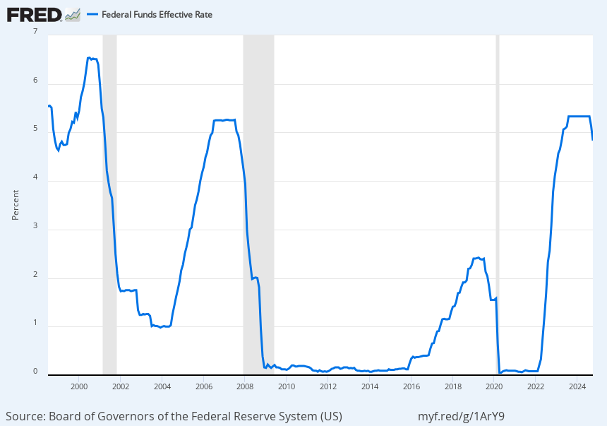
Nominal Interest Rate chosen by the US Fed
Federal funds effective rate is the nominal interest rate set by fed.

Slide 21
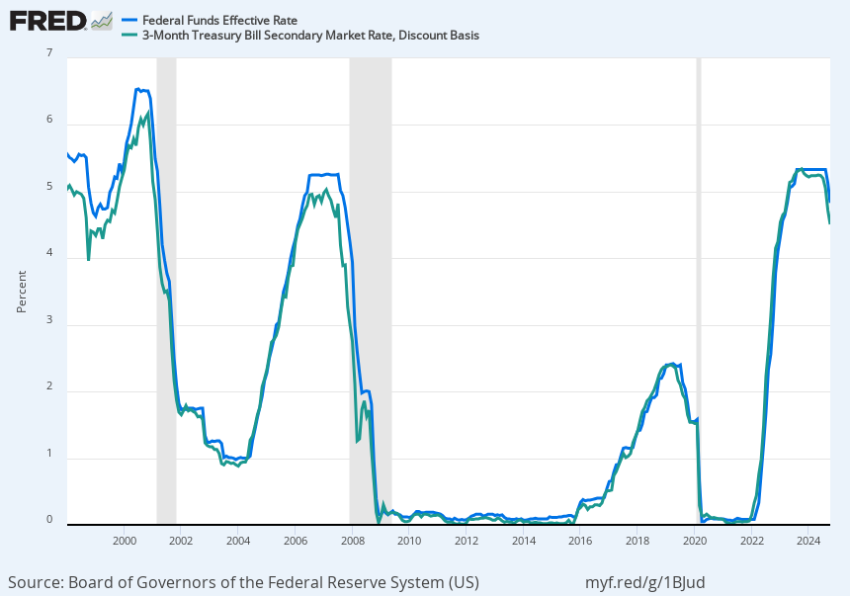
Nominal Interest Rate chosen by the US Fed
Federal funds effective rate is the nominal interest rate set by fed. Interest rate on 3-month Treasury Bill follows very closely.

Slide 22
Quiz
Why do the Fed funds rate and the interest rate on short-term Treasury bonds follow each other closely?
A. The market expects interest on 1-year treasury bonds to increase in the next two years
B. The market expects interest on 1-year treasury bonds to decrease in the next two years
C. The market expects interest on 1-year treasury bonds to stay the same in the next two years
D. None of the above necessarily

Slide 23
Money Demand Curve Economy Wide
Money demand curve
Nominal Interest Rate i
Money M
Money demand declines with interest i because money does NOT pay interest.
Interest is the opportunity cost of holding money

Slide 24
Money Demand Curve and Fed Money Supply
Fed controls money supply
Nominal Interest Rate i
Money demand curve
Money M
Money demand declines with interest i because money does NOT pay interest.
Interest is the opportunity cost of holding money

Slide 25
Fed Money Supply = Control on Nominal Interest Rate
Fed increases money supply
which lowers the interest rate i
Nominal Interest Rate i
Money M
Money demand declines with interest i because money does NOT pay interest.
Interest is the opportunity cost of holding money

Slide 26
The Fed’s Ability to Influence the Real Interest Rate—the Short Run
As we have seen, the Fed can change “the” nominal interest rate, i.
Recall: real interest rate r = i − π, and there is nominal rigidity: prices are rigid so that inflation moves relatively slowly
So: When the Fed changes i, it changes r.

Slide 27
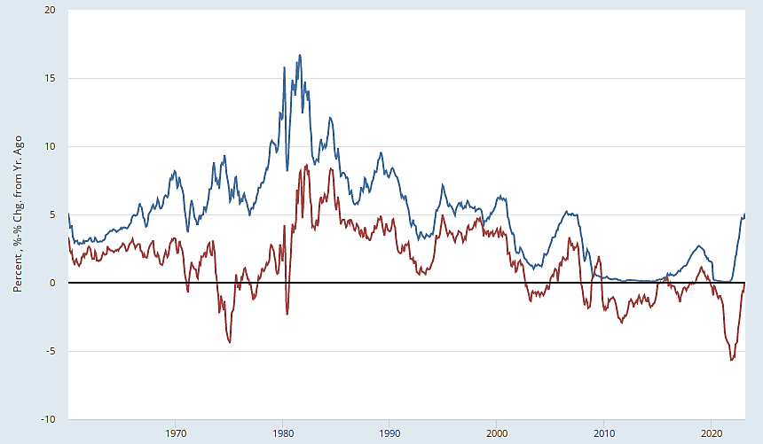
Nominal and Real Interest Rates (1-year nominal interest rate, and 1-year nominal rate minus 1-year inflation rate)
Nominal
Real
Fed sets the nominal interest rate (blue line) which affects the real interest rate (red line) as inflation does not respond quickly due to nominal rigidities
Notes:
Note to myself: From Lecture 19.

Slide 28
Takeaways
The Fed has a variety of tools that allow it to affect “the” nominal interest rate.
Effectively: decreasing the nominal interest rate means increasing money supply (and conversely)
In the short run, when the Fed changes the nominal interest rate, the real interest rate moves in the same direction.
Notes:
And, there’s a long-run constraint, which we’ll talk about a lot next time.

Slide 29
III. Monetary Policy and Short-run Macroeconomic Fluctuations

Slide 30
The Real Interest Rate and Planned Aggregate Expenditure (PAE)
Recall: PAE = C + I^{p} + G + NX.
I^{p} decreases with interest rate r.
Saving increases with r and therefore consumption C decreases with interest rate r.
We will see later that NX is lower when r is higher.
PAE(r) = C(r) + I^{p}(r) + G + NX(r).
Conclusion: An increase in r reduces PAE at a given Y through these 3 channels.
Normal interest r* defined such that PAE(r*)=Y*

Slide 31
Quiz
Why does investment I by firms decrease with r?
A. Because with higher r, there is less money available for businesses to use
B. Because the Fed sets the interest rate r
C. Because with higher r, the present value of an investment is lower
D. All of the above
E. None of the above necessarily

Slide 32
Normal interest rate r* defined such that PAE(r*)=Y*
PAE
Y=PAE
PAE(r*)
Y*
Y
In the long-run, economy produces normal output Y*, which defines the normal interest rate r* such that PAE(r*)=Y*

Slide 33
An Increase in the Real Interest Rate by Fed lowers PAE
PAE
Y=PAE
PAE(r*)
PAE(r)
Y₁
Y*
Y
If r>r* then PAE(r) crosses Y diagonal at Y₁ below Y*

Slide 34
A Decrease in the Real Interest Rate lifts PAE up
PAE
Y=PAE
PAE(r)
PAE(r*)
Y*
Y₂
Y
If r<r* then PAE(r) crosses Y diagonal at Y₂ below Y*

Slide 35
The Fed’s Ability to Influence the Real Interest Rate—the Short Run versus the Long Run
The Fed can affect the real interest rate in the short run (Keynesian macroeconomics)
However, in the long run, r must be at the level that equilibrates S* and I*—that is, it must equal r* [this is the normal interest rate where PAE=Y crosses at Y*]
The Fed cannot keep r away from r* indefinitely (as we will discuss later)

Slide 36
Quiz
In the model, why is there a single interest rate r* such that PAE(r*)=Y*?
A. Because in the long-run, the economy goes back to Y*
B. Because the PAE decreases with r
C. Because the Fed can only affect r in the short-run
D. All of the above
E. None of the above necessarily

Slide 37
Monetary Policy
Actions taken by the central bank to affect nominal and hence real interest rates.
Contractionary monetary policy: Federal Reserve actions to increase nominal and hence real interest rates => Decreases output Y in short-run
Expansionary monetary policy: Federal Reserve actions to decrease nominal and hence real interest rates => Increases output Y in short-run

Slide 38
Why Might the Central Bank Undertake Expansionary or Contractionary Monetary Policy?
To offset some other force that is shifting the PAE line (countercyclical monetary policy).
We’ll discuss an example at the end of lecture (monetary policy in the Great Recession).
To pursue some other objective.
We’ll discuss the Fed’s main other objective next lecture: inflation.
A mistake.
Example: Monetary policy in the Great Depression.

Slide 39
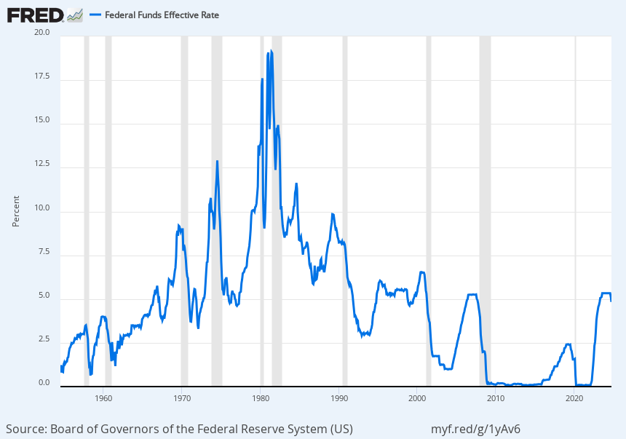
Nominal Interest Rate chosen by the US Fed
During recessions (grey bars): Fed reduces interest rate to stimulate the economy and cranks up interest rate during booms to prevent overheating

Slide 40
Nominal Interest Rate chosen by the US Fed
During recessions (grey bars): Fed reduces interest rate to stimulate the economy and cranks up interest rate during booms to prevent overheating

Slide 41
Suppose PAE falls: Absent policy response, this generates a recession
PAE
Y=PAE
PAE₁
PAE₂
PAE shifts down (to PAE₂):
Example fall in autonomous consumption
Y₂
Y*
Y

Slide 42
Combining the Effects of a Fall in PAE and an interest rate cut by the Fed
PAE
Y=PAE
PAE₁,PAE₃
PAE₂
PAE shifts back up (to PAE₃) because of the interest rate cut.
PAE shifts down (to PAE₂) because of the recession (e.g. fall in autonomous consumption).
Y*
Y

Slide 43
Industrial Production, 1927–1934
Source: Federal Reserve Bank of St. Louis, FRED.

Slide 44
Monetary Policy in the Great Depression
“Money Stock,” 1923–33
Bank Reserves, 1928–1932
Sources: FRED; Friedman and Schwartz, A Monetary History of the United States
Money stock and bank reserves fell because many banks went bankrupt

Slide 45
Real Interest Rate, 1923–1933
Source: Federal Reserve Bank of St. Louis, FRED.
During Great Depression: Fed failed to reduce the real interest rate and this worsened and prolonged the economic downturn. Interest rate fell during New Deal of Roosevelt but WWII spending provided the strongest stimulus.

Slide 46
Monetary Contraction in the Great Depression
PAE
Y=PAE
PAE₁
PAE₂
Y₂
Y*
Y
PAE₂ shows the effects of the fall in autonomous consumption.

Slide 47
Monetary Contraction in the Great Depression
PAE
Y=PAE
PAE₁
PAE₂
PAE₃
Y₃
Y₂
Y*
Y
PAE₃ shows the effect of monetary contraction and the rise in r.

Slide 48
Industrial Production, 1927–1934
Source: Federal Reserve Bank of St. Louis, FRED. Industrial production collapsed by 50% from 1929 to 1932 worse economic recession ever in the US (unemployment rate climbed to 25%)

Slide 49
Limit of Monetary Policy: Zero Lower Bound for nominal interest
Fed stimulates the economy by lowering the nominal interest rate
Fed cannot lower the nominal interest rate below zero because economic agents can always get a zero nominal interest rate by just holding money
This is called the Zero Lower Bound limit on monetary policy. US hit zero lower bound in 2009-2016 and 2020-21. Japan has been there for decades.
Some countries such as Switzerland have experimented with negative interest rate (can be done as most money is now electronic).

Slide 50
Nominal Interest Rate chosen by the US Fed
During recessions (grey bars): Fed reduces interest rate to stimulate the economy and cranks up interest rate during booms to prevent overheating

Slide 51
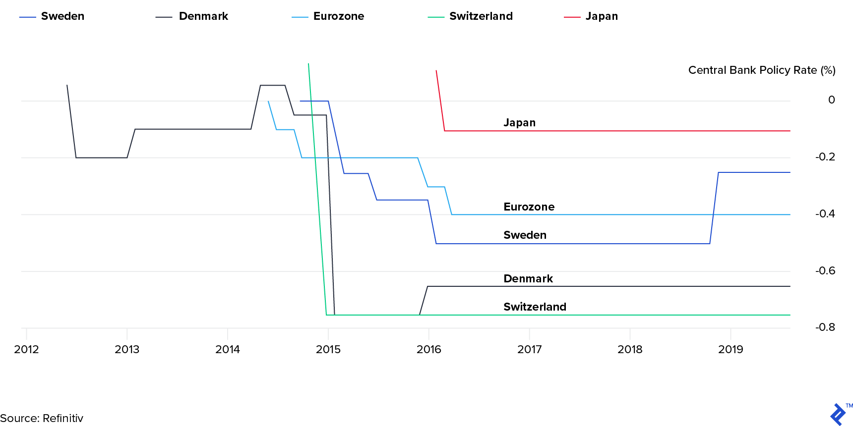
Central Banks in some countries have gone slightly below the Zero Lower Bound
A (slightly) negative interest rate is possible if banks can charge negative interest rate on bank accounts (and cash is not convenient alternative for users)

Slide 52
Poll
What would you do if banks charged a negative nominal interest rate of -5% and bank accounts? You put $1000 in your account, after one year, you have only $950.
A. I would spend more to keep my account balance as small as possible.
B. I would cash out my account and keep the cash in my wallet or at home.
C. I would move my money to gold, bitcoin, or the stock-market
D. I wouldn’t do anything because I need my bank account and cash is not convenient

Slide 53
IV. Financial Crises

Slide 54
Financial Intermediation
The process of getting saving into productive investment.
Financial intermediaries are the markets and institutions that do this.
Financial intermediaries include banks, investment banks, money market mutual funds, pension funds, etc.
Simple example: your savings deposited at the bank (=saving) are used to provide a loan to a business that buys new capital (=investment)

Slide 55
What Is a Financial Crisis?
A time when:
A number of financial institutions are in danger of failing.
People lose confidence in many financial institutions.
As a result, there is widespread disruption of financial intermediation
Affects negatively “real economy” as businesses struggle to get access to finance (loans, etc.)

Slide 56
A Stylized Bank Balance Sheet
Uses of funds Sources of funds
(= Assets) (= Liabilities) .
Loans Deposits
Reserves Equity (“Capital”) provided by bank owners

Slide 57
How an Individual Financial Institution Can Fail
Defaults and changes in asset values can reduce the value of an institution’s loans
If the value of the loans falls to the point where they are worth less than the institution’s obligations to its depositors and lenders, the institution is insolvent.
A belief that the institution is in danger of becoming insolvent can cause depositors to withdraw their funds. Institution is then said to be illiquid
Illiquid bank risks becoming insolvent if forced to liquidate its assets at low prices (fire sale prices)
Fed can solve illiquid bank problems by being lender of last resort

Slide 58
How an Individual Financial Institution Can Fail—The Case of Silicon Valley Bank
Many of its assets were long-term U.S. Treasury bonds (with fixed interest set when issued)
What happens to the value of those bonds when interest rates rise?
They fall (this is the concept of “present value” at work).
Silicon Valley Bank became insolvent and was taken over by govt in March 2023, eventually sold to First Citizen Bank
Notes:
Explain what they are.
Safe, in the sense that=~ no risk that the gov’t won’t pay.
But …

Slide 59
Contagion from SVB—The Case of First Republic Bank
“First Republic shares’ price dives on contagion fear”
- Reuters, 3/13/2023
SVB
collapes
Source: MarketWatch.

Slide 60
Contagion of Crises across Financial Institutions
Confidence: Troubles at one institution create doubts about the health of other institutions, even if there are no connections between them.
Linkage: Troubles at one institution directly harm other institutions because of loans, insurance contracts, and other direct links among them.
Fire Sale: Troubles at one institution cause it to sell off assets, driving down the prices of assets held by other institutions.
Macroeconomic: Troubles at one institution reduce PAE and hence Y, and so harm other institutions.

Slide 61
Effects of a Financial Crisis on PAE
It raises credit spreads (that is, the amounts that interest rates on risky bonds and loans exceed interest rates on safe assets).
It may raise lending standards or otherwise reduce the availability of loans.
It may harm consumer and firm confidence.
All of these developments are likely to reduce PAE at a given level of Y.

Slide 62
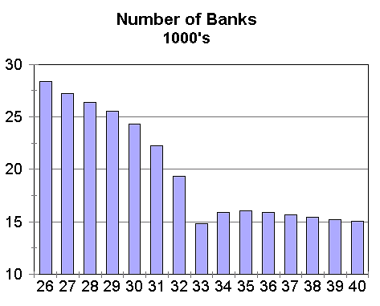
Decline in the Number of Banks in the Great Depression
Number of Banks (1000s)
Source: www.econreview.com. Bernanke won Nobel prize in 2022 for documenting that bank bankruptcies disrupted business and worsened the Great Depression.

Slide 63
The Effects of a Financial Crisis on Output
PAE
Y=PAE
PAE₁
Y*
Y

Slide 64
The Effects of a Financial Crisis on Output
PAE
Y=PAE
PAE₁
PAE₂
Y₂
Y*
Y

Slide 65
Possible Policies to Prevent Financial Crises
Deposit insurance (done in 1933 after Great Depression). All accounts below $250K are insured.
Higher “capital” requirements for financial institutions (done in 2010 Dodd-Frank Act after Great Recession)
Regulation of risk-taking by financial institutions and linkages among financial institutions (Dodd-Frank addresses some of that, watered down since)
Using monetary and fiscal policy to keep the economy stable

Slide 66
Unconventional Monetary Policy:
The Great Recession and Covid
Notes:
We’ve discussed m.p., the r. i. rate, and the K. cross.
And we’ve done 1 application—mp in the Great Depression. Want to do a second.
[to next slide]

Slide 67
Nominal Interest Rate chosen by the US Fed
During recessions (grey bars): Fed reduces interest rate to stimulate the economy and cranks up interest rate during booms to prevent overheating

Slide 68
Monetary Policy in 2007–2008
PAE
Y=PAE
PAE₁
PAE₂
Y₂
Y*
Y

Slide 69
Monetary Policy in 2007–2008
PAE
Y=PAE
PAE₁
PAE₃
PAE₂
Y₂
Y₃
Y*
Y
Setting i=0 is not sufficient to bring economy back to normal output Y*
Notes:
Effects - ASK
- [Tie back to “Why might the c.b. undertake exp.y or contr.y m.p.?” “To offset some other force that is shifting the PAE line (countercyclical m.p.).”]
- It typically is quite effective: Spending does respond to i. rate changes.
One problem with using m.p. to deal with recessions, however, is that it affects the economy with a lag.
a. The Fed can drop i. rates quickly, but takes a while for spending to resp.
- As much as 6 months to a year.
- People have to see the lower rates, decide to spend, + then implement the change in spending.
- The lags are especially long for bus. i.–where planning takes quite a while.
The Fed started cutting i. rates in July 2007.
Because of the lags, and perhaps because they were a little slow, their actions came too late to prevent a recession.
COULD STOP HERE. [3:27]
E. The start of the Great Recession vs. the start of the Great Depression
Last thing I want to say about the G.D., the G.R., + the policy responses:
Talk of “preventing a second G.D.” is based on something real!

Slide 70
Two Tools That Affect a Subset of Nominal Interest Rates (“Unconventional” Monetary Policy)
The main motivation for unconventional monetary policy is that nominal interest rates cannot go (much) below zero.
The reason is that there is an asset—currency—that offers a zero nominal rate of return for sure.
Forward guidance: Statements or actions that influence expectations about future nominal interest rates.
Quantitative easing: Buying assets other than short-term government debt or providing liquidity to financial institutions using newly created money
Notes:
Now, those are the Fed’s main tools. But they have others.
[Go thru first bullet + subbullet.FG: - A simple version is for the Fed to say that they plan to keep the safe, short-term nominal interest rate [federal funds rate] close to zero for at least a certain period of time, like the next 6 months.
Why this affects longer-term rates
- Think about a firm that’s trying to issue long-term debt.
- If the Fed has said it will keep short-term interest rates low for a long time, that probably will make people thinking of lending to the firm more willing to make it a long-term loan at a low interest rate – because the alternative of holding a short-term asset and then rolling the proceeds over to another short-term asset, …, doesn’t look as attractive.
Quantitative easing:
- Normally when the Fed changes the quantity of reserves, ….
- But the Fed can also buy other assets, like long-term government debt.
- If the Fed has bought up a lot of the long-term debt in the economy, people who are interested in holding long-term debt will have fewer options, and so again they’re likely to be willing to give the firm a lower interest rate on its long-term debt.
Bottom line: Fed can influence i’s.
I’ll go back to talking about “the” nominal i. rate.
[2:34]
[SWITCH BACK TO NOTES]

Slide 71
Forward Guidance in 2008 and 2009
December 16, 2008: “The Federal Reserve … anticipates that weak economic conditions are likely to warrant exceptionally low levels of the federal funds rate for some time.”
March 18, 2009: “[T]the Federal Reserve … anticipates that economic conditions are likely to warrant exceptionally low levels of the federal funds rate for an extended period.”
Announcing that interest rate will stay low is going to lower interest on longer maturity bonds, helping businesses and households borrow more cheaply
Notes:
Unconventional: Forward guidance
(Comment re Fed watchers: “for some time” vs. “an extended period.”)
[3:24]

Slide 72
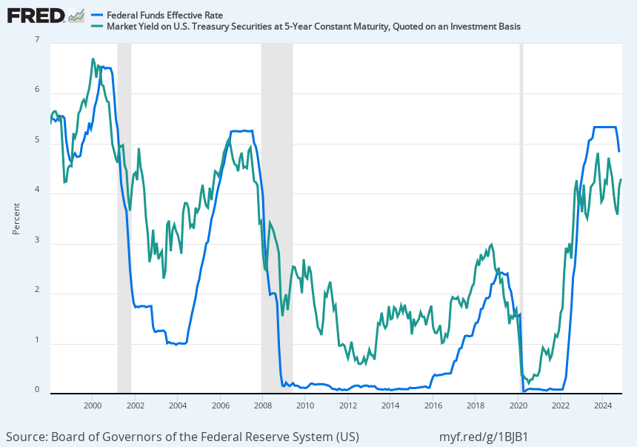
Nominal Interest Rate chosen by the US Fed
Fed controls short-run interest rate. Longer-run interest rate (on 5-year Treasury bonds in green) responds to expectations about future short-run rate

Slide 73
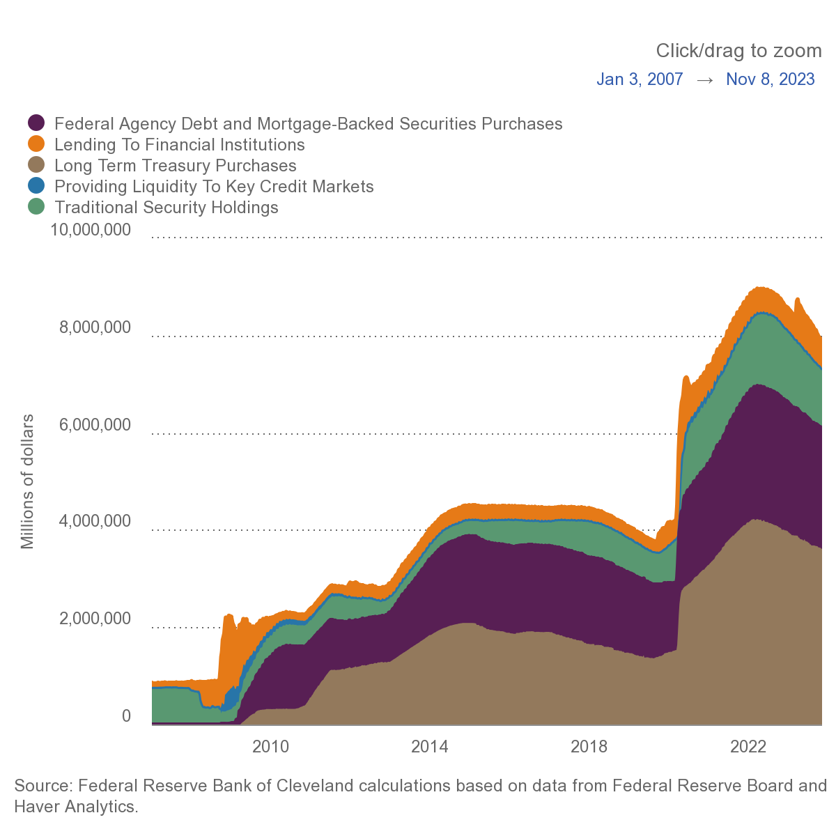
Fed balance sheet: Quantitative Easing since 2008
Lending to financial institutions to avoid collapse of financial system in 2008-9
$4 trillion extra money
created during COVID which absorbed majority of the extra Fed spending of 20 GDP points
Source: Cleveland Fed By buying other assets, the Fed can help struggling bank, stabilize financial markets and influence longer term interest rates.
Notes:
Unconventional – QE.
Don’t want to go into gory detail about the various things the Fed bought.
MBS.
CP.

Slide 74
Unconventional Monetary Policy, March 2020
Quantitative easing: “the [Federal Reserve] will increase its holdings of Treasury securities by at least $500 billion and its holdings of agency mortgage-backed securities by at least $200 billion.”
Forward guidance: “The [Federal Reserve] expects to maintain [low interest rates] until it is confident that the economy has weathered recent events and is on track to achieve its maximum employment and price stability goals.”
Notes:
They also took some unconventional monetary policy actions.
Quantitative easing to lower longer-term interest rates, particularly mortgage rates.
Forward guidance to convince people that interest rates will stay low for a long time. This can also help lower longer-term interest rates.
Most economists think that monetary policy has definitely helped stabilize the economy and the financial system.
Prevented the recession from getting even worse than it already was.

Slide 75
Interest Rates on Bonds of Different Maturities
Interest on long-term maturity bond of 2 or 5 years reflects expected average interest on short-term bonds (set by Fed) over the next 2 or 5 years

Slide 76
Monetary vs. Fiscal Policy
Government can use both monetary and fiscal policy to smooth business cycle
Monetary policy is simpler to deploy than active fiscal policy
  Fed chair (or central banker) decides on interest rate policy regularly
  Active fiscal policy requires enacting new legislation (act of congress and president signature in the US)
Monetary policy not as powerful to stimulate due to Zero Lower Bound in recent decades. Fiscal policy prominent in Great Recession and COVID.
Notes:
They also took some unconventional monetary policy actions.
Quantitative easing to lower longer-term interest rates, particularly mortgage rates.
Forward guidance to convince people that interest rates will stay low for a long time. This can also help lower longer-term interest rates.
Most economists think that monetary policy has definitely helped stabilize the economy and the financial system.
Prevented the recession from getting even worse than it already was.

Slide 77
References
CORE-The Economy, Chapter 15.
Principles of Economics, Chapters 26.

