Slide 1
Lecture 8
Monopoly and Market Power
Economics 2 Emmanuel Saez
Fall 2024

Slide 2
Introduction to Market Failures

Slide 3
Overview
So far we have been talking about well-functioning markets (rationality, competition, no external effects).
    In this case, the market outcome maximizes the total surplus (=efficiency)
Now we are going to think about market failures (when markets don’t function well).
    Will show that market outcomes in these cases do not maximize the total surplus.
    Government intervention can make things better (reduce the deadweight loss).

Slide 4
Markets function well under key assumptions
Economic agents are rational: firms maximize profits, people maximize their own utility
Perfect competition: firms and consumers are price takers
No externalities: economic activity does not create external harm

Slide 5
Markets function well under key assumptions
Economic agents are rational: firms maximize profits, people maximize utility
Perfect competition: firms and consumers are price takers
Monopoly: perfect competition assumption fails
No externalities: economic activity does not create external harm

Slide 6
Monopoly
There is only one producer of a good
Most goods are specific to a brand/company where monopoly reasoning applies:
  Only Apple makes and sells I-phones or Macbooks
  Monopoly power stronger when there are no close substitutes
The monopoly chooses the price to maximize profits and taking into account that demand falls with the price

Slide 7
Natural monopoly
A natural monopoly is a situation in which one single producer can supply the whole market at a lower average cost than multiple firms
Marginal cost pretty low so efficient to price low; fixed costs high so efficient pricing cannot recoup fix costs. Examples:
  utility companies like PG&E (gas and electricity)
  Railways
  Software, digital books/news/music (zero marginal cost)
Facebook, rideshare (UBER/Lyft) also natural monopolies as value increases with larger customer base.

Slide 8
Barriers to Entry
A barrier to entry is any force that prevents firms from entering a market.
Main types of barriers to entry:
High fixed costs (railway construction)
Patents and other legal protections (medical drugs)
Anti-competitive practices (sink/buy competitors)

Slide 9
II. Profit Maximization for a Monopolist

Slide 10
Monopoly Profit Maximization
Monopoly is the only producer of the good (e.g. Apple I-Phone)
Monopoly faces a demand curve D(P) that decreases with P (from consumers’ choices)
Monopoly has a curve of marginal cost of production MC
Monopoly chooses the price P that maximizes its profits: Profits = P × Q - C(Q) with Q=D(P)

Slide 11
Profit Maximization for a Monopolist
P
MC
Consumer
Surplus
P*
Profits
D
Q*
Q
P*,Q* is the competitive efficient equilibrium but
monopolist can choose any point along demand curve

Slide 12
Profit Maximization for a Monopolist
P
MC
Consumer
Surplus
P₁
Profits
P*
D
Q₁
Q
Increasing P above P* increases monopoly’s profit

Slide 13
Profit Maximization for a Monopolist
P
MC
Consumer
Surplus
P₁
Profits
P*
D
Q₁
Q
Increasing P above P* increases monopoly’s profit
until red area is maximized

Slide 14
Profit Maximization for a Monopolist
P
Consumer
Surplus
MC
P₁
Profits
P*
D
Q₁
Q
Increasing P above P* increases monopoly’s profit
until red area is maximized

Slide 15
Profit Maximization for a Monopolist
P
Deadweight loss
MC
Consumer
Surplus
P₁
•
Profits
P*
D
Q₁
Q
Monopoly squeezes consumer surplus (inequitable) and
creates deadweight loss (inefficient)

Slide 16
Quiz:
  Question: Why is monopoly bad relative to perfect competition?
  A. Because it reduces quantity produced
  B. Because it creates deadweight loss
  C. Because it increases profits at the expense of consumers
  D. Because of all A, B, C.

Slide 17
Monopolist with elastic demand
P
Deadweight loss
MC
Consumer
Surplus
P₁
•
Profits
D
Q₁
Q
Monopoly distortion is small when demand is very elastic
When demand is perfectly elastic, we are back to competitive model

Slide 18
With infinitely elastic demand:
Monopoly is equivalent to perfect competition
P
No Deadweight loss
MC
No Consumer
Surplus
P₁
•
Profits
D
Q₁
Q
Monopoly distortion is small when demand is very elastic
When demand is perfectly elastic, we are back to competitive model

Slide 19
Implications of Monopoly
A monopoly doesn’t take the price as given.
  However, monopoly is constrained by demand curve.
A monopoly produces below where MC = P.
  This reduces consumer surplus and increases profits (inequitable)
  This also creates deadweight loss (inefficient)
If demand is inelastic, monopoly distortion is large
  Monopoly with close substitutes (where demand is very elastic) is not as bad (e.g. Android vs. I-phone)

Slide 20
Mathematics of Monopoly
Monopolist chooses P to maximize: Profits = P × D(P)-C(D(P))
Profits are maximized when derivative of profits with respect to P is zero:
D(P)+P × D’(P)-C’(D(P)) × D’(P)=0
D(P)+(P-MC) × D’(P)=0 with MC=C’(D(P))
1=-D’(P)/D(P) × (P-MC) > 0 => P>MC
1= -ε_{D} × (P-MC)/P => P>MC

Slide 21
Example of Monopoly Maximization
D(P)=a – b × P [and D(P)=0 if P>=a/b]
C(Q)=d × Q => MC=d
Profits = P × D(P)-C(D(P))=P ×(a-b × P)-d ×(a-b × P) =-d × a+(a +d × b) × P-b × P²
Profits maximized when dProfits/dP=0 =>
a +d × b -2b × P=0
P = (a +d × b)/(2b) =a/(2b)+d/2
Note that P<a/b implies that P<d=MC

Slide 22
Long-Run Profit Maximization
for a Monopolist

Slide 23
Profit Maximization for a Monopolist
P
Deadweight loss
MC
Consumer
Surplus
P₁
•
Profits
D
Q₁
Q
Red area represents profits before the fixed costs of production
are paid. Final profits = red area - fixed cost of production

Slide 24
How Does a Monopolist Respond to Profits?
Graphical analysis ignored fixed costs. Fixed costs need to be deducted from red profit area in figure (but don’t change price choice analysis)
If fixed costs higher than profits red area: monopolist makes negative profits and the monopolist will want to leave the industry.
If fixed costs smaller than red area profits, the monopolist makes positive economic profits in the long run, and positive profits are sustainable [as no competitors can enter by definition]

Slide 25
Barriers to entry
The monopolist can make positive profit, but unlike the perfectly competitive case with identical firms it can sustain them in the long run
This is because of the barriers to entry
In the competitive industry, profits attracts new entrants
  This expands industry supply and so drives down the price and the profit of producers

Slide 26
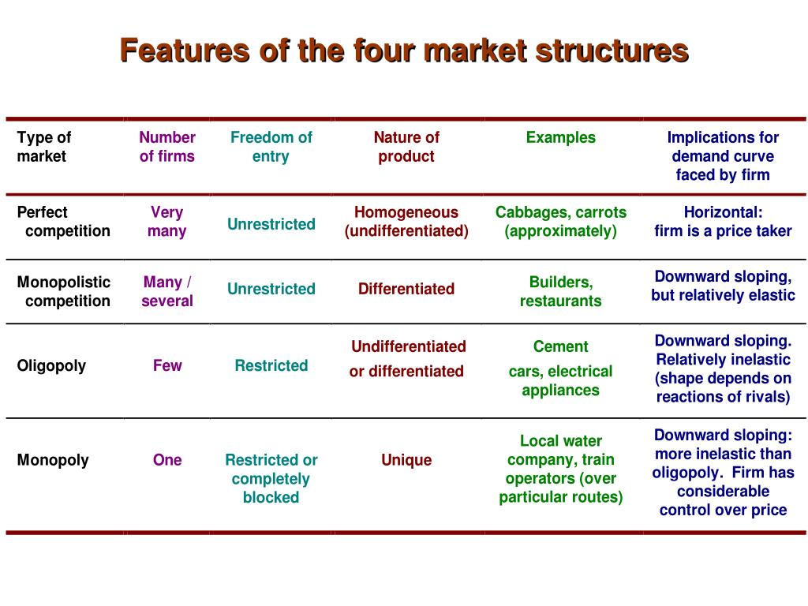

Slide 27
Quiz:
  Question: Look at the shoes you are wearing. Were they produced and sold in:
  A. Perfect competition
  B. Monopolistic competition
  C. Oligopoly
  D. Monopoly

Slide 28
Effect of Advertisement for a Monopolist
P
P₂
•
MC
Consumer
Surplus
P₁
•
Profits
D₂
D
Q₁
Q₂
Q
Advertisement to drive up demand only makes sense with monopolistic competition (not perfect competition)

Slide 29
Quiz:
  Question: Suppose Apple ads for the new I-Phone 16 shift up the demand curve. This increases Apple profits but also the consumer surplus people get from the new I-phone 16. Is this good for consumers?
  A. Yes, more people learn about how great the new I-phone 16 is
  B. Yes, people feel more special about getting it.
  C. Uncertain, it shifts demand from Samsung to Apple
  D. No, people get manipulated into buying
  E. A, B, C, or D could each be true for different people

Slide 30
Government Responses to Monopoly

Slide 31
Monopoly in the real world
With monopoly, consumers lose, producers gain but by less (deadweight loss)
But bigger producers can sometimes operate at lower costs which may mean win-win for producers and consumers if the cost savings are shared.
So how do we identify market power?
  Look at market shares of biggest firms in industry
What can and should we do about it?

Slide 32
Many US industries are heavily concentrated (data from 2017-8)

Slide 33
Policies to Deal with Monopoly
Antitrust laws – laws designed to promote competition and prevent monopolization:
  2024 judgement: Google has an illegal monopoly on search
  2024 lawsuit: VISA stifled competition in debit cards
Regulations that range from pricing regulations (US local utilities for water, electricity, gas) all the way to nationalization (government owns and controls monopoly: US postal service)
Limits on patents and other legal protections.

Slide 34
Trade-off innovation vs. competition
Innovating and inventing new products is costly. High fixed costs of invention and low marginal costs of production (e.g. drug industry)
Innovation costs are recouped by future profits when invention is successful
Future profits are eroded by competition if new product can be replicated/reverse engineered by competitors
Most countries protect innovations by granting time limited monopoly power through intellectual property: patents for inventions, copyrights for authors, trademarks for brands

Slide 35
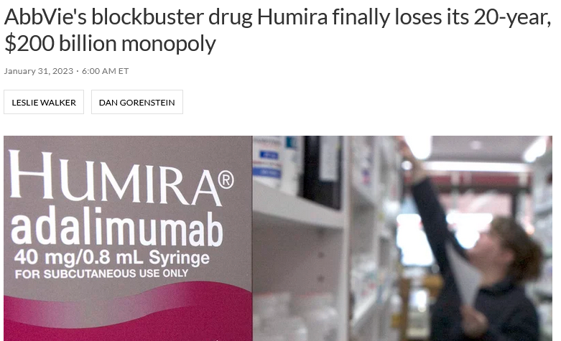
Drug Humira provides treatment against pain from arthritis.
Pfizer Covid vaccine surpassed Humira in 2022 for profits.

Slide 36
Patents and Innovation
Considerable amount of innovation happens outside patent system (secret innovations in firms, publicly funded research)
Difficult to evaluate empirically if more generous patent protections fosters innovation
Easier to find examples where firms strategically use patent protections (e.g., patent more when protections become more generous)
Some evidence that patents hinder follow-on innovation (Williams 2003)
In the long-run, growth driven by innovations that are in the public domain for anybody to use

Slide 37
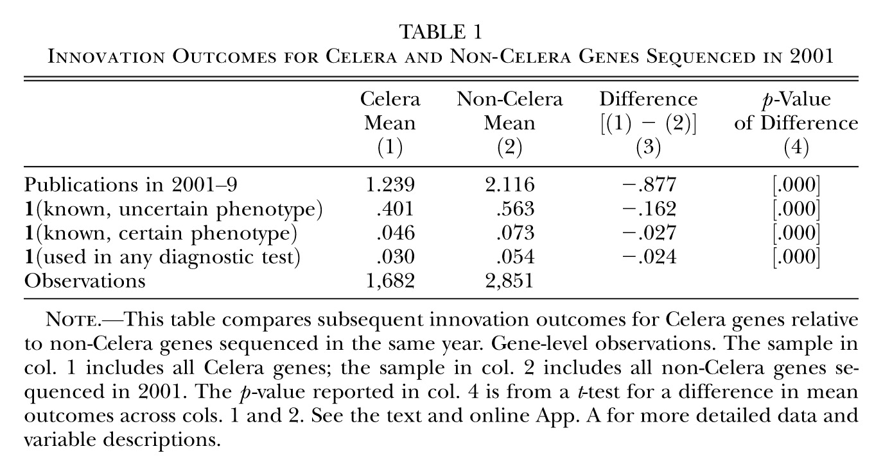
Sequencing of Human Genome: Private vs. Public
Genes sequenced by Celera with Intellectual Property led to reductions in later scientific research and product development by 20–30 percent relative to Genes sequenced in the public domain.
Source is Williams 2003

Slide 38
Historical Context
Industrial revolution of 1800s: many industries (railroads, shipping, oil, etc.) consolidated into monopolies
US Gilded Age (late 1800s): monopolized industry and wealth concentration (Robber Barons) squeezing customers, workers, buying competitors and politicians.
US developed antitrust laws in early 1900s: successful at dismantling monopolies of the Gilded Age. Utilities (water, electricity, gas, telecom, airlines) were regulated
Since late 1970s, wave of deregulation (e.g., telecom and airlines). Resurgence of monopoly power in new utilities such as cable/broadband and new tech sectors.

Slide 39
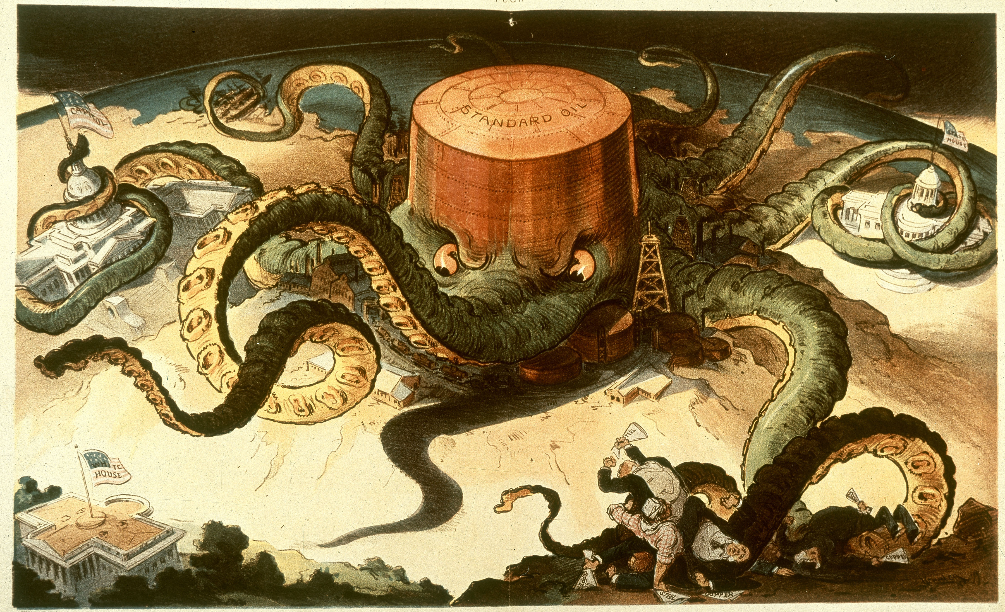
Robber Barons illustration: Standard Oil became the US monopoly of oil industry making owner John D. Rockefeller immensely wealthy. Was broken in 1911 into many companies through antitrust.

Slide 40
New Gilded Age
Today: large tech companies have redeveloped monopoly power (GAFAM: Google, Amazon, Facebook, Apple, Microsoft)
Apple brand gives it market power, Microsoft has monopoly on operating system of PCs
Google, Facebook don’t charge users but make money by charging advertisers on platform. Network effect leads to monopoly power
Amazon doesn’t squeeze consumers (yet) but squeezes suppliers to increase consumer base.

Slide 41
Top .00001% = top 20 wealthiest Americans today
Source: Piketty, Saez, and Zucman (2022)

Slide 42
Current Debate on Antitrust Policy
Consumer welfare standard has come to dominate US antitrust thinking since late 1970s (law&economics)
As long as price is low and consumer is not harmed, no concern for industry concentration per-se
Has allowed new monopolies to rise: Walmart, Amazon, Google, Facebook, etc.
New monopolies develop market share by pricing low and staying dominant by acquiring potential competitors (e.g. Facebook bought Instagram and WhatsApp)
European Union and US under Biden (Lina Kahn at FTC) have become tougher in antitrust in recent years

Slide 43
Quiz:
  Question: What is your view about GAFAM: Google, Amazon, Facebook, Apple, Microsoft:
  A. They provide great new products at low cost
  B. It’s great for the US to have such dominant companies
  C. I am concerned that they are too dominant in their industry and stifle innovation
  D. I am concerned that they have too much power to influence society
  E. All of A, B, C, D

Slide 44
Monopoly Sum-up
Businesses make more profits if they have monopoly power and hence have strong incentives to become monopolists.
Historically, even industries with standard products (e.g. oil with Standard oil) become monopolized. Perfect competition is rare.
Requires constant vigilance from governments to regulate monopoly power.
Analogous to how a democracies can devolve into tyrannies when rulers concentrate power

Slide 45
References
CORE-The Economy, Unit 7.
Principles of Economics, Chapter 8.

