Slide 1
Lecture 3
Supply and Demand
Economics 2 Emmanuel Saez
Fall 2024

Slide 2
I. Introduction to Markets, Supply, and Demand

Slide 3
Market
An arrangement by which economic exchanges between people/firms take place
  Specialization in production requires us to exchange
Market exchange voluntarily entered into for mutual benefit (unlike taxation from government)
Exchange is often impersonal (unlike transfers/exchanges among friends, family)
Market is a relatively novel form of exchange in human history (last 5000 years)
  anthropology: reciprocated gifts more ancient, less calculating form of exchange-like friends/families today

Slide 4
Demand
The buying side of the market (generally consumers)
There is a negative relationship between the quantity demanded of a good and its price.
The relationship reflects optimizing behavior on the part of buyers: if price of the good is high, I can’t buy as much or I’ll buy something else.
At price P, buyers want to buy quantity Q=D(P) of the good.
Key assumption: buyers are price takers

Slide 5
Demand Curve for oil (worldwide)
Price
(P)
D
0
0
Quantity (Q)

Slide 6
Demand Curve for oil (worldwide)
Price
(P)
Rich consumers, high value users only
+ Poor consumers, lower value users
D
Quantity (Q)

Slide 7
Supply
The selling side of the market (generally producers)
There is a positive relationship between the quantity supplied of a good and its price.
This relationship reflects optimizing behavior on the part of producing firms.
A price P, producers are willing to supply quantity Q=S(P) of the good.
Key assumption: producers are price takers

Slide 8
Supply Curve of oil worldwide
P
S
Q

Slide 9
Supply Curve of oil worldwide
P
S
High cost producers
(US fracking)
Low cost producers
(Saudi Arabia)
Q

Slide 10
Quiz 1:
  Question: Why is demand for oil sloping down?
  A. There are trade offs
  B. Oil is cheaper to produce in Saudi Arabia than North America
  C. Some consumers are willing to pay more for oil than others
  D. I don’t know

Slide 11
Quiz 2:
  Question: Why is supply for oil sloping up?
  A. There are trade offs
  B. Oil is cheaper to produce in Saudi Arabia than North America
  C. Some consumers are willing to pay more for oil than others
  D. I don’t know

Slide 12
II. Market Equilibrium
Key assumption 1: consumers are price takers (makes sense if many small consumers)
Key assumption 2: producers are price takers (makes sense if many small producers who don’t collude)
This is called the competitive model

Slide 13
Equilibrium in the Market for oil
P
Q

Slide 14
Equilibrium in the Market for oil
P
S₁
D₁
Q

Slide 15
Equilibrium in the Market for Oil
P
S₁
P₁
•
Equilibrium
D₁
Q₁
Q

Slide 16
What happens if the price is below P₁?
P
S₁
P₁
D₁
Q₁
Q

Slide 17
What happens if the price is below P₁?
P
S₁
P_{too low}
D₁
Q

Slide 18
What happens if the price is below P₁?
P
S₁
P_{too low}
D₁
Q_{S}
Q_{D}
Q

Slide 19
What happens if the price is below P₁?
P
S₁
P_{too low}
D₁
Q_{S}
Q_{D}
Q
Excess Demand (Shortage)

Slide 20
What happens if the price is below P₁?
P
S₁
P₁
•
P_{too low}
D₁
Q_{S}
Q₁
Q_{D}
Q
Excess Demand (Shortage)

Slide 21
What happens if the price is above P₁?
P
S₁
P₁
D₁
Q₁
Q

Slide 22
What happens if the price is above P₁?
P
S₁
P_{too high}
D₁
Q

Slide 23
What happens if the price is above P₁?
P
S₁
P_{too high}
D₁
Q_{D}
Q_{S}
Q

Slide 24
What happens if the price is above P₁?
P
S₁
P_{too high}
D₁
Q_{D}
Q_{S}
Q
Excess Supply (Surplus)

Slide 25
What happens if the price is above P₁?
P
S₁
P_{too high}
P₁
•
D₁
Q_{D}
Q₁
Q_{S}
Q
Excess Supply (Surplus)

Slide 26
Equilibrium in the Market for Oil
P
S₁
P₁
•
Equilibrium
D₁
Q₁
Q

Slide 27
How Do Markets Deal with Scarcity and the Gains from Specialization?
The existence of markets allows people to specialize along the lines of comparative advantage because they can trade for other goods that they want.
Markets deal with scarcity by balancing the optimizing behavior of consumers and producers. Prices adjust to equilibrate the two sides of the market.
The consumers who actually get the good are those who are willing and able to pay the equilibrium price.
The firms that actually produce the good are those that find it profit-maximizing to produce at the equilibrium price.

Slide 28
III. Shifts in the Curves
We have looked at the equilibrium where given demand and supply curves intersect
We now analyze how the equilibrium changes when supply or demand curves shift

Slide 29
Ceteris Paribus
“other things being equal”
We have been looking at the relationship between the quantity demanded and price and between the quantity supplied and price, assuming that the only thing that varies is the price.

Slide 30
Oil market: Supply goes up
A new technology (fracking)
P
S₁
P₁
D₁
Q₁
Q

Slide 31
Oil market: Supply goes up
A new technology (fracking)
P
S₁
S₂
P₁
D₁
Q₁
Q

Slide 32
Oil market: Supply goes up
A new technology (fracking)
P
S₁
S₂
P₁
P₂
D₁
Q₁
Q
Q₂
When supply goes up, quantity increases and the price decreases

Slide 33
Oil market: Supply goes down
The US bans fracking
P
S₂
S₁
P₂
P₁
D₁
Q₂
Q₁
Q
When supply goes down, quantity decreases and the price increases

Slide 34
What can shift supply curves?
Outward supply shifts (supply increases, goes up):
  Innovation that increases productivity
  Prices of inputs needed for production going down
  More producers enter the industry
Inward supply shifts (supply decreases, goes down):
  Regulation decreases productivity
  Prices of inputs needed for production going up
  Producers exit the industry

Slide 35
Oil market: Demand goes down
Electric cars appear
P
S₁
P₁
D₁
Q₁
Q

Slide 36
Oil market: Demand goes down
Electric cars appear
P
S₁
P₁
D₂
D₁
Q₁
Q

Slide 37
Oil market: Demand goes down
Electric cars appear
P
S₁
P₁
P₂
D₂
D₁
Q₂
Q₁
Q
When demand goes down, quantity decreases and the price decreases

Slide 38
Oil market: Demand goes up
US bans electric cars
P
S₁
P₂
P₁
D₂
D₁
Q₁
Q₂
Q
When demand goes up, quantity increases and the price increases

Slide 39
What can shift demand curves?
Outward demand shifts (demand increases, goes up)
  New complementary good is released
  The price of a substitute good goes up
  People got richer
  The product becomes fashionable
Inward demand shifts (demand decreases, goes down)
  The price of a complementary good goes up
  The price of a substitute good goes down
  The product goes out of fashion or becomes obsolete

Slide 40
Quiz 3:
  Question: World market for oil. Europe removes its ban on fracking (lots of oil sits deep in European continent). What is the effect on P & Q of oil worldwide?
  A. P increases, Q increases
  B. P decreases, Q increases
  C. P increases, Q decreases
  D. P decreases, Q decreases
  E. P effect unknown, Q decreases

Slide 41

Anchor House Building Opens at UC Berkeley

Slide 42
Quiz 4:
  Question: Market for rental apartments in city of Berkeley. UC Berkeley opens the new Anchor House building that provides 244 new apartments for 772 UC students (at market prices). What is the effect on P & Q of rental apartments in Berkeley?
  A. P increases, Q increases
  B. P decreases, Q increases
  C. P increases, Q decreases
  D. P decreases, Q decreases
  E. P effect unknown, Q decreases

Slide 43
Quiz 5:
  Question: UC Berkeley increases the size of its undergraduate class from current 8000 to 10000. What is the effect on P & Q of rental apartments in the city of Berkeley?
  A. P increases, Q increases
  B. P decreases, Q increases
  C. P increases, Q decreases
  D. P decreases, Q decreases
  E. P effect unknown, Q decreases

Slide 44
Estimating Demand Curves Empirically
In real data, we observe only the intersection of supply and demand curve, not the curves
Demand curve is revealed in real data when there is a supply shift with stable demand curve.
Working (1925) is early example using potatoes in Minneapolis area: annual production varies with weather (supply shift) while demand curve is expected to be stable
Is this compelling estimation?

Slide 45
Supply shifts can reveal the demand curve
P
S₁
S₂
P₁
P₂
D₁
Q₁
Q
Q₂
When supply shifts, equilibrium moves along the demand curve

Slide 46
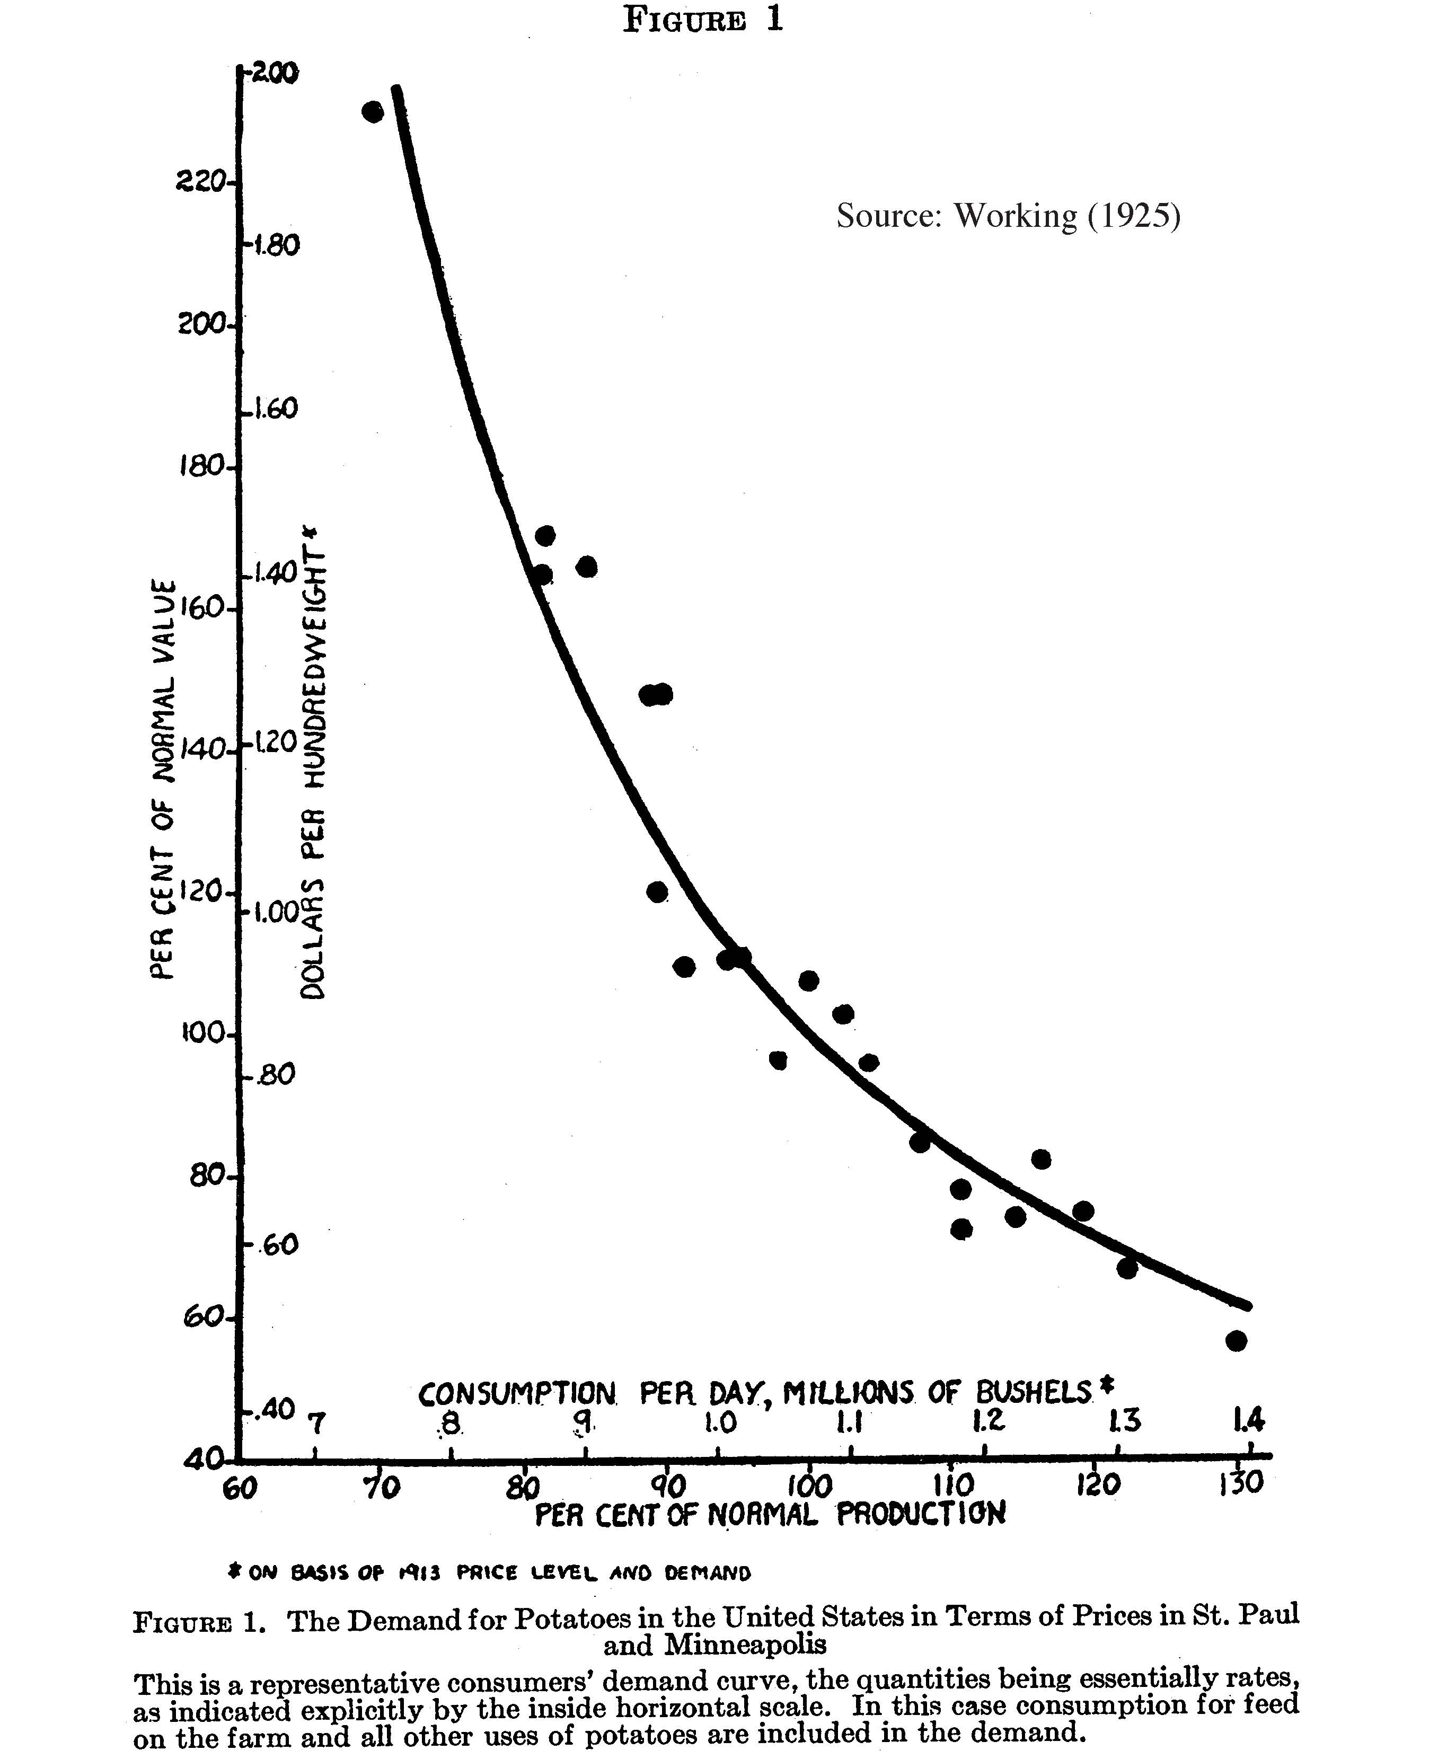

Slide 47
Estimating Demand Curves Empirically
Demand curve is revealed in real data when there is a supply shift with no change in demand curve
Working (1925) is early example using potatoes in Minneapolis area: annual production varies with weather (supply shift) while demand curve is expected to be stable
Is this compelling estimation? Yes, for 1925 but:
  Weather can affect other crops and their prices and that can affect demand for potatoes as well
  Ideal would be to have exogenous change in price of potatoes only and look at demand response

Slide 48
Randomized experiments to Estimate Demand
Randomized experiments: sample is randomized into treatment vs. control (like medical science experiment)
Widely used today in development economics (Banerjee, Duflo, Kremer 2019 nobel prize)
Studies offer important preventive health products at randomized prices to estimate demand [ultimate goal of studies is to study health impacts]

Slide 49
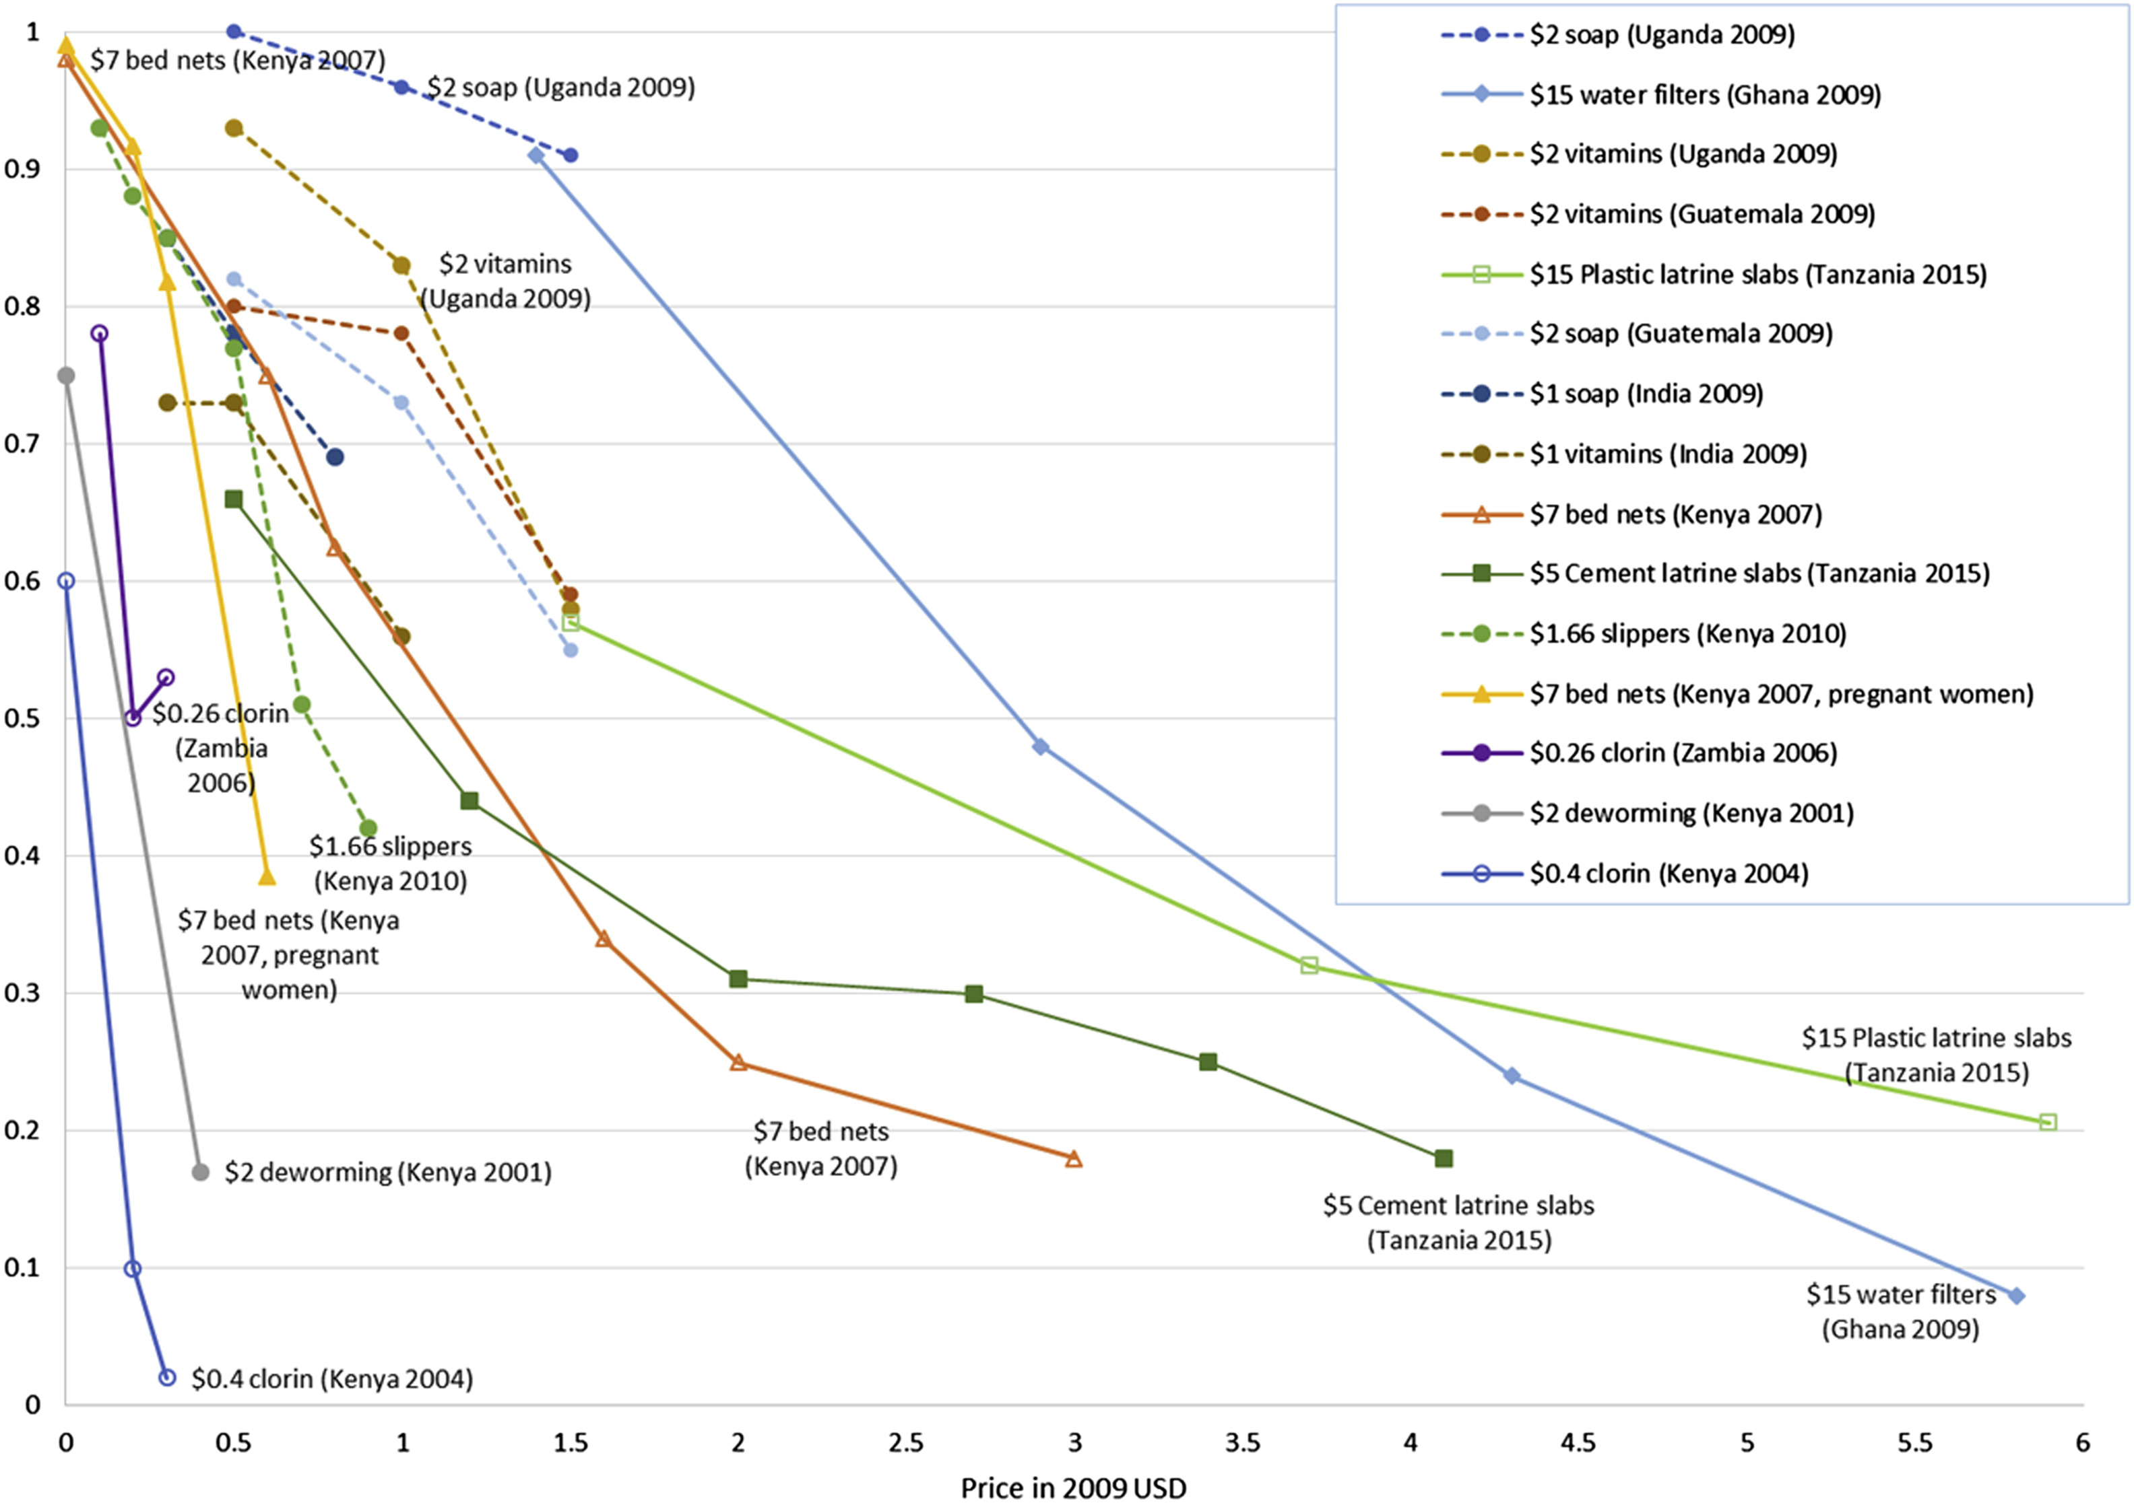
Figure 2. Purchase rate of preventive health products, by TIOLI price, Dupas and Miguel (2017)

Slide 50
Randomized experiments to Estimate Demand
Randomized experiments: sample is randomized into treatment vs. control (like medical experiment)
Widely used today in development economics (Banerjee, Duflo, Kremer 2019 nobel prize)
Studies offer important preventive health products at randomized prices to estimate demand
  Higher prices sharply reduce demand
  Demand small at market prices for many such goods in spite of substantial future health (and hence economic) benefits
  Makes sense for government to provide such goods (instead of market allocation) if consumers don’t value/buy products
  Libertarian vs. socialism debate

Slide 51
Meta Quiz:
  Question: What do you think of in-class quizzes?
  A. I like them, they help keep me focused
  B. I like them, it’s a way to communicate with the class
  C. I dislike them, they stress me out
  D. I dislike them, I find them boring

Slide 52
References
CORE-The Economy 2.0, micro, Unit 8.
Principles of Economics, Chapter 3.
Working, Holbrook. 1925 “The Statistical Determination of Demand Curves,” Quarterly Journal of Economics.
Dupas, Pascaline, and Edward Miguel. "Impacts and determinants of health levels in low-income countries." In Handbook of economic field experiments, vol. 2, pp. 3-93. North-Holland, 2017.

